Slide 1
An Adaptive Optimization Approach To Expansion Of The Forest and Bioenergy Sectors Utilizing Wood From The Boreal Forests Version 170816
Peter Lohmander Professor Dr.
Optimal Solutions www.Lohmander.com Peter@Lohmander.com
August 27-30, 2017, Clearwater Resort Suquamish, Washington, (near Seattle)

Slide 2
This presentation will show that:
There are very large options to increase sustainable continuous cover forestry in the Borel forests. This way, sustainable flows of bioenergy and all kinds of forest industry raw materials can be obtained and these sectors can be expanded. This is also good when we consider the global warming problem.
Continuous cover forestry is often the production economically optimal forestry method. Hence, the method is not just rational from environmental perspectives.)
The fundamental understanding of forest dynamics can be improved via new growth functions and estimations.
The complete system can be optimized with new adaptive methods.

Slide 3
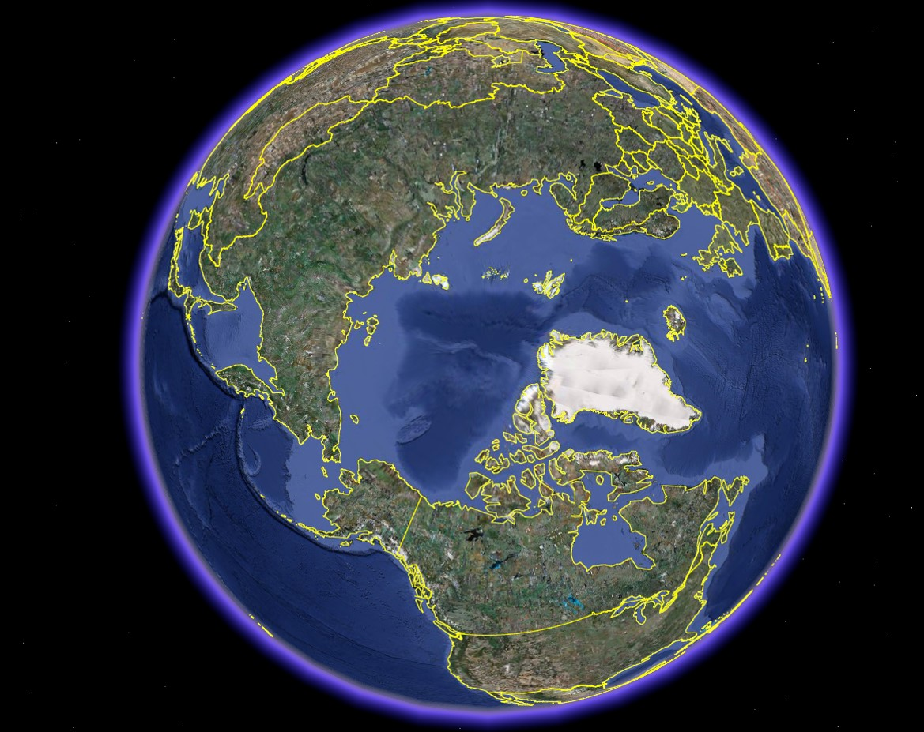
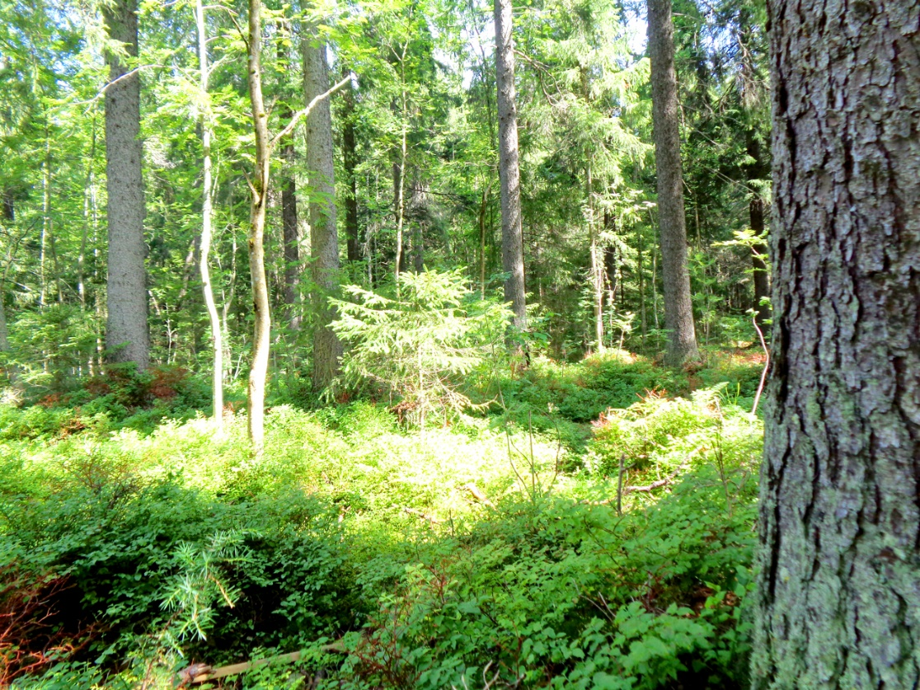
The boreal forest covers very large areas in Canada, USA, Russia and Scandinavia.

Slide 4
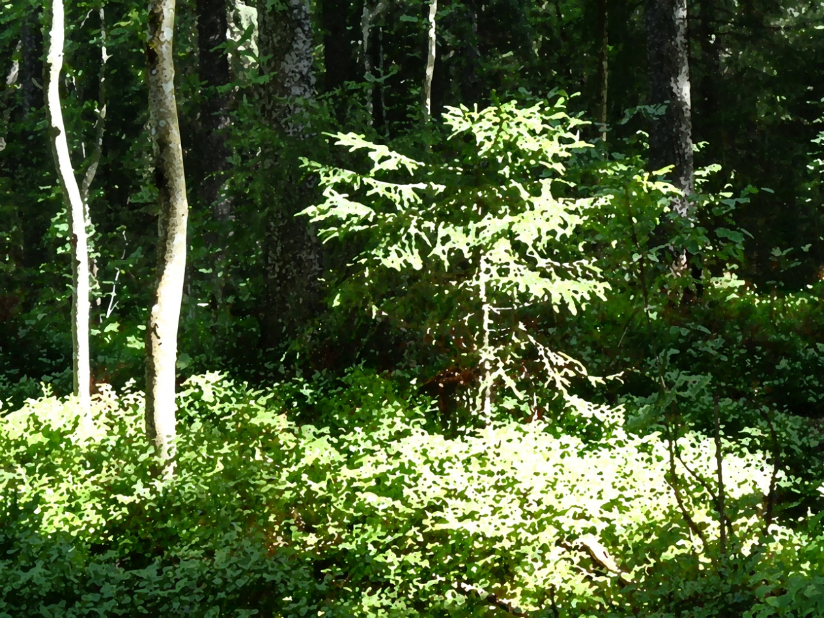
FAO, Global Forest Resources Assessment 2015
How are the world’s forests changing?
Second edition

Slide 5
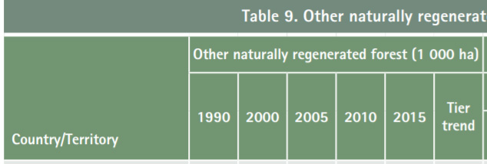
Parts of
Table 9.
522 Million ha
208 Million ha
125 Million ha
Source: FAO (2015) GLOBAL FOREST RESOURCES ASSESSMENT 2015,
Desk reference, http://www.fao.org/3/a-i4808e.pdf

Slide 6
Other Natually
Regenerated
Forests:
Russian Federation
522 Million ha
USA
208 Million ha
Canada
125 Million ha
Source: FAO (2015)

Slide 7
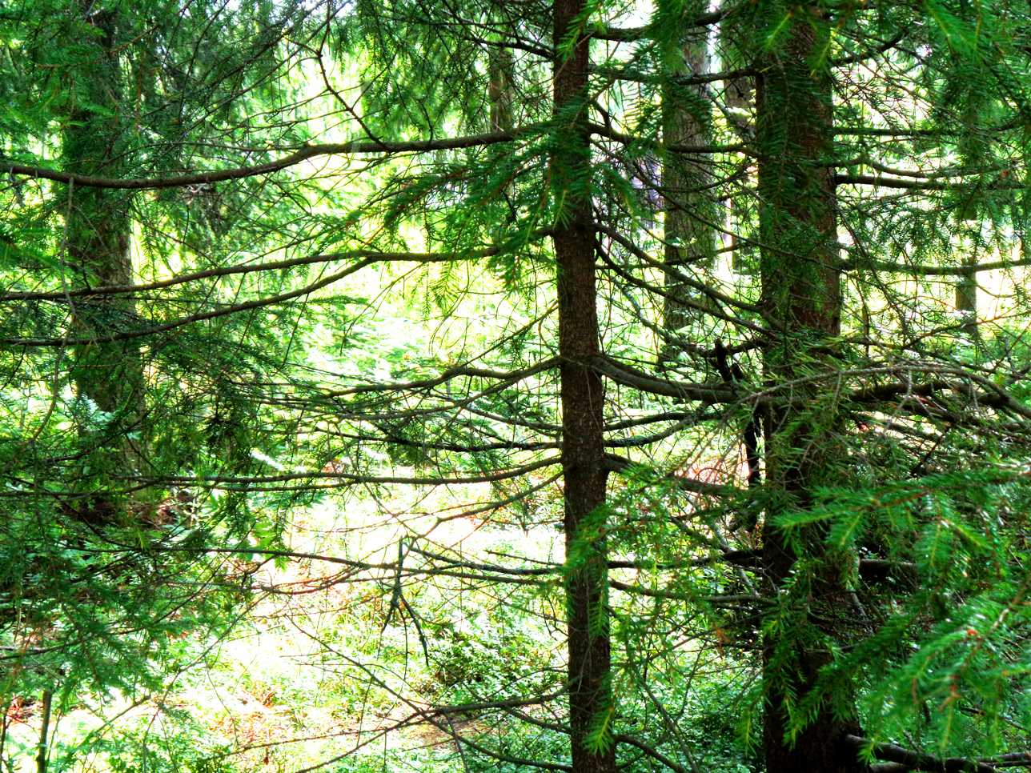
Large parts of these regions are presently covered by more or less natural forests, often dominated by different species of spruce, pine and larch.

Slide 8
In large parts of these forests, in particular in Canada and Russia, the industrial utilization presently is and historically has been close to zero.
Expanding infrastructure, technological development of harvesters and forwarders, increasing costs and environmental problems associated with fossil fuel extraction, a growing interest in sustainability and the debate on climate change, make it rational to investigate environmentally acceptable harvesting options in the remote and natural boreal forests.
This presentation suggests a way to develop the forest and bioenergy sectors, taking relevant objectives, facts and options into account.

Slide 9
Industrial expansion of forest utilization is often considered as very negative for the environment.
It is often assumed that the initially existing natural forests, with trees of many size classes, should be removed and replaced by uniform plantations.
However, it is often optimal, also from a production economic point of view, to start harvesting the natural forests using continuous cover methods.

Slide 10
CAN THIS BE PROVED?
You should never believe in results from a model with hidden parameters, a black box.
Here, you find a few simple but completely described examples.
In these examples, it is not economically optimal to make clear fellings.

Slide 11
First example:
Determination of the optimal initial harvest and the stock level after the initial harvest.
In this first example, set up costs are ignored. In the second example, they are considered.

Slide 12
We start with the stock level V0 (usually higher than the optimal stock level). After the initial harvest, h, we have the stock level V1 ( = V0-h). Our objective function is the total present value (*). * = The sum of all revenues minus costs, at all points in time, with consideration of the rate of interest in the capital market.

Slide 13
This is a growth function example:
G(V) = Growth (m3 per hectare and year)
V = Stock level (m3 per hectare)

Slide 14
Maximization of , the total present value :
V0 = Initial stock level (m3 per hectare).
p0 = Net price per cubic metre (price minus cost per m3) in the initial harvest.
p1 = Net price per cubic metre (price minus cost per m3) in future harvests.
h = Initial harvest (m3 per hectare).
V0-h = Stock level after the initial harvest (m3 per hectare).
G(V0-h) = Growth (m3/year) after the initial harvest.
(Note that the future harvest level is identical to the future growth.)
r = Rate of interest in the capital market.

Slide 16
First order optimum condition
Second order maximum condition

Slide 18
The optimal stock level after the initial harvest

Slide 19
EXAMPLE: Optimization with specific parameters and a graphical approach:
Initial stock level = 130 m3/ha.
p0 = p1 = 200 SEK/m3.
r = 3%.
Estimated growth function: G = 0.054011123·V - 0.000129731·V·V

Slide 20
Present value (SEK/ha)
h (m3/ha)

Slide 21
Present value (SEK/ha)
V1=V0-h (m3/ha)

Slide 22
G(V)
V

Slide 23
Growth function derivatives:

Slide 24
V

Slide 25
Determinaion of the optimal stock level:

Slide 26
V
92.3

Slide 27
Conclusion: The optimal stock level is 92.3 m3 per hectare if the rate of interst is 3% in this case. It is not optimal to make a clear felling and reduce the stock level to zero.

Slide 28
We can also determine an equation for the optimal stock level.

Slide 30
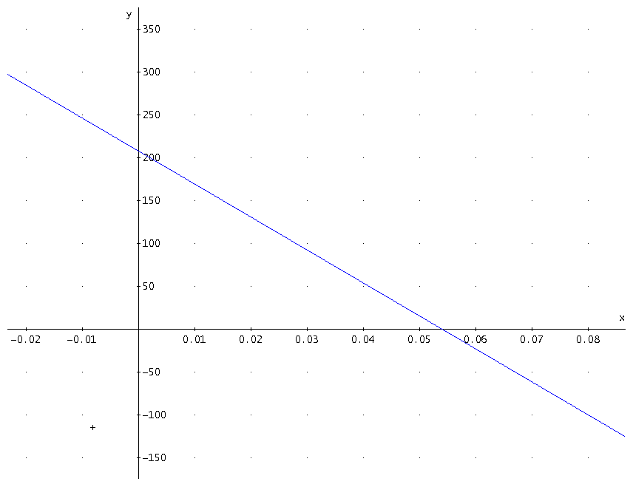
Here, we have an expression
for the optimal stock level
as a function of the rate of interest
and the net prices.

Slide 31
General principles of rational continuous cover forestry derived from the simple analytical method:
1. The optimal stock level is a decreasing function of the rate of interest.
2. The optimal stock level decreases if the net price per cubic metre in the initial harvest increases in relation to the net price per cubic metre in future harvests.
3. The optimal stock level increases if the net price per cubic metre in the initial harvest decreases in relation to the net price per cubic metre in future harvests.
4. It is optimal to let the stock level be equal to the stock level that maximizes the average growth (MSY) only if the rate of interest in the capital market is zero.

Slide 32
Second example:
Determination of the optimal harvest levels, the stock level after harvest and the harvest intervals.
In this second example, set up costs are considered

Slide 33
Present value
h = The first harvest volume
R(h) = Profit from the first harvest
P(.) = Price per cubic metre
(reduced by variable cost per
cubic metre)
in future harvests
Q(.) = Harvest volume per hectare
in future harvests
c = Set up cost per harvest
occation
r = Rate of interest
v = volume per hectare
v0
v1
0
time
0
t

Slide 34
In Finland, continuous cover forest management can be optimized without constraints.
In Sweden, there are several constraints in the forest act. For instance, the volume always has to stay above
a specified lower limit. If the volume is below the limit, you have to make a clearcut.
WITH Swedish constraints, forestry with clearcuts often is the economically optimal choice.
WITHOUT Swedish constraints, continuous cover forestry is very often the economically optimal choice.

Slide 36
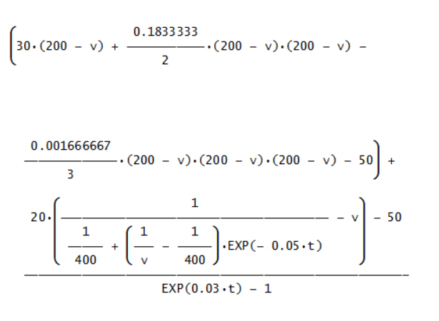
Example:
Graphical
illustrations
based on
specified
functions
and
parameters

Slide 37
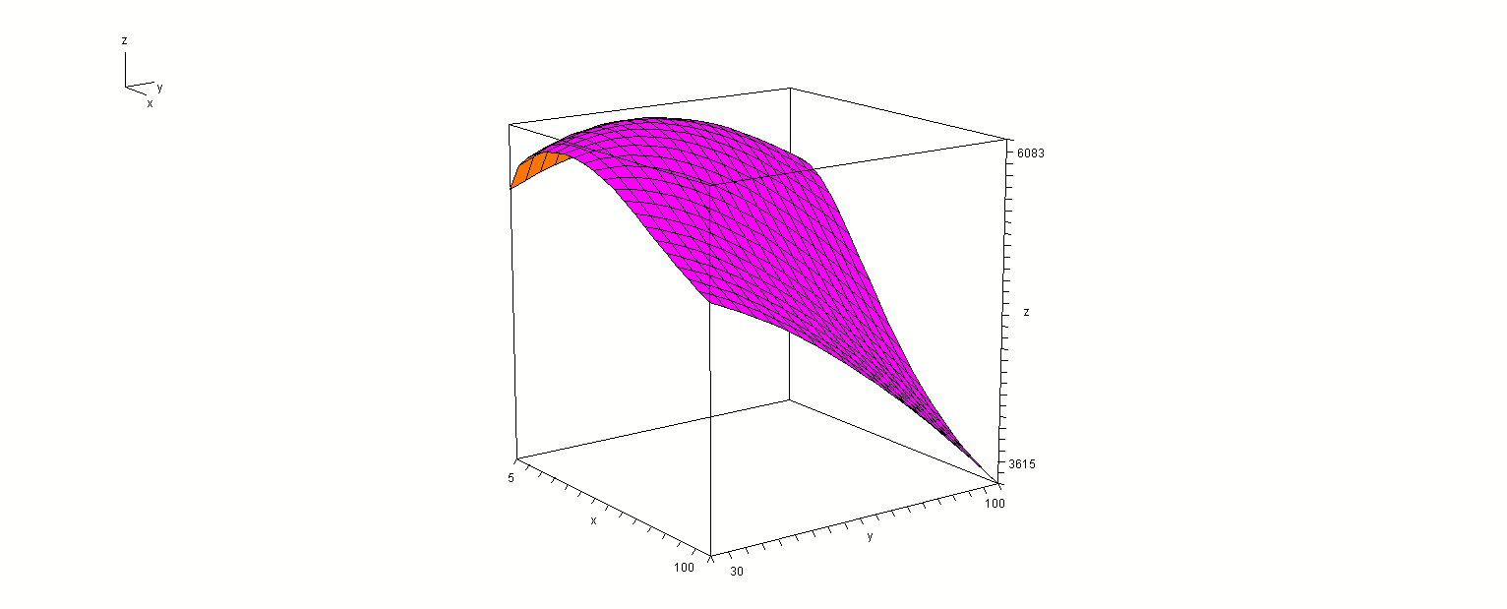
Present
value
t
v1

Slide 38
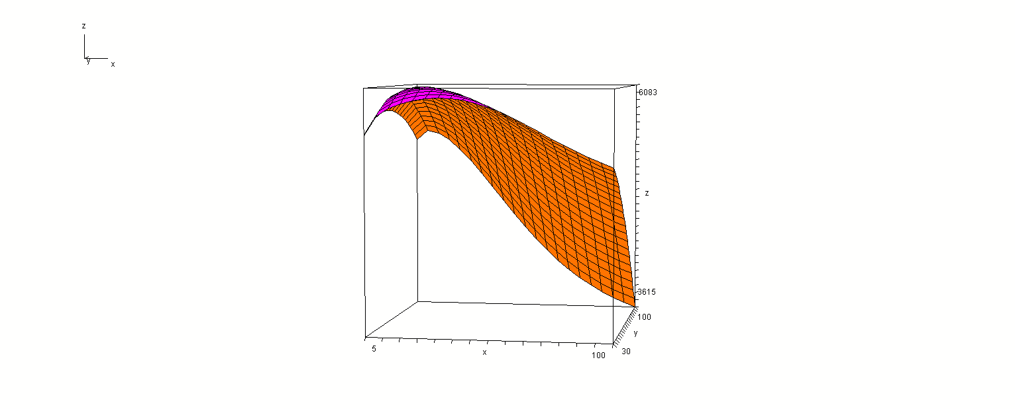
Present
value
v1
t

Slide 39
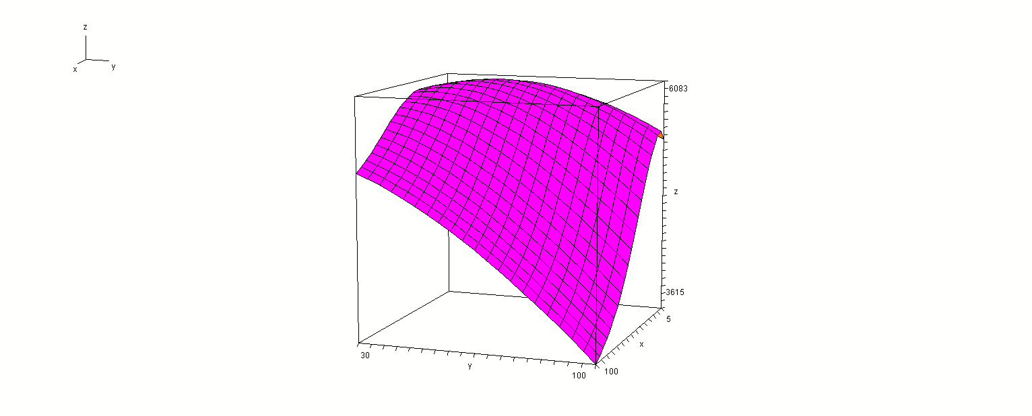
Present
value
t
v1

Slide 40
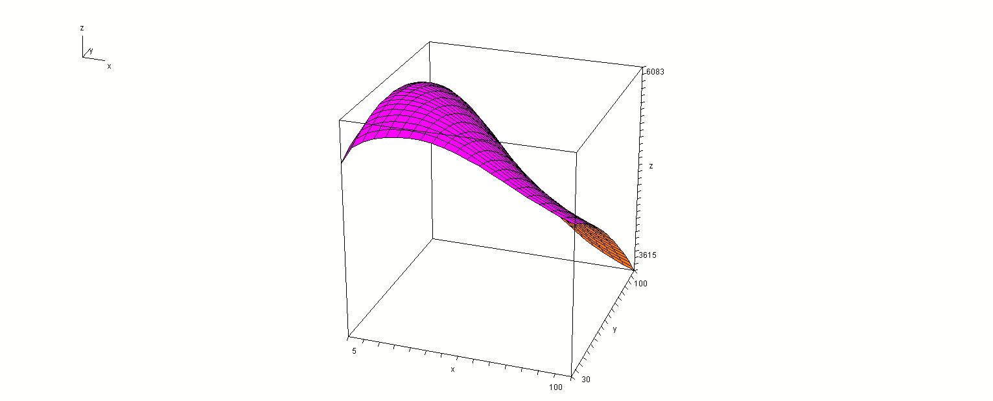
Present
value
v1
t

Slide 42
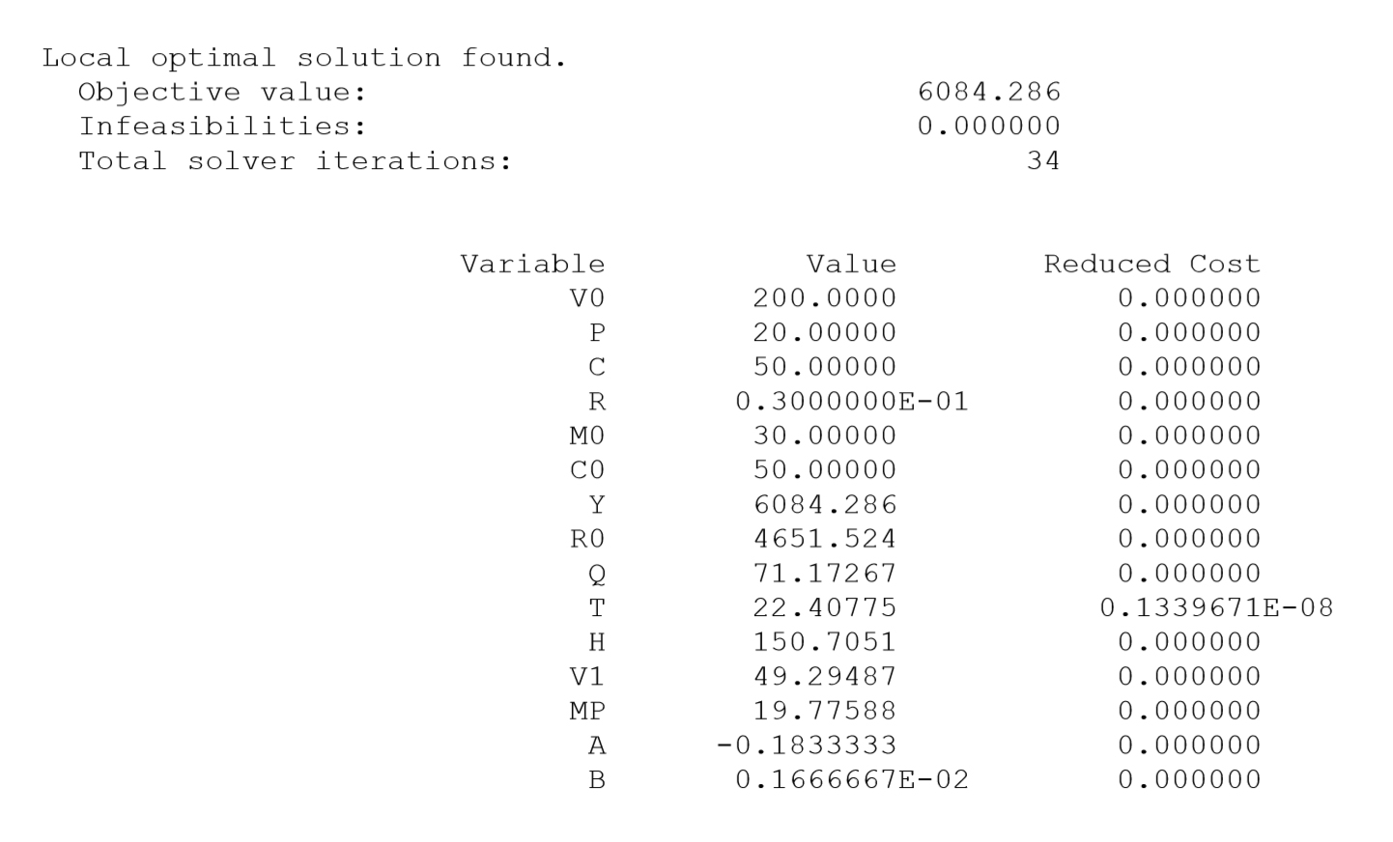
Maximum
present
value
Optimal
harvest
interval
The optimal value of V1 is far below the Swedish constraint.

Slide 43
Conclusions:
The two examples showed that it was not economically optimal to make clear fellings.
Considerable numbers of small trees should be left for continued production.

Slide 44
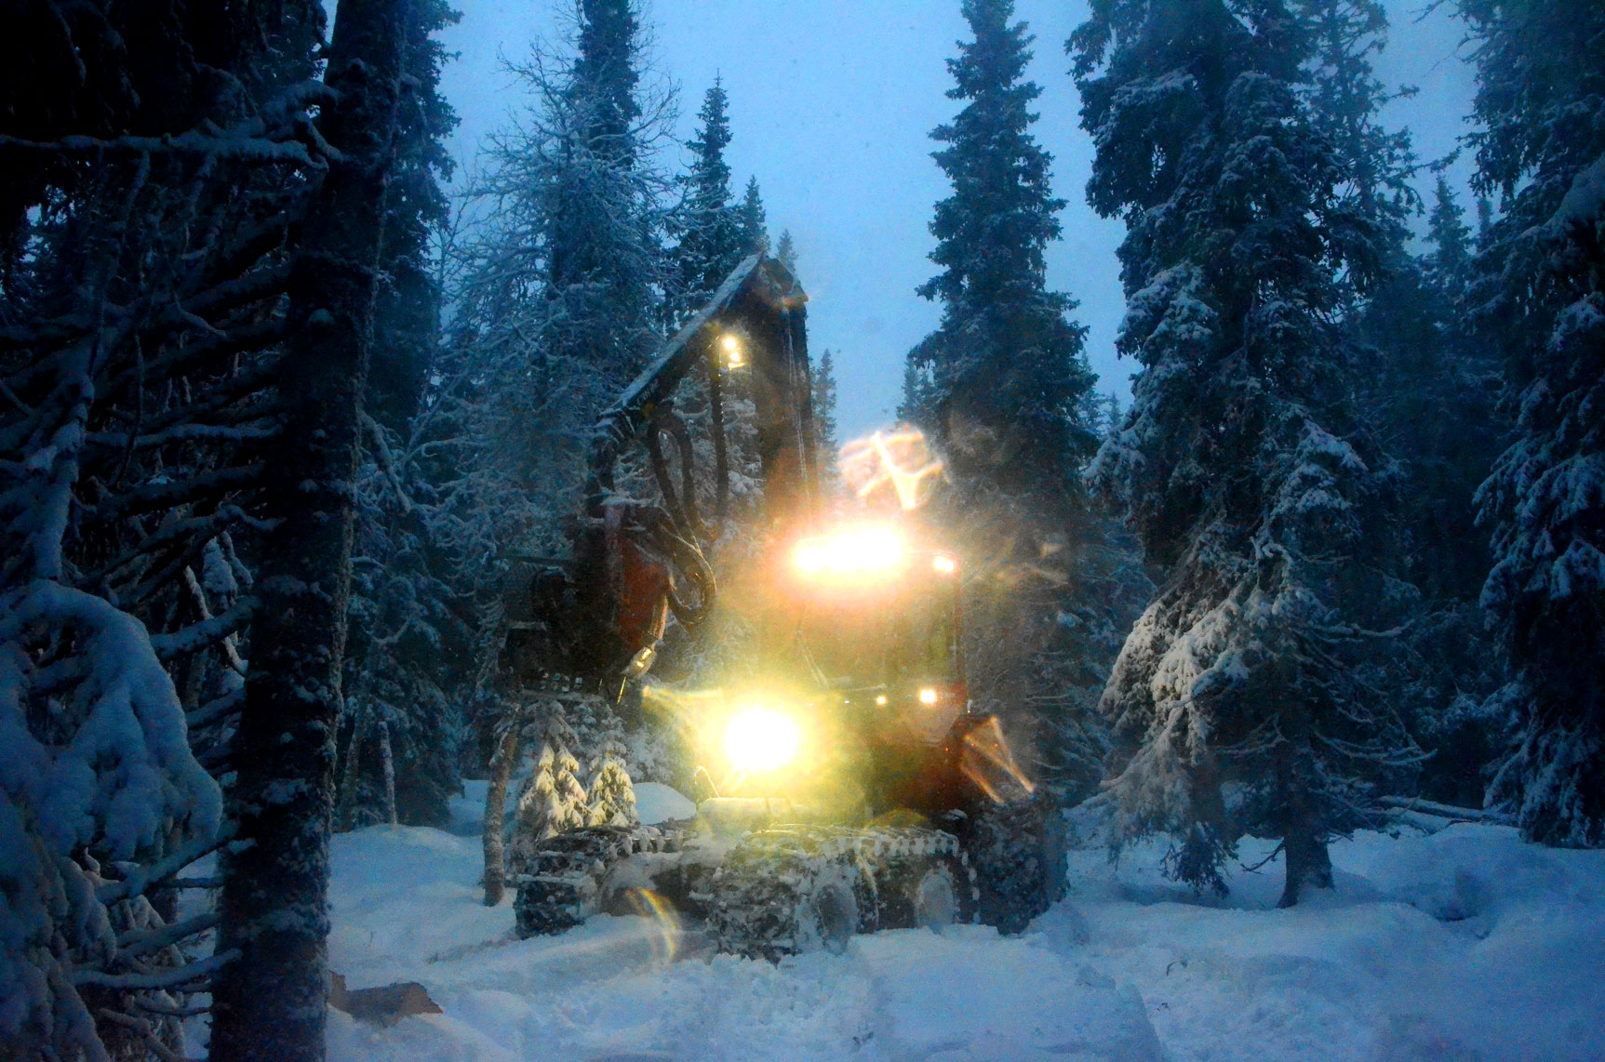
Continuous
cover
forest
harvesting
In the
Swedish
mountains
December
2014

Slide 45
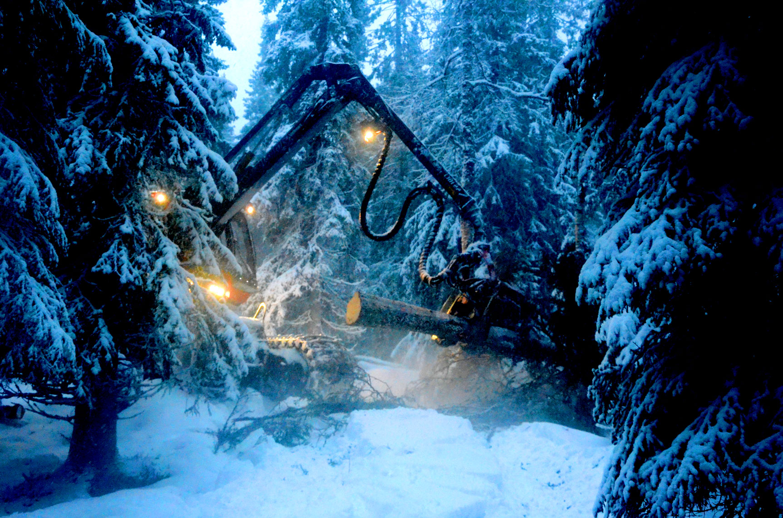

Slide 46
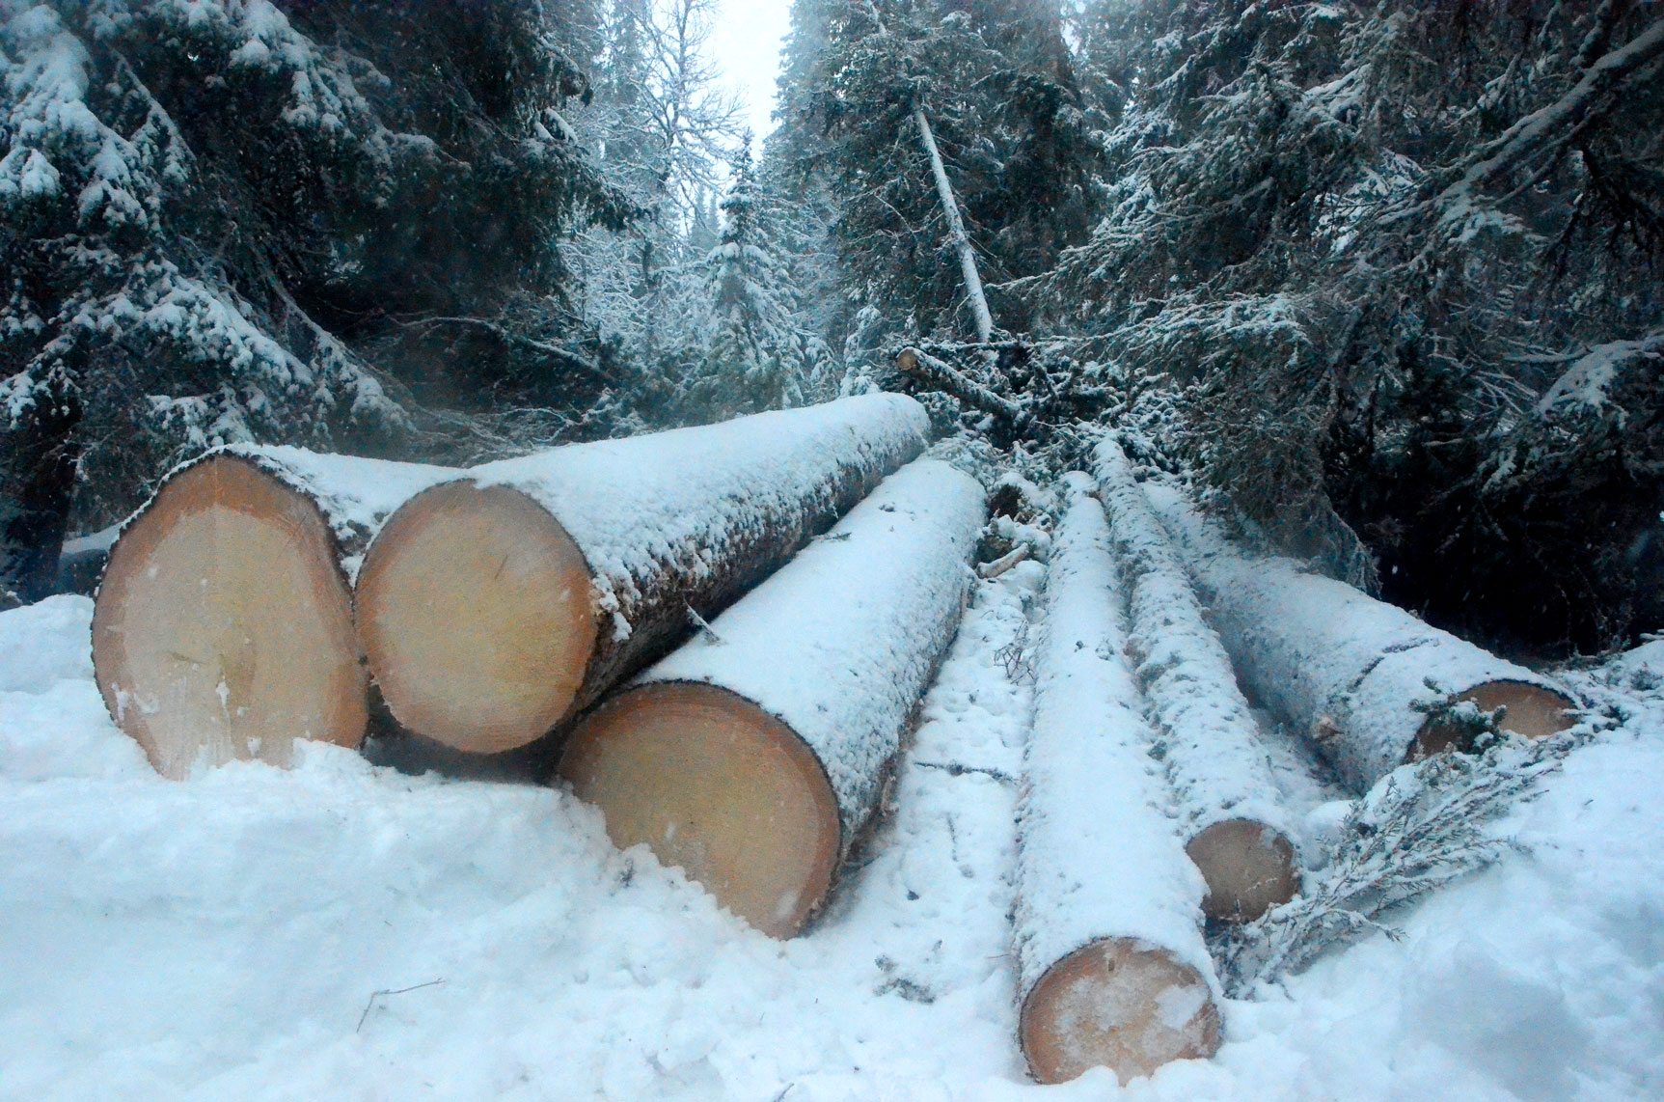

Slide 47
Sometimes, we may want to consider the forest at the individual tree level or at the size class level.
In order to optimize the utilization of the natural forests, it is necessary to understand the dynamics of growth and the intertemporal harvesting options in the already existing forests.
This study contains new approaches to nonlinear estimations of diameter increment and mortality functions for trees of different size classes, under the influence of competition within forests with many size classes.

Slide 48
A general dynamic function for the basal area of individual trees derived from a production theoretically motivated autonomous differential equation Peter Lohmander
Abstract
A general dynamic function for the basal area of individual trees has been derived from a production theoretically motivated autonomous differential equation. The differential equation is:
and the general dynamic function is:
Keywords: Dynamic function, differential equation, basal area, forest growth

Slide 49
Consider a stem segment, of height
of the tree. The stem segment is cylindrical with diameter
The leaves cover a cylinder with diameter

Slide 50
The sun light reaches the tree from the side.
is the volume of the stem segment.
is the basal area.

Slide 51
Volume increment is proportional to the photo synthesis level,
which in turn is proportional to the sun light projection area on the leaves,

Slide 52
We may conclude that:
Hence,
or

Slide 53
As the size of the tree increases, the production efficiency declines.
Furthermore, the value of
is often lower for large trees than for small trees.
A relevant function considering this is:

Slide 54
Mathematical model development and analysis
The parameters can be estimated via this linear reformulation:

Slide 55
Integration gives

Slide 57
Let us investigate the left hand side, called

Slide 58
This confirmes that the integration was correct.

Slide 59
which leads to

Slide 60
Let
Then

Slide 61
Let
We get the simplified expression:
which can be transformed to:
or

Slide 62
which gives the desired equation

Slide 63
Let us determine
We utilize the initial condition:
which leads to
Hence,
and finally

Slide 64
Now, we know how to determine
.
Later, the sign and magnitude of
will be needed in the analysis. Do we know the sign of
?
Let us investigate the sign of

Slide 65
We assume that the value of
makes sure that the increment is strictly positive.
Then, we know that:
As a result, we know that

Slide 66
Do we know the something about
?
With this information, we know that

Slide 67
Now, we may determine
as an explicit function of
and the parameters.

Slide 68
Now, the dynamic properties of
will be determined.

Slide 69
We already know that
. Hence,
As a result, we find that

Slide 70
Hence, we know that, as
monotonically converges to

Slide 71
How does the function work?
Below, parameter values representing the following case are used.
Species: Maple (Acer velutinum)
Initial diameter: 10 cm.
Source: Hatami, Lohmander, Moayeri and Mohammadi Limaei (2017)
Competition: No.

Slide 72
Basal Area (Square Centimeter) as a function of time, t (Years)

Slide 73
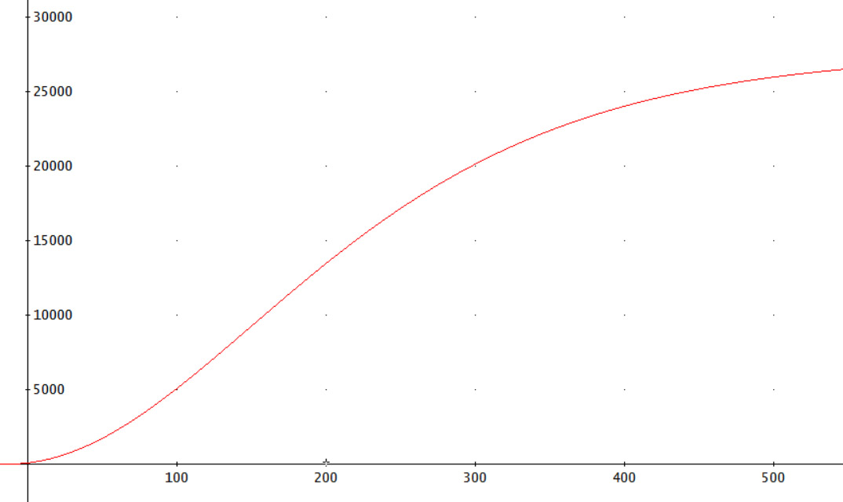
Basal Area (Square Centimeter)
Time (Year)

Slide 74
Diameter (Centimeter) as a function of time, t (Years)

Slide 75
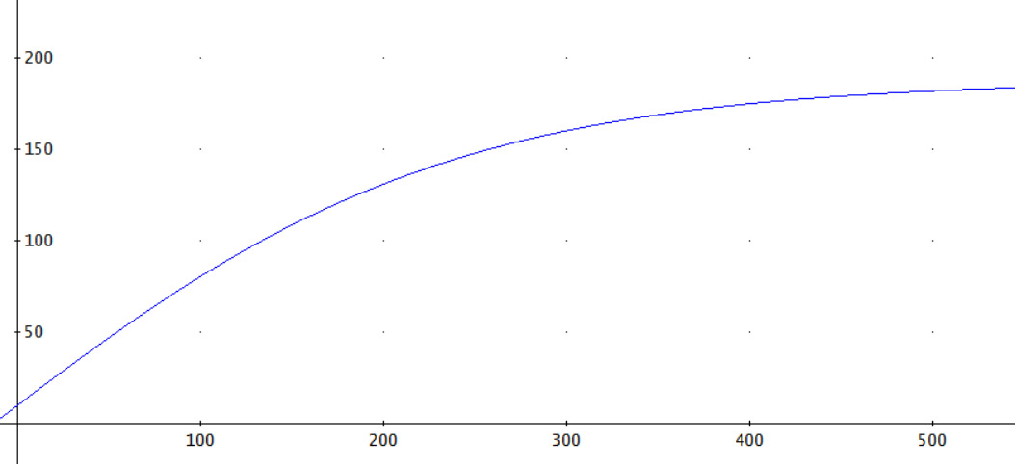
Diameter (Centimeter)
Time (Year)

Slide 76
Theoretical Growth Function Results
A general dynamic function for the basal area of individual trees has been derived from a production theoretically motivated autonomous differential equation.
The dynamic properties have been determined and monotone convergence has been proved.

Slide 77
Several version of the growth function exist.
Some of these take competition into account, via individual tree information or via size class information.
They have been statistically estimated with forest data from Sweden and Iran.
The estimations can also be based on already published diameter frequency distributions from natural forests in dynamic equilibria, in Canada, Russia and Scandinavia.

Slide 78
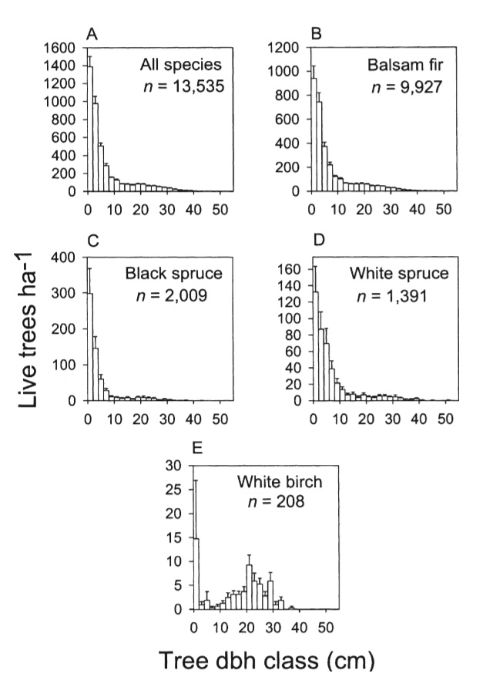
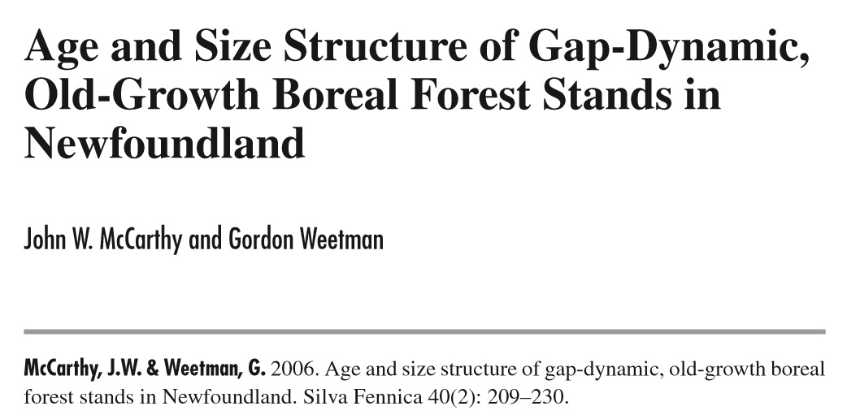
NORTH AMERICA

Slide 79
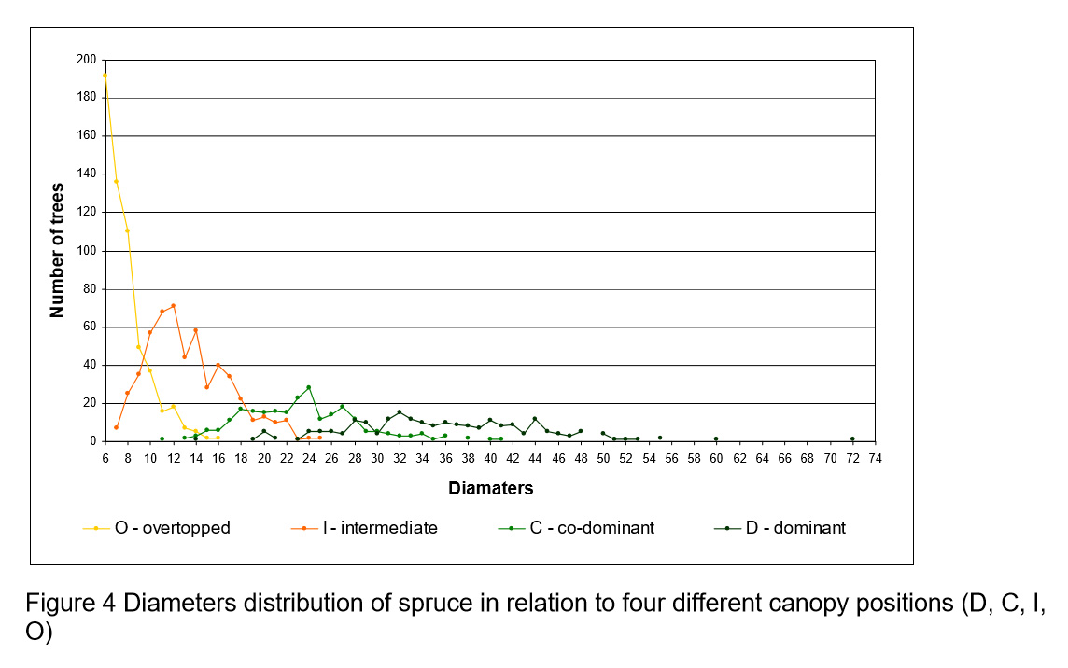
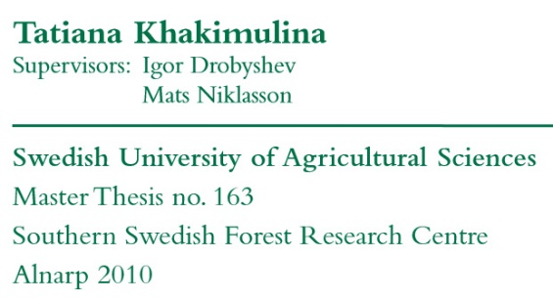
RUSSIA
250 Years of Disturbance Dynamics in a Pristine Old-growth Picea abies Forest in Arkhangelsk Region, North-Western Russia: a Dendrochronological Reconstruction

Slide 80
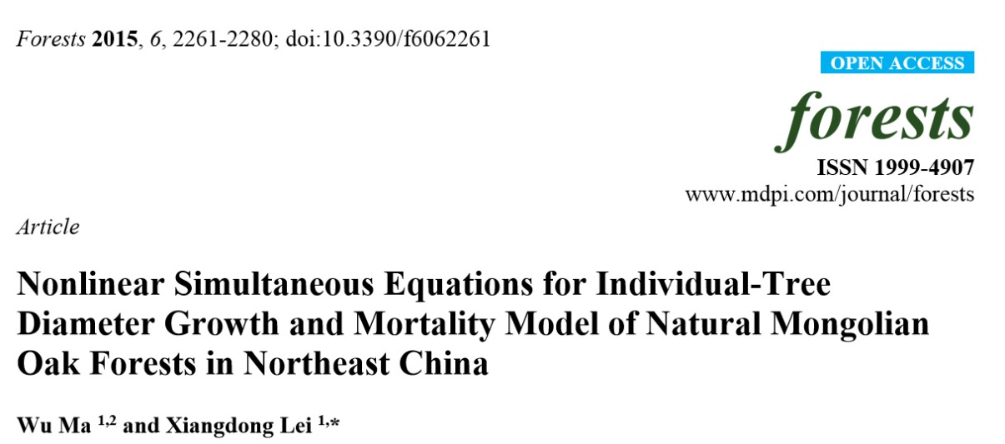
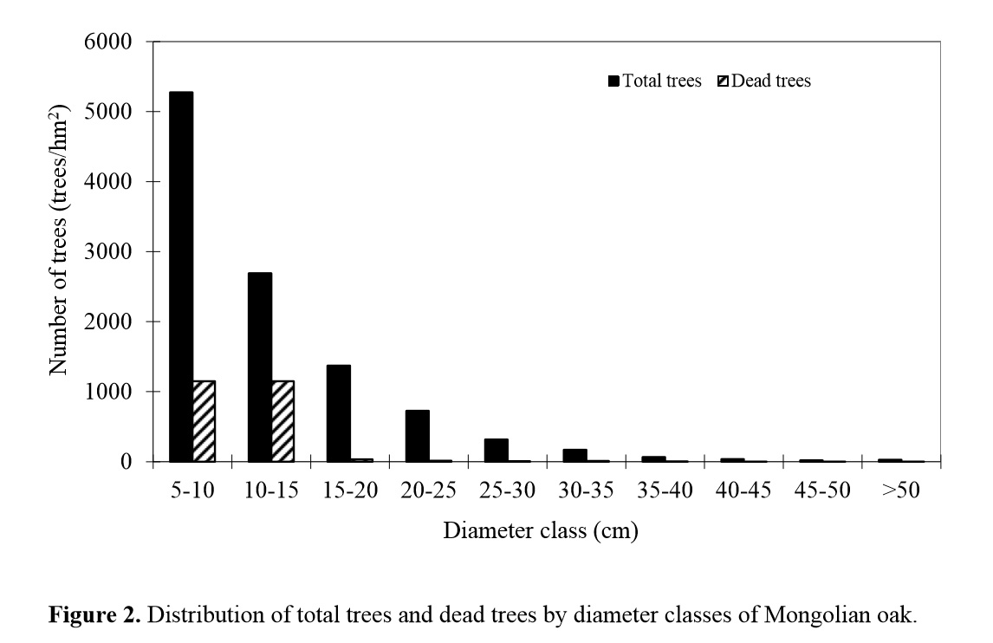
CHINA

Slide 81
Size class dynamics
Number of individuals
in size class i
Probability to move up
Relative harvest
Relative mortality
i-1
i
i+1

Slide 82
Observation:
Of course, the probabilities to move up are usually affected by competition. We may sometimes want to consider these things explicitly.
In other cases, we may be interested in equilibrium probabilities (when competition is considered fixed).

Slide 83
In dynamic equilibrium:
In dynamic equilibrium, without harvesting:

Slide 85
Special case:
P = > 0, P is constant (=1), m > 0, m is constant.
If i represents diameter class, then if P constant, this
implies constant diameter increment, which means that the
basal area increment is proportional to the square root of the
basal area. Then, if m = constant:

Slide 87
With realistic growth
function:
x = basal area

Slide 88
IN GENERAL:
With observations of n(i) for sufficiently many values
of i, it is possible to simultaneously determine
the parameters of the increment function,
the competition function and the relative
mortality function.

Slide 89
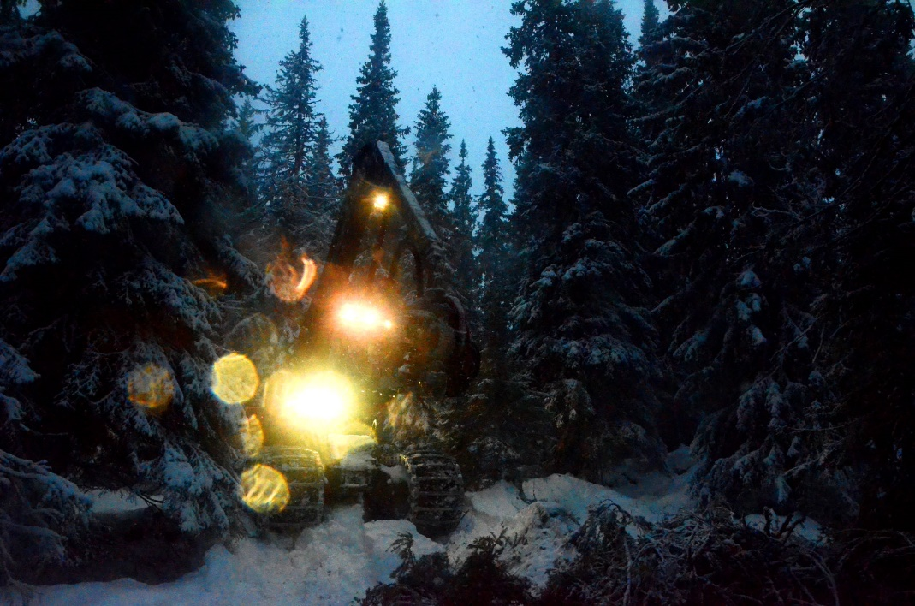
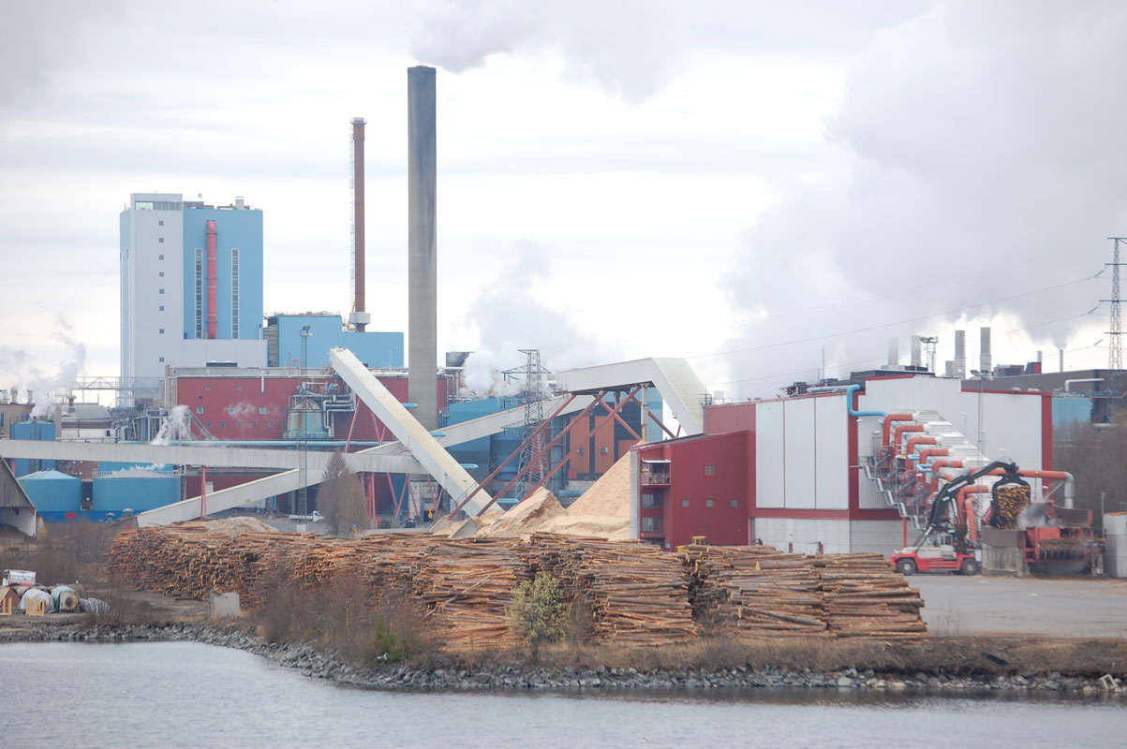
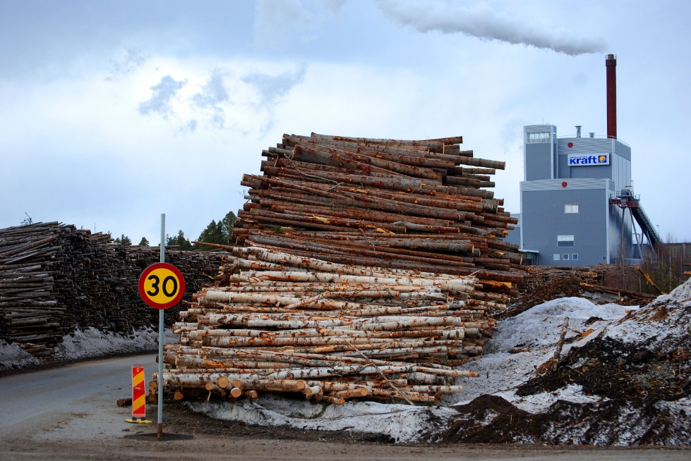
The master model:
Stochastic dynamic programming with detailed sub problems

Slide 91
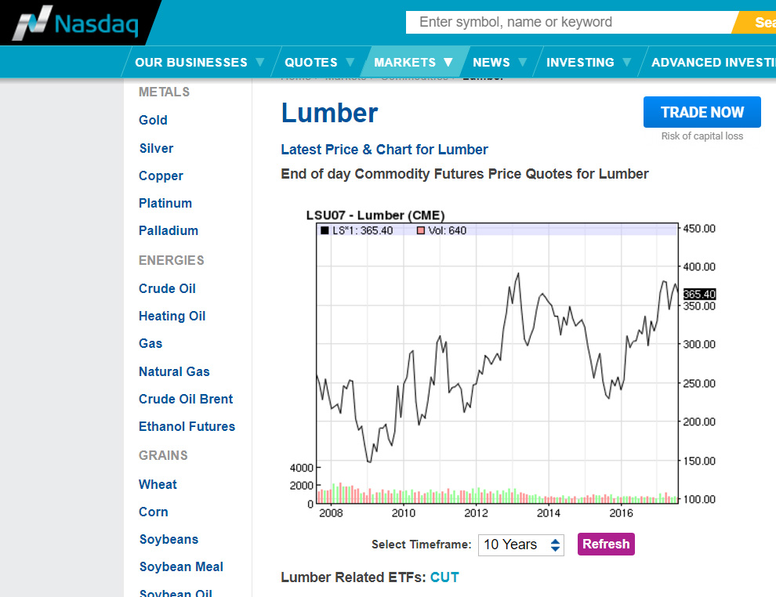

Slide 92
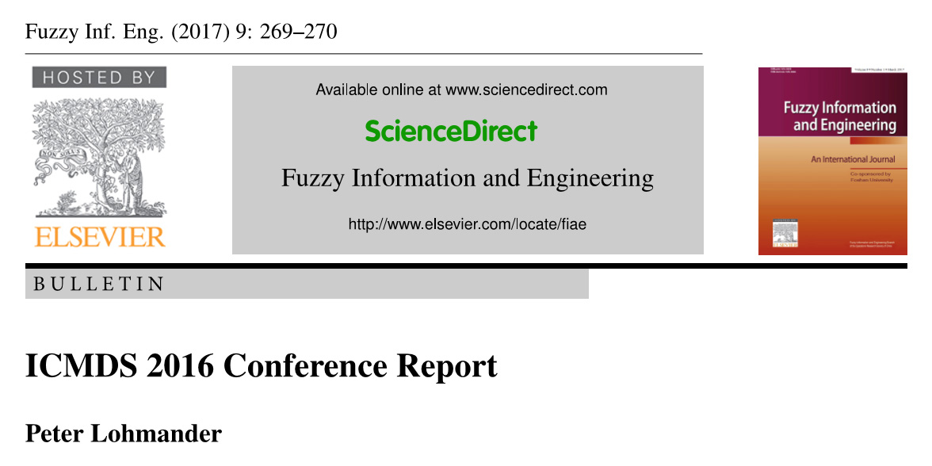
Stochastic dynamic programming with detailed sub problems:

Slide 93
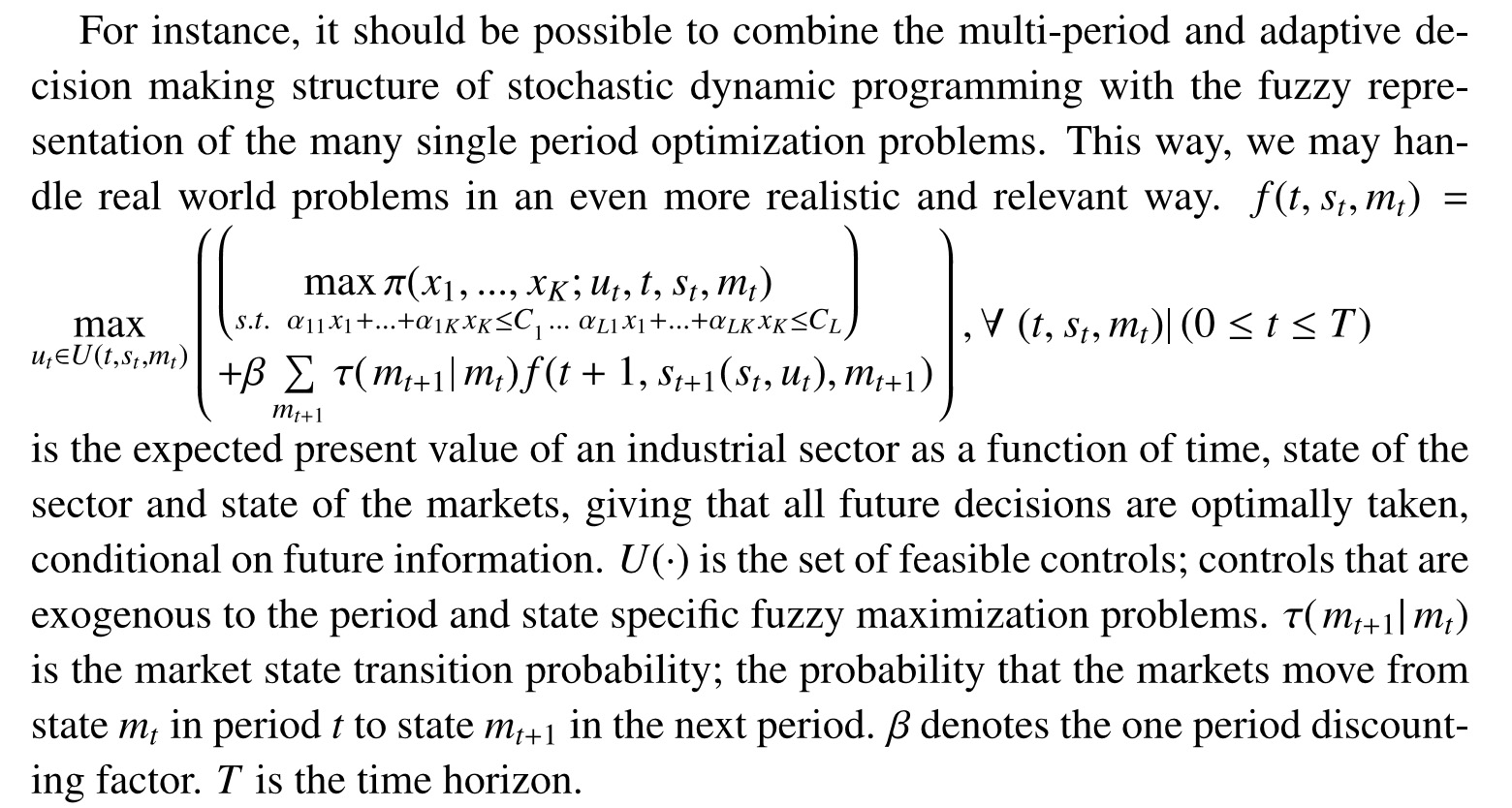

Slide 94
The forest resource dynamics sub model of the industrial model, is based on an approximation of the intertemporal forest production function, derived via the estimated dynamic model of a part of the boreal forest.
The market price transition probability matrix, used in the stochastic dynamic programming model, is derived via world market price series.

Slide 95
In each period, the production levels of bioenergy, sawn wood and fiber products, are optimized, based on the revealed market prices, the state of the natural resource and all other parameters. The model also determines the expected shadow prices.

Slide 96
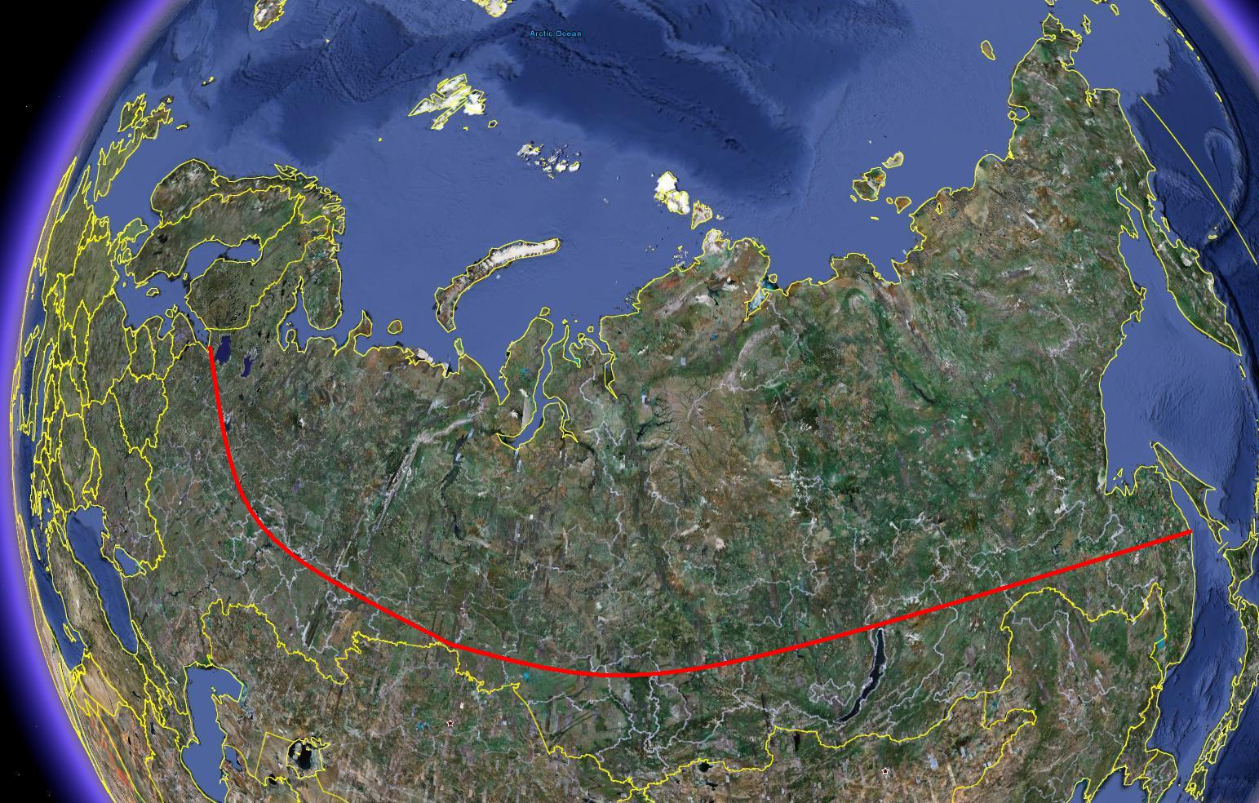

Slide 97
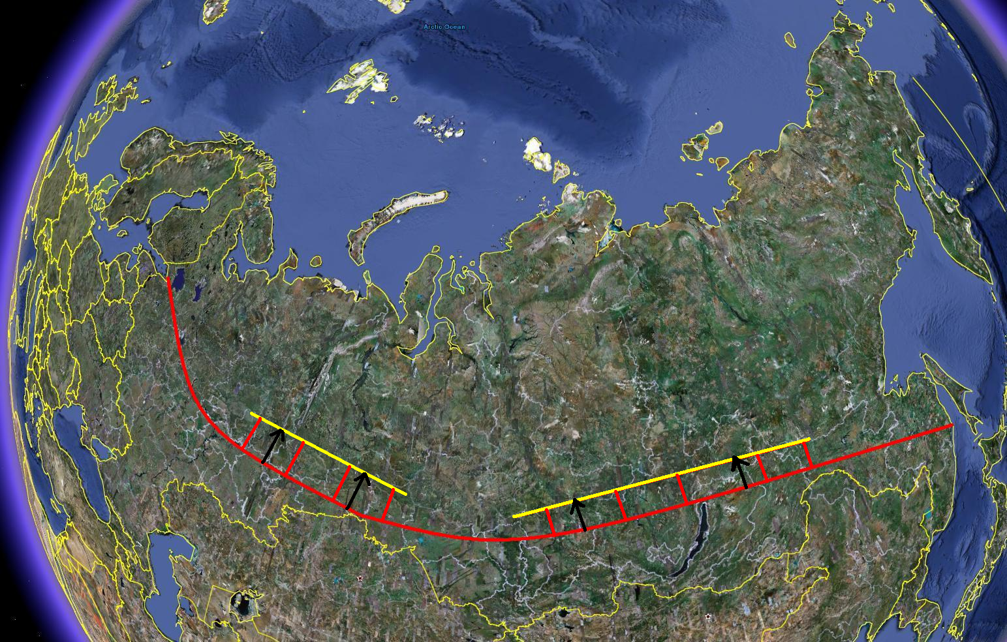

Slide 98
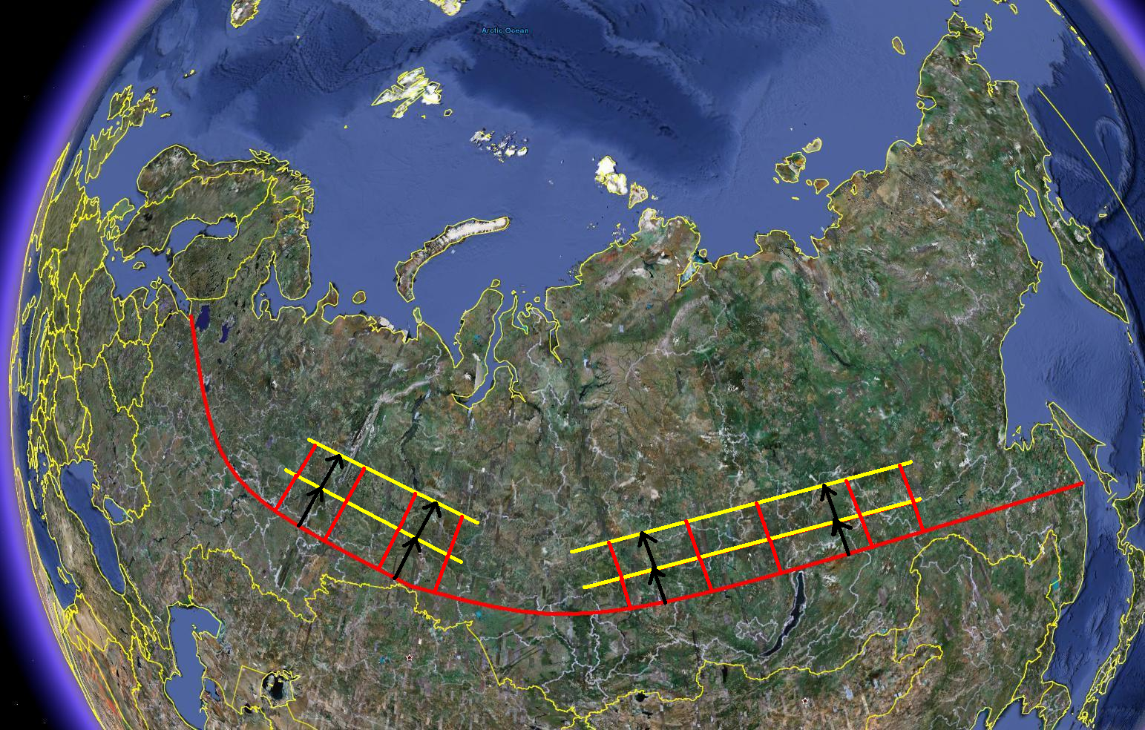

Slide 99
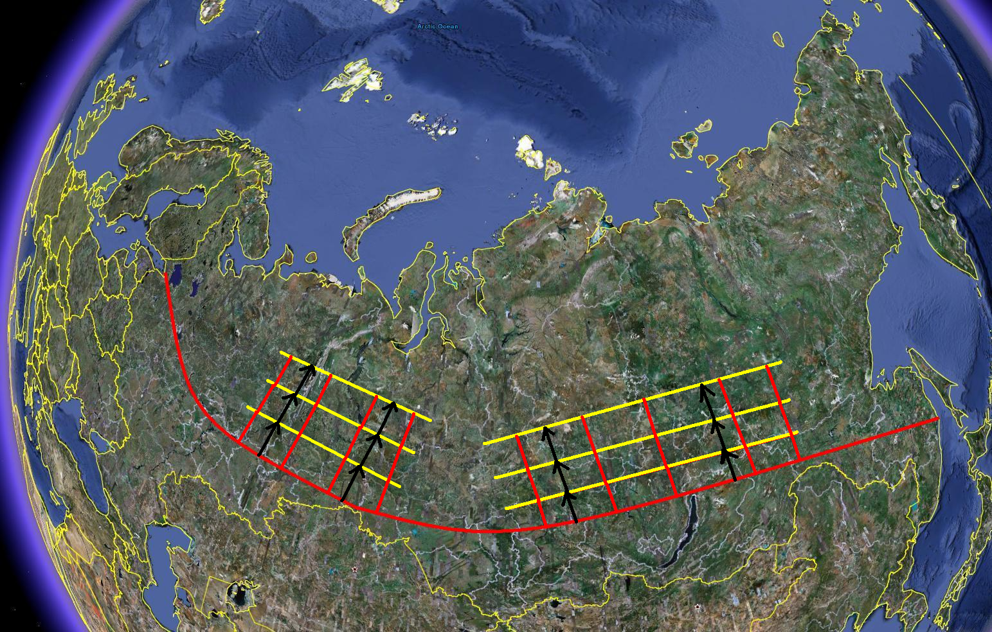

Slide 100
Alternative model structure:
The maximum
expected present
value is determined
via the determined
control function
parameter values.
A multidimensional loop with different adaptive
control function parameter value combinations is created.
For each parameter combination:
10 stochastic simulations
of the complete system
during 200 years with estimation
of the expected present value.
The adaptive control
function parameters
are analytically
determined via
the first order
optimum conditions
and the second
order maximum
conditions.
A table with expected present values for different
adaptive control function parameter value combinations is created.
A multidimensional nonlinear approximation of the expected
present value, as a function of the adaptive control function
parameters, is derived via regression analysis.

Slide 101
FINAL CONCLUSIONS:
There are very large options to increase sustainable continuous cover forestry in the Borel forests. This way, sustainable flows of bioenergy and all kinds of forest industry raw materials can be obtained and these sectors can be expanded. This is also good when we consider the global warming problem.
Continuous cover forestry is often the production economically optimal forestry method. Hence, the method is not just rational from environmental perspectives.)
The fundamental understanding of forest dynamics can be improved via new growth functions and estimations.
The complete system can be optimized with new adaptive methods.

Slide 102
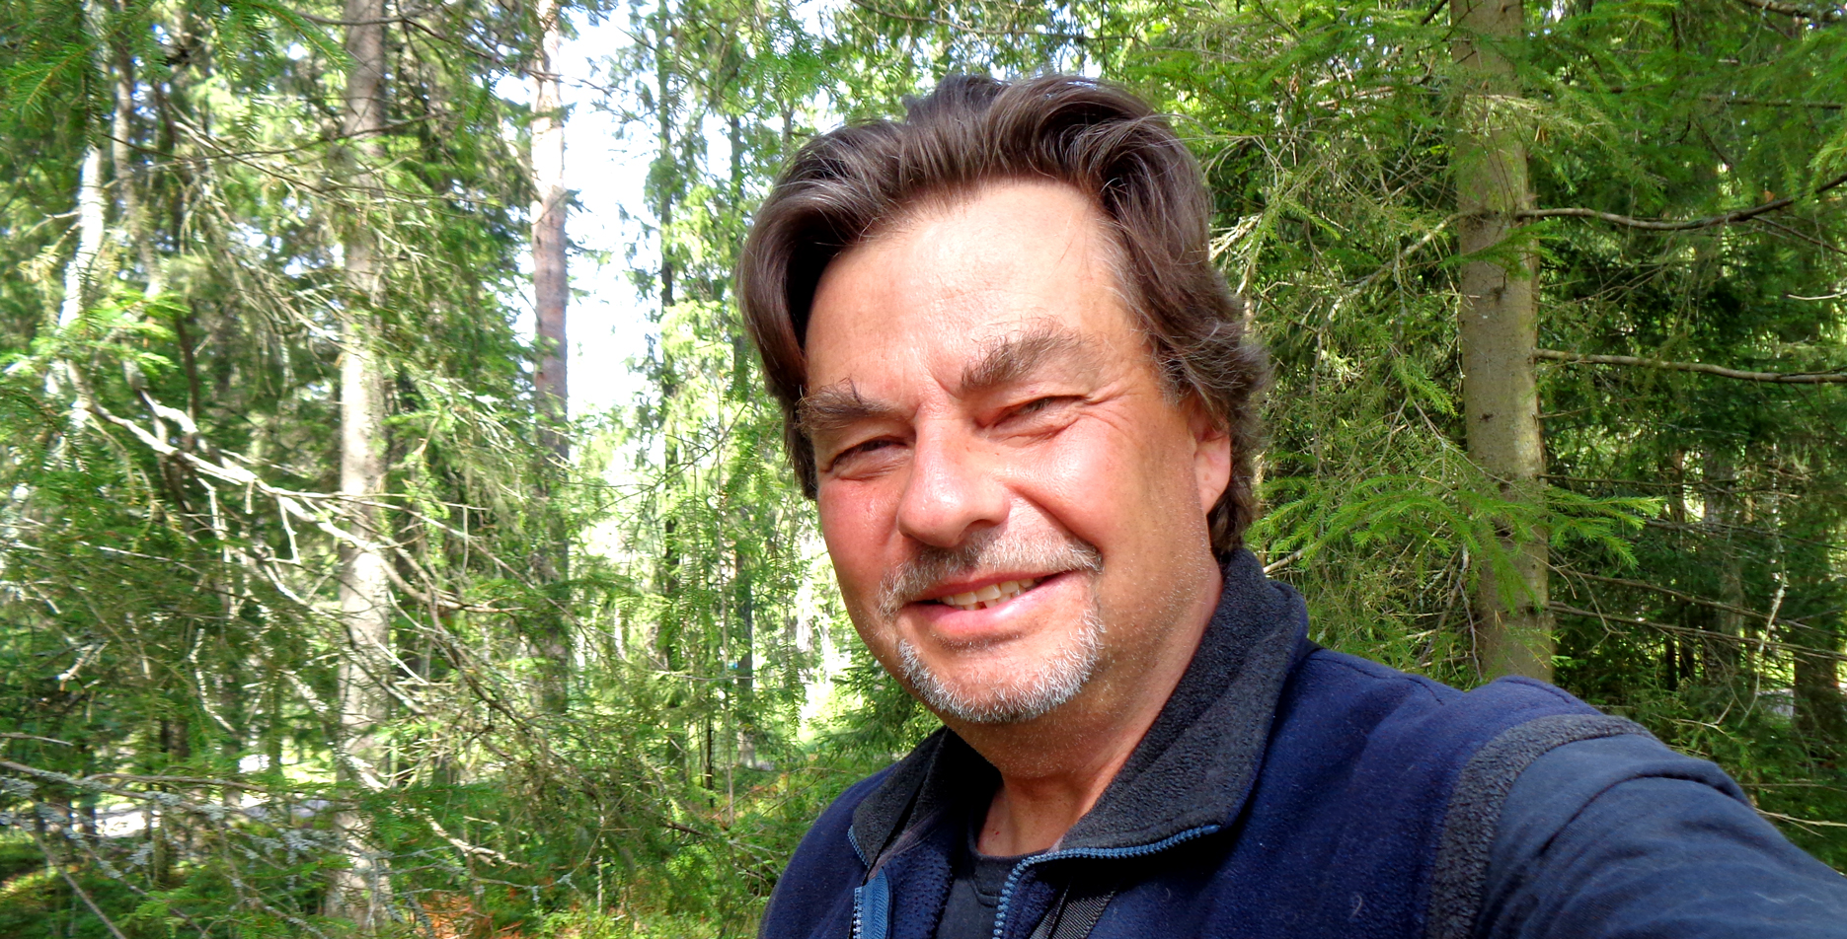
QUESTIONS?

Slide 103
An Adaptive Optimization Approach To Expansion Of The Forest and Bioenergy Sectors Utilizing Wood From The Boreal Forests Version 170816
Peter Lohmander Professor Dr.
Optimal Solutions www.Lohmander.com Peter@Lohmander.com
August 27-30, 2017, Clearwater Resort Suquamish, Washington, (near Seattle)

