Slide 1
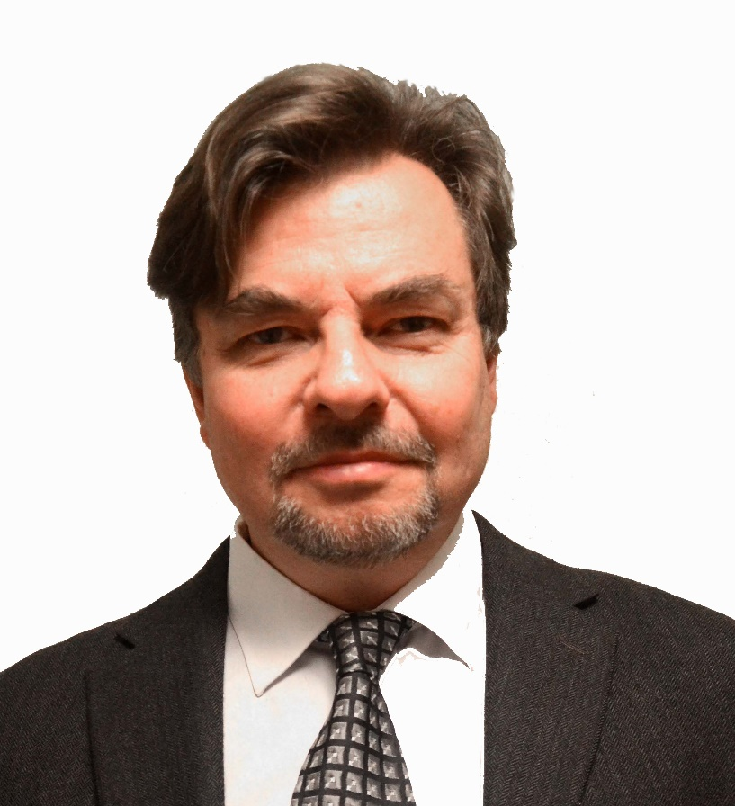
Optimal forest management topics in the boreal forest region with special focus on Sweden KEYNOTE Version 170416 Peter Lohmander Professor Dr., Optimal Solutions in cooperation with Linnaeus University www.Lohmander.com & Peter@Lohmander.com

Slide 2
Optimal forest management topics in the boreal forest region with special focus on Sweden Peter Lohmander
Abstract
This paper contains a briefing on forestry and forest management issues in Sweden and the Boreal forest region.
It also introduces some topics of fundamental importance to present forest research and policy.
This paper is an introduction to a keynote lecture.
Keywords: Forest management, Sweden, Boreal forest, optimal solutions.

Slide 3
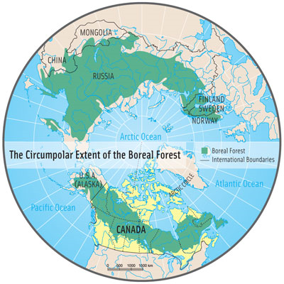
Introduction
The boreal forest covers very large areas in Russia, Canada, USA, and Scandinavia, including Sweden.

Slide 4
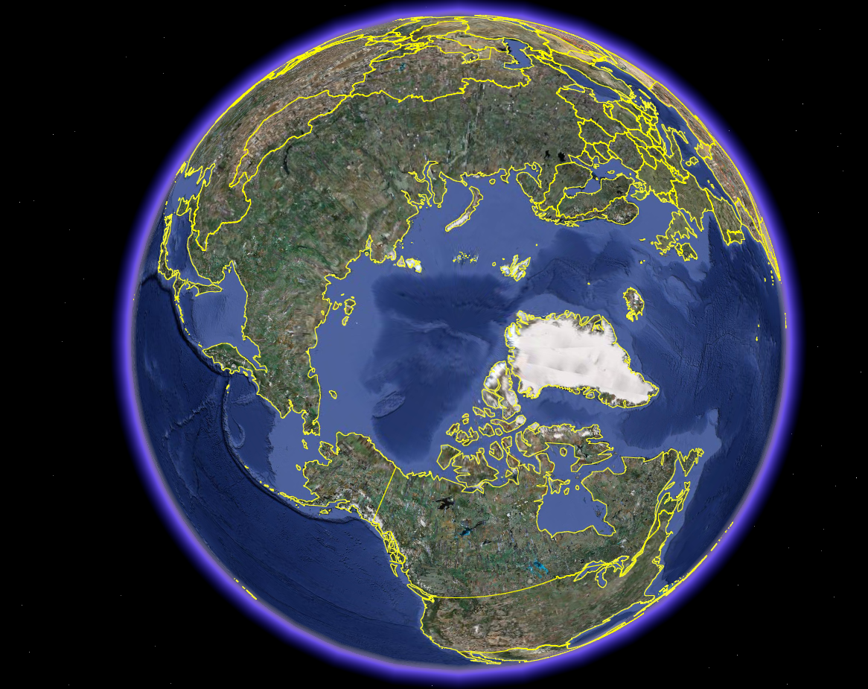
Sweden
Russian Fed.
Canada

Slide 5
23
809
261
(NR)
Forest area
(Million hectares)

Slide 6
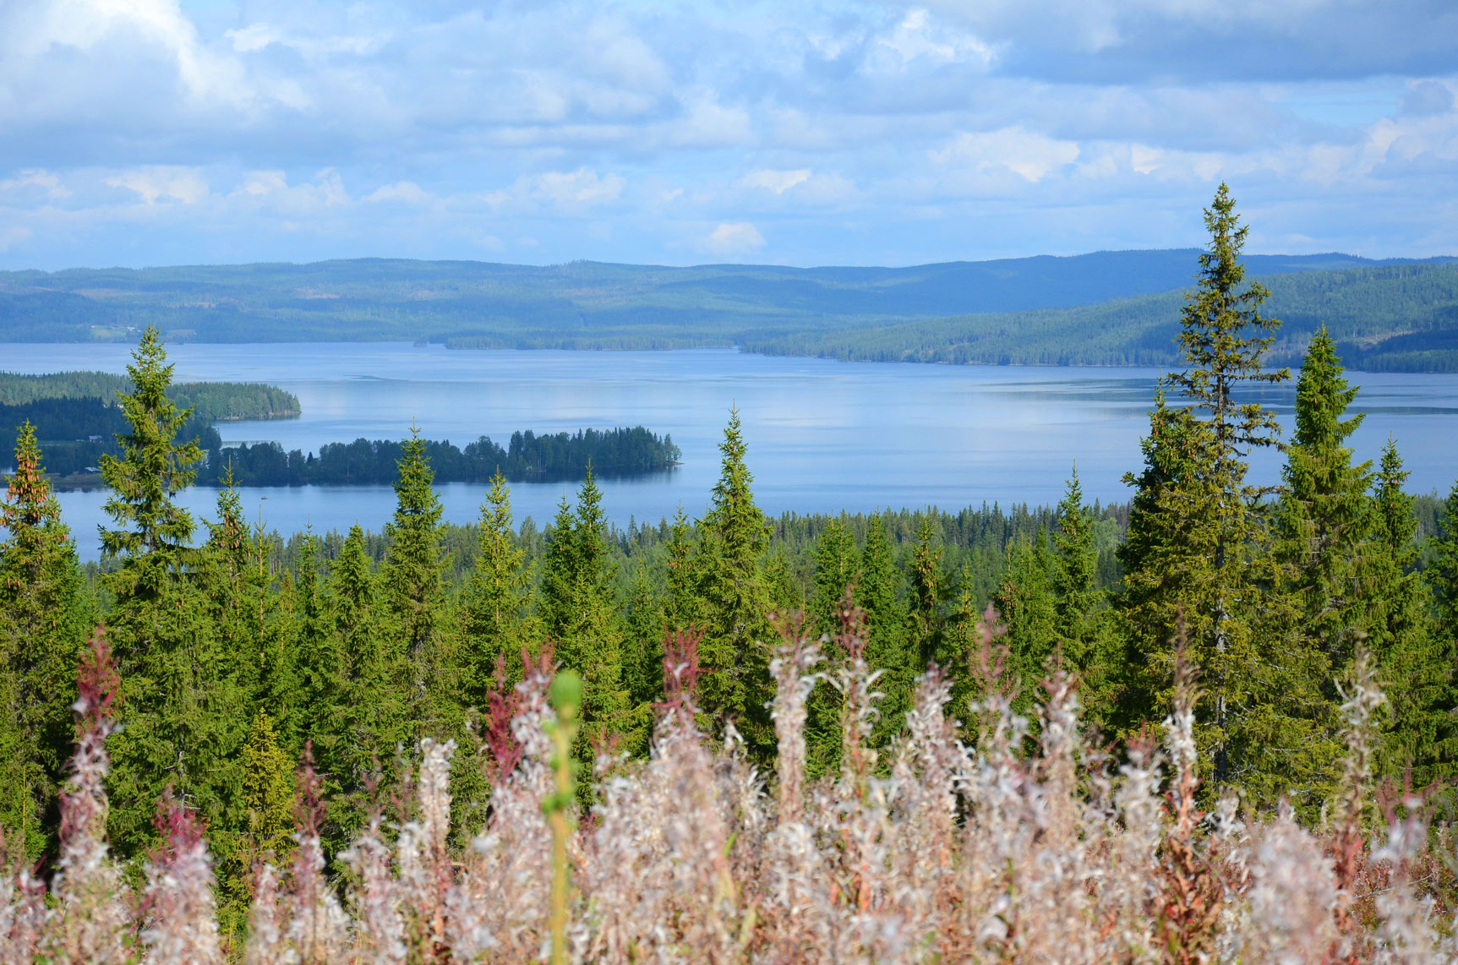

Slide 7
Considerable parts of these regions presently contain more or less natural forests, often dominated by different species of spruce, pine and larch.
In several regions, in particular in Russia and Canada, the industrial utilization of forest raw materials presently is and historically has been close to zero.
Expanding infrastructure, technological developments of harvesters and forwarders, increasing costs and environmental problems associated with fossil fuel extraction, a growing interest in sustainability and the debate on climate change, make it rational to investigate environmentally acceptable harvesting options in the remote and natural boreal forests.

Slide 8
In Sweden, most forestry operations have for many decades been performed via “rotation forestry”,
clear cuts, usually followed by single species plantations.

Slide 9
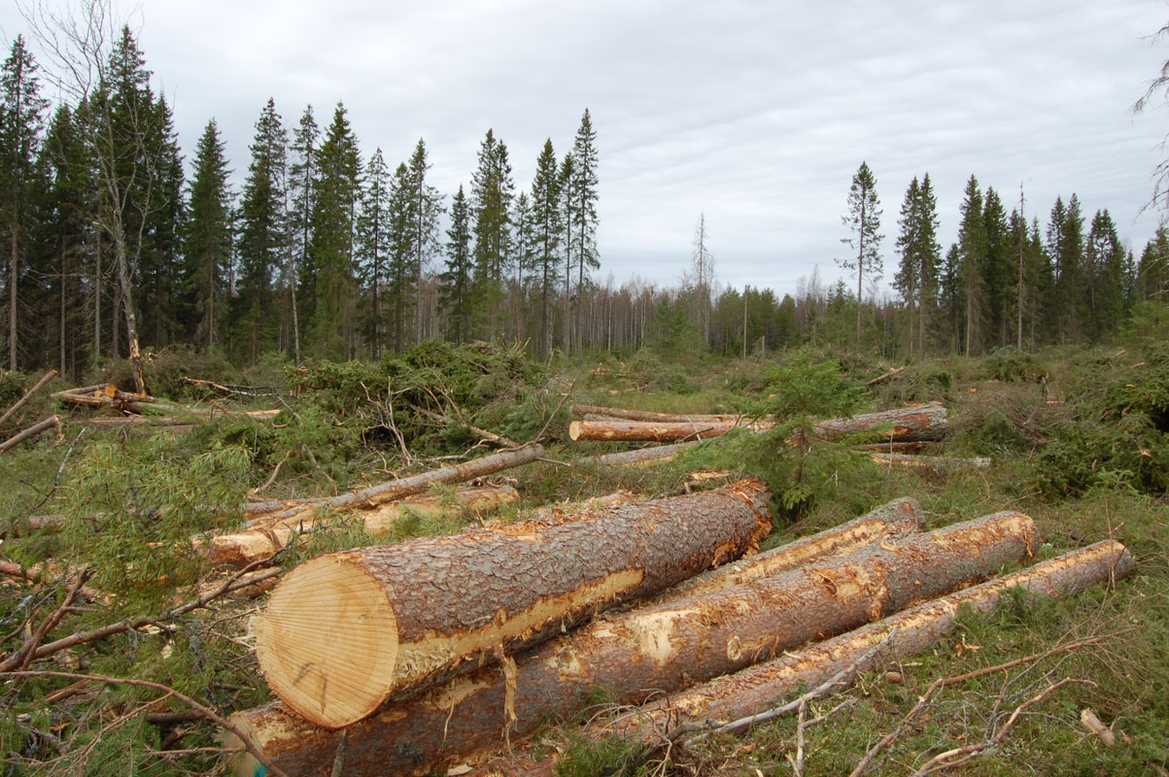

Slide 10
The Swedish level of harvesting in relation to the standing volume is much higher than in Russia and Canada.

Slide 11
P.S. This graph is based on the simplifying assumption that the stock in ”Latin America” = the stock in ”South America”.

Slide 12
This paper contains a briefing on some topics of present importance to forestry and forest policy in the boreal forests, with a special focus on Sweden.
Industrial expansion of forest utilization is often considered as very negative for the environment.
It is often assumed to be obvious that the initially existing natural forests, with trees of many size classes and species, should be removed and replaced by uniform plantations.
However, careful analysis shows that it is often optimal, also from a production economic point of view, to start harvesting the natural forests using continuous cover methods.

Slide 13
Furthermore, mixed species forests do not only have environmental advantages compared to single species forests.
They also contain the economically important option to sequentially adjust forest harvesting to the often rapidly shifting demands in the timber markets.
Relative prices of different tree species often change in unpredictable ways. Furthermore, over time, we get more and more information about how different species grow in a particular area.
If we have several species in the forest to work with, we can sequentially adjust the mix of species in the forest to the latest information.
The optimal forest management decisions in problems of this nature must be determined with adaptive optimization. Such methods and forestry applications are found in Lohmander (2007).

Slide 14
Lohmander (2007) shows how dynamic and stochastic management decisions can be optimized with different methods, including different versions of stochastic dynamic programming.
Lohmander, P. (2007), Adaptive Optimization of Forest Management in a Stochastic World, in Weintraub A. et al (Editors), Handbook of Operations Research in Natural Resources, Springer, Springer Science, International Series in Operations Research and Management Science, New York, USA, pp 525-544

Slide 15
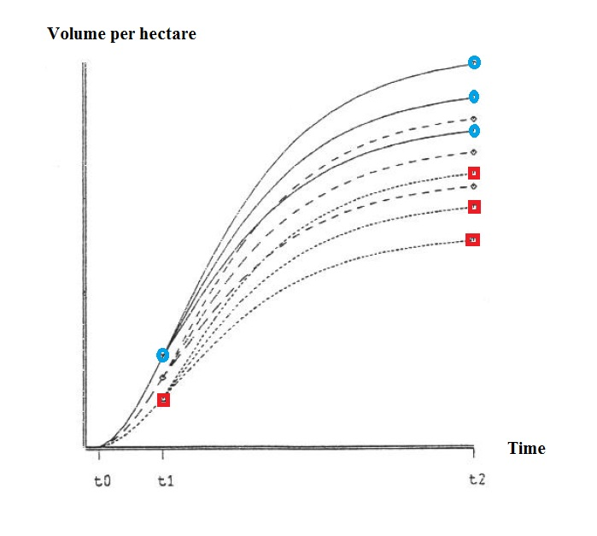
How will the climate and the
acidity of soils change during
the next 30 years?
How will this affect the
growth of different species?
That is not yet known.
If we have several species
in the forest, we can change
the species mix
when we know more,
at a later point in time.

Slide 16
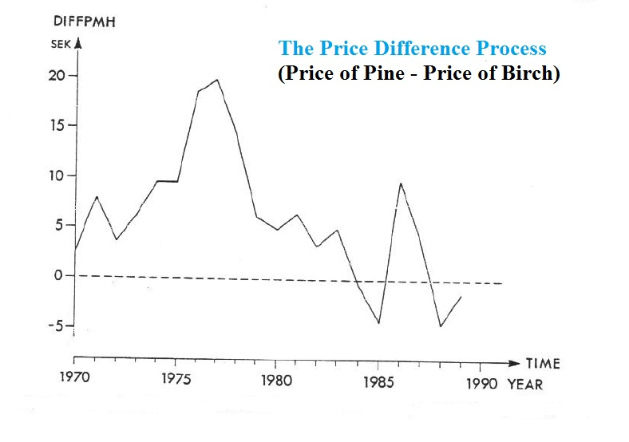
Which species will be
the most valuable to industry?
That is not yet known.
Relative prices change
as a function of technical
development in the
process industries.
If we start with a mixed forest,
we can rapidly adapt forest
production and harvesting
to changing prices.

Slide 17
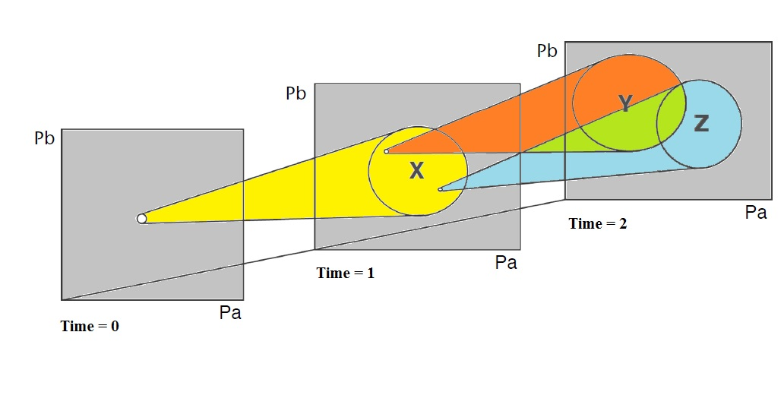
With a mixed species plantation at Time 0, we can select species for continued production at Time 1.
At Time 1, we know more (than what we knew at Time 0)
and we can make a better prediction of the conditions at Time 2.

Slide 18
Forests and Forestry in Sweden
All kinds of statistical information concerning
Swedish forests, forestry, rules and regulations are
well document by the Swedish Forest Agency (2017).

Slide 19
Continuous cover forestry versus forestry with clear cuts
In the past, continuous cover forestry was common in Sweden.

Slide 20
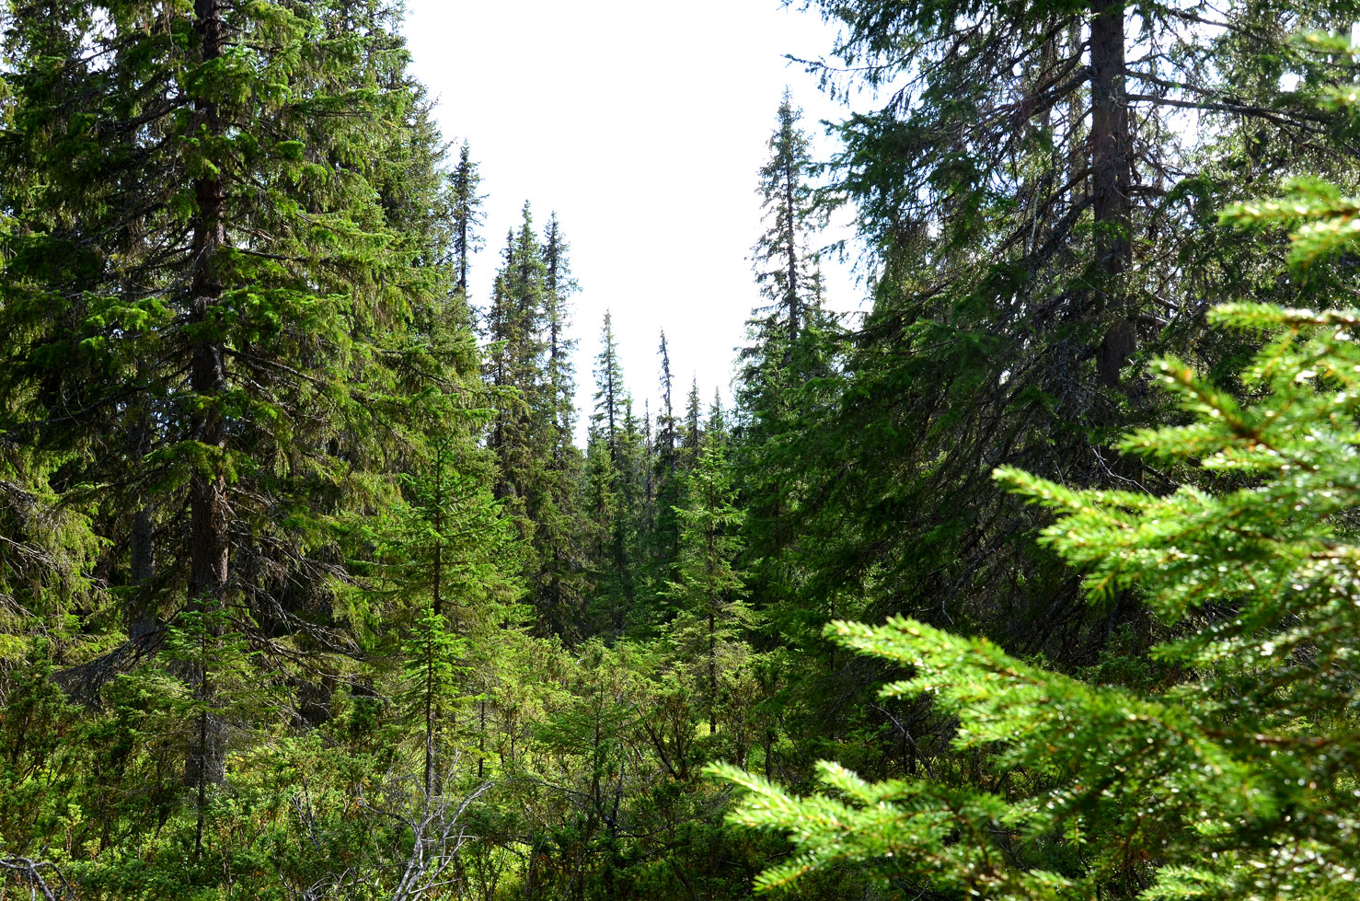

Slide 21
Only the largest trees were harvested and the rest of the trees continued to grow.
Natural regeneration was the standard method.
Forest workers used manual saws to make the trees fall, axes to remove the branches, manual saws to cut the timber to logs and horses with sleds to drag the logs to the roads.
Harvesting was usually performed in the winter, when the ground was frozen and covered by ice and snow.
This made it easy to transport the logs to the roads.

Slide 22
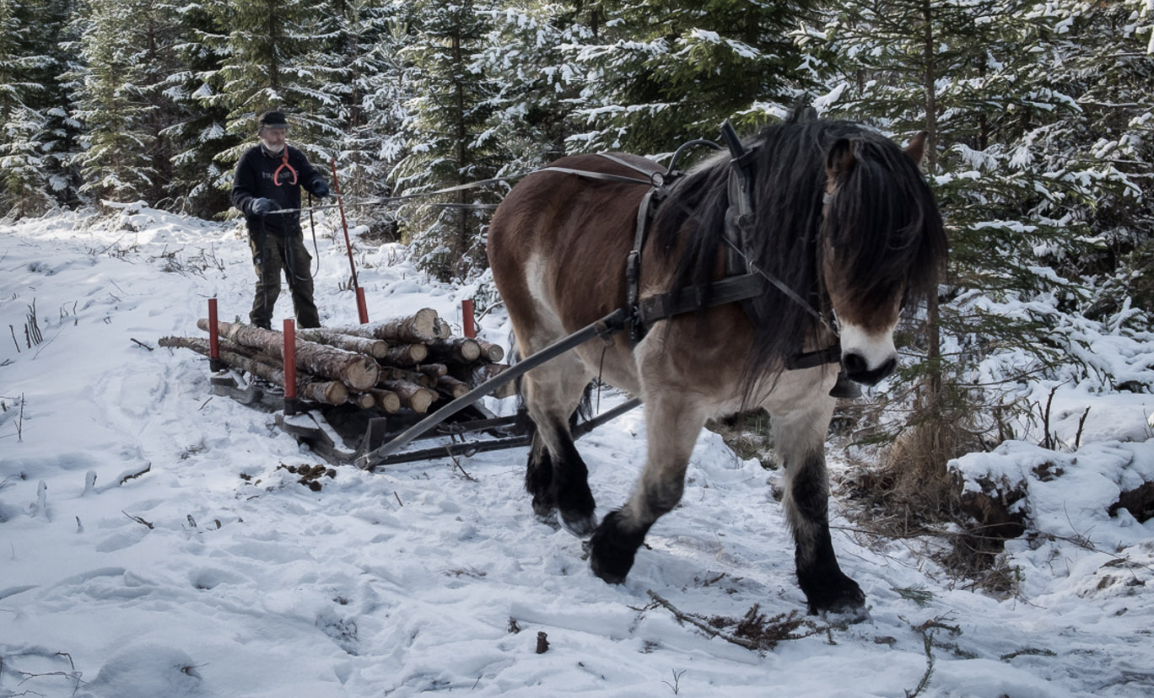
http://www.osterbyfotografen.com/skogsbruk-nordsvensk-2016

Slide 23
The forest workers were usually employed in agriculture during the warm season, which made the winter season suitable for forestry activities.
Over the decades, the number of combined small scale agricultural and forestry farms and the many workers, decreased.
Most young people moved to the cities and large and heavy forest machines took over the forest operations. These machines could not move between the trees in the same way as a horse. Hence, all trees were removed simultaneously and the era of rotation forestry with clear cuts started.

Slide 24
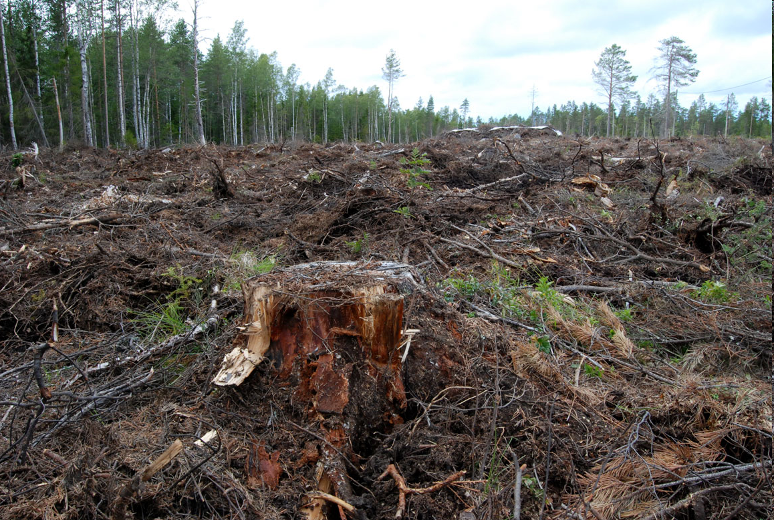
Clear cut in Sverige (10 km S Umeå).

Slide 25
New forests were created in the form of uniform plantations, usually dominated by only one species, Scots pine (Pinus silvestris) or Norway spruce (Picea abies).
The large scale forestry methods often included very heavy machines, deep tracks in the soil, erosion, the use of poison to handle insects eating the young softwood seedlings, other poison to kill large numbers of unwanted naturally regenerated hardwood seedlings, low seedling survival rates and poor timber quality development in the softwood plantations and several other problems.
The large clear cuts gradually gave rise to a political debate. Many people preferred not to see large clear cut areas. Swedish forest management is presently dominated by rotation forestry, clear cuts and single species plantations. The forest political debate continues.

Slide 26
Now, new developments of forest machines such as small and flexible harvesters and forwarders, make it possible to once again start using continuous cover forestry methods in Sweden and other countries with similar conditions, found in the Boreal forest region.
Lohmander (2014a), (2015), (2016a) and (2016b) contain more information about these topics and new ways to optimize continuous cover forest management decisions.

Slide 27
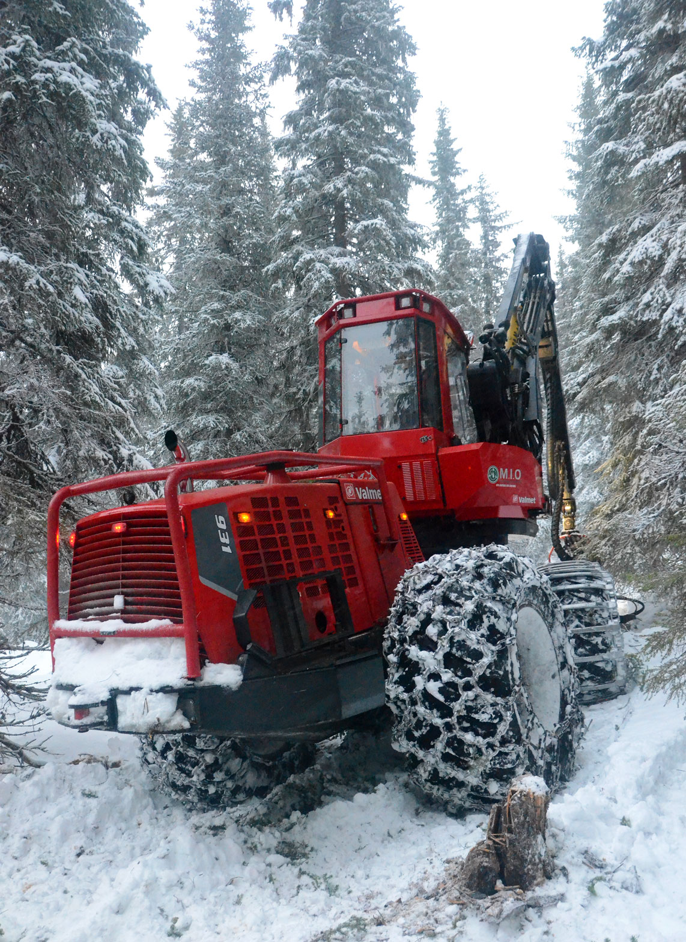
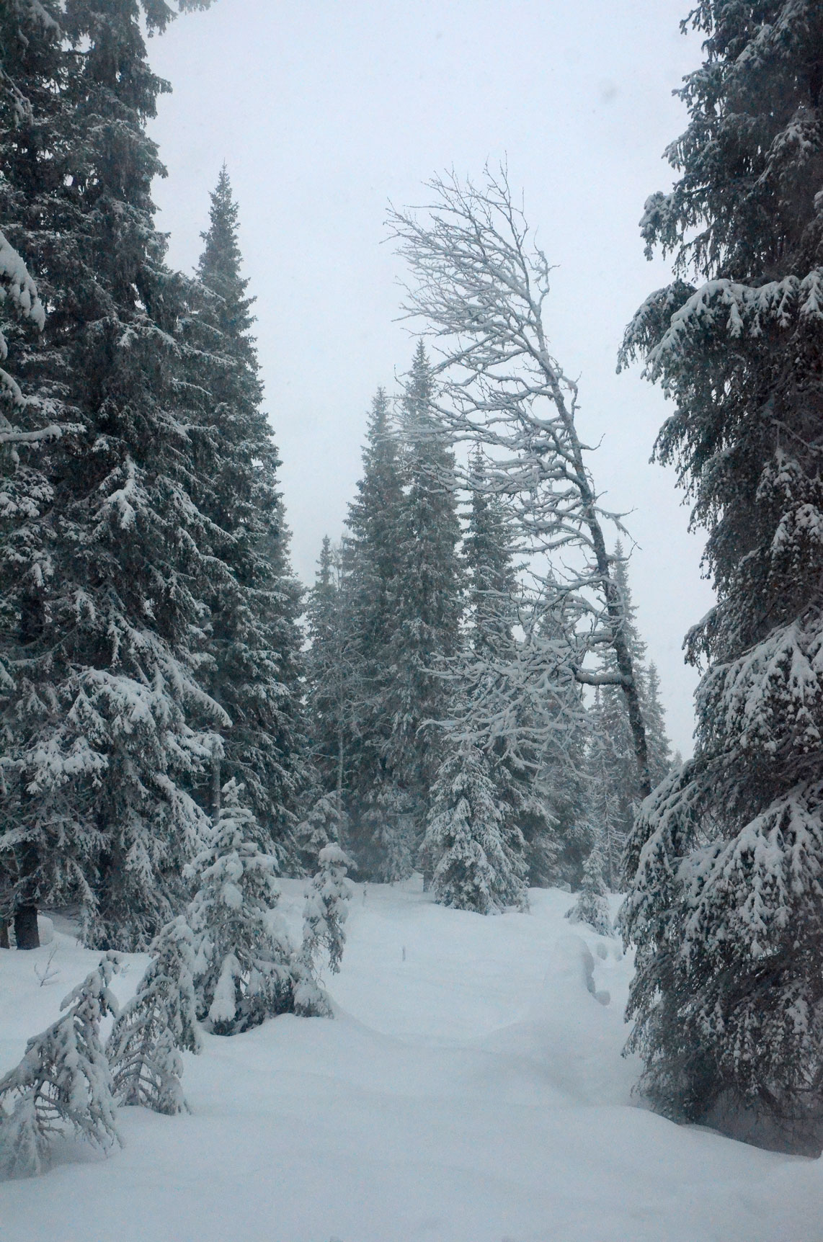

Slide 28
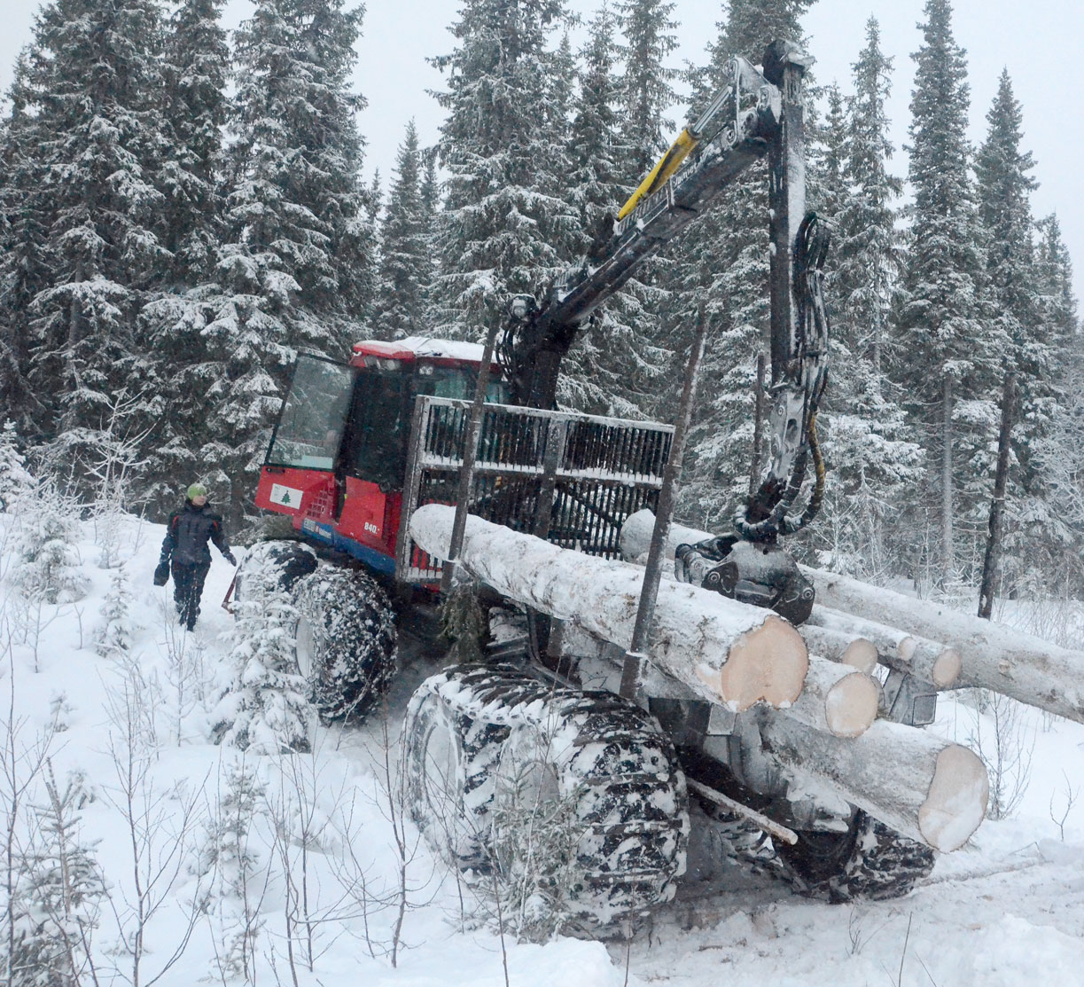

Slide 29
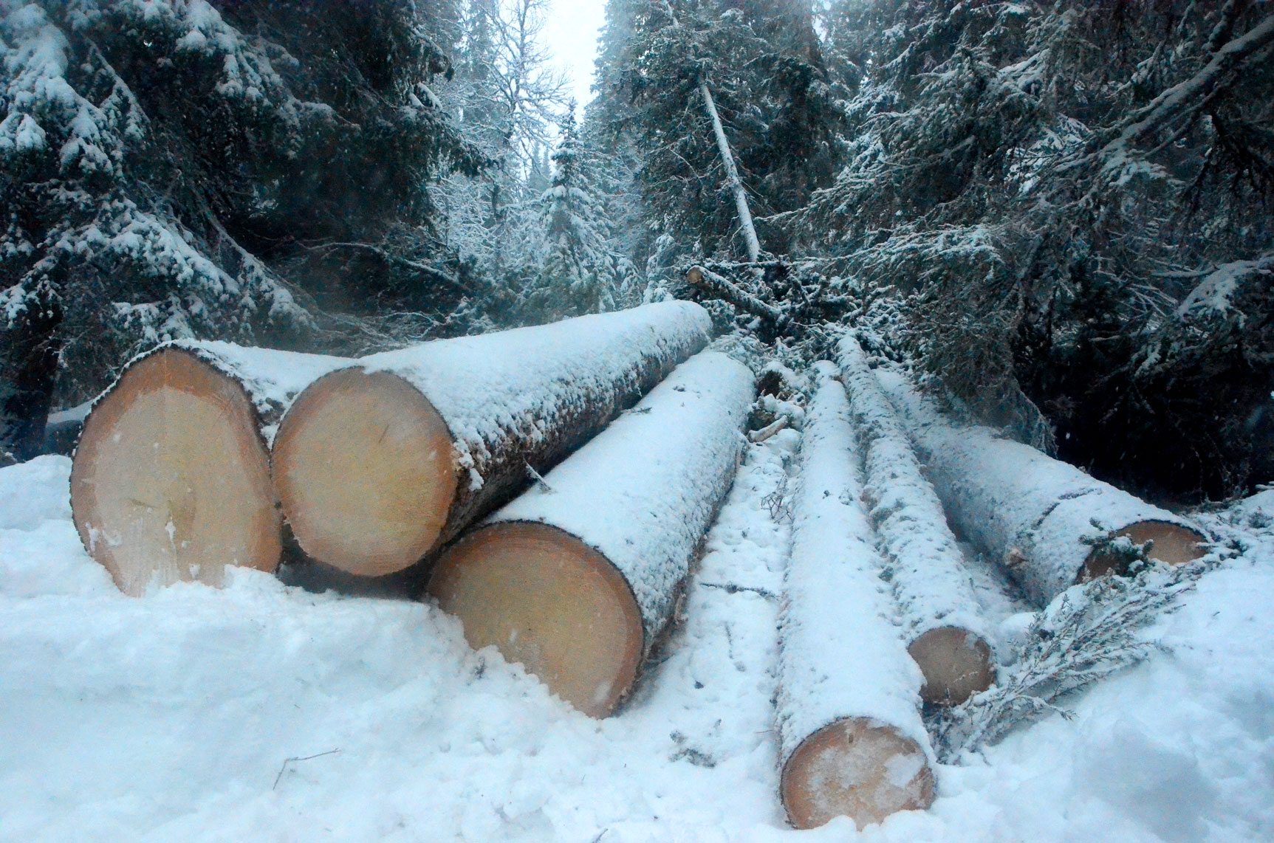

Slide 30
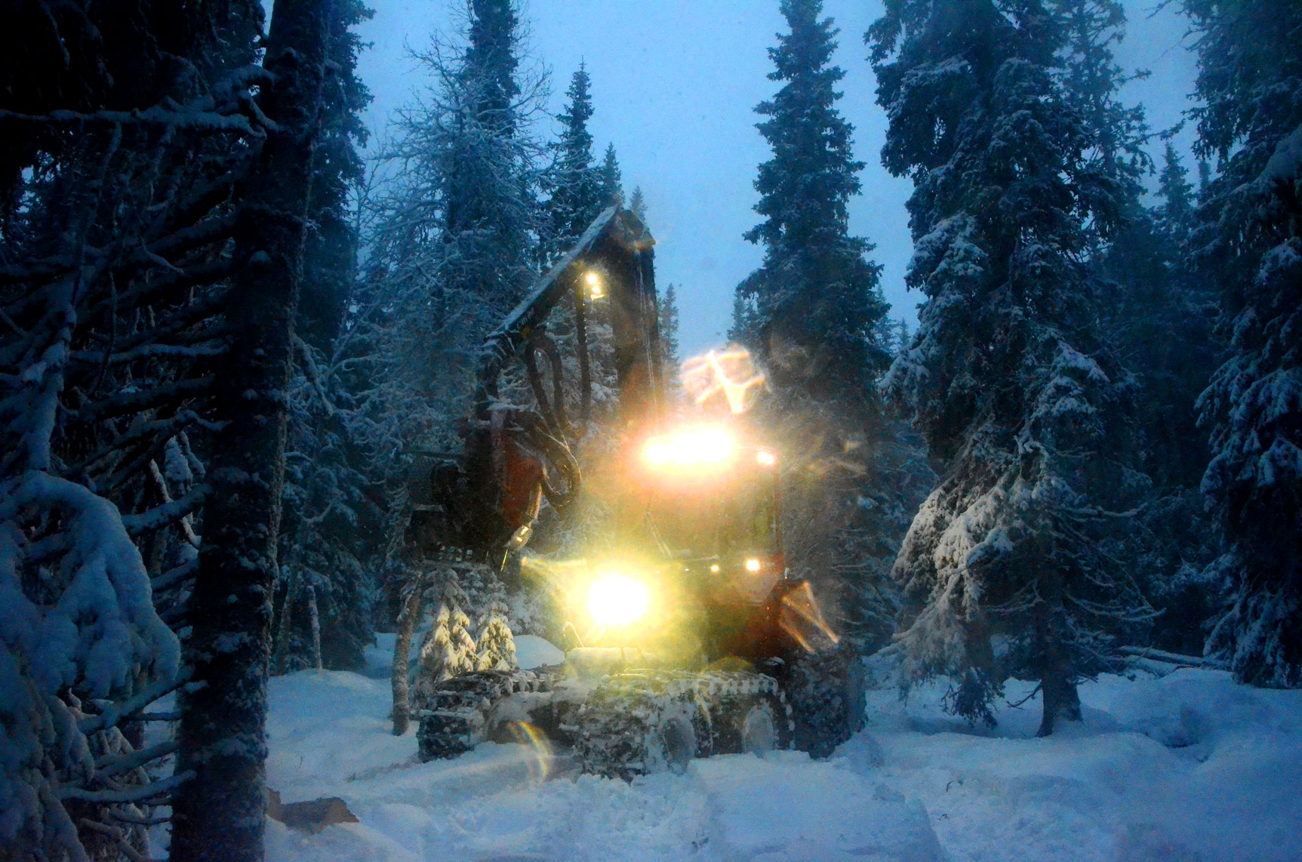

Slide 31
Rational forestry considering forest industry,
energy and the climate
Lohmander (2011b) includes a general briefing on forest harvesting potentials and utilization in the Boreal region and an analysis of some options to solve parts of the global warming problem via expanded utilization of these forests.

Slide 32
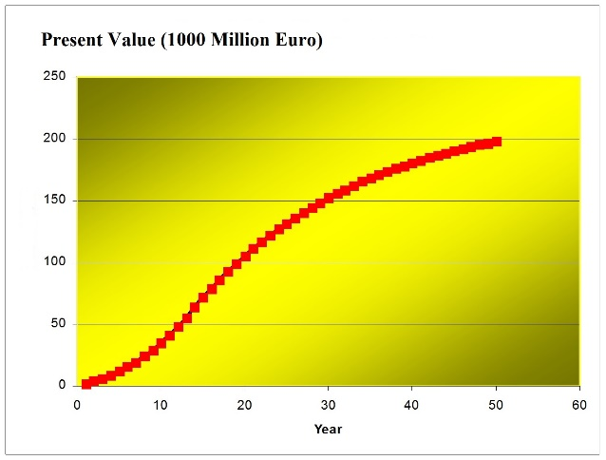
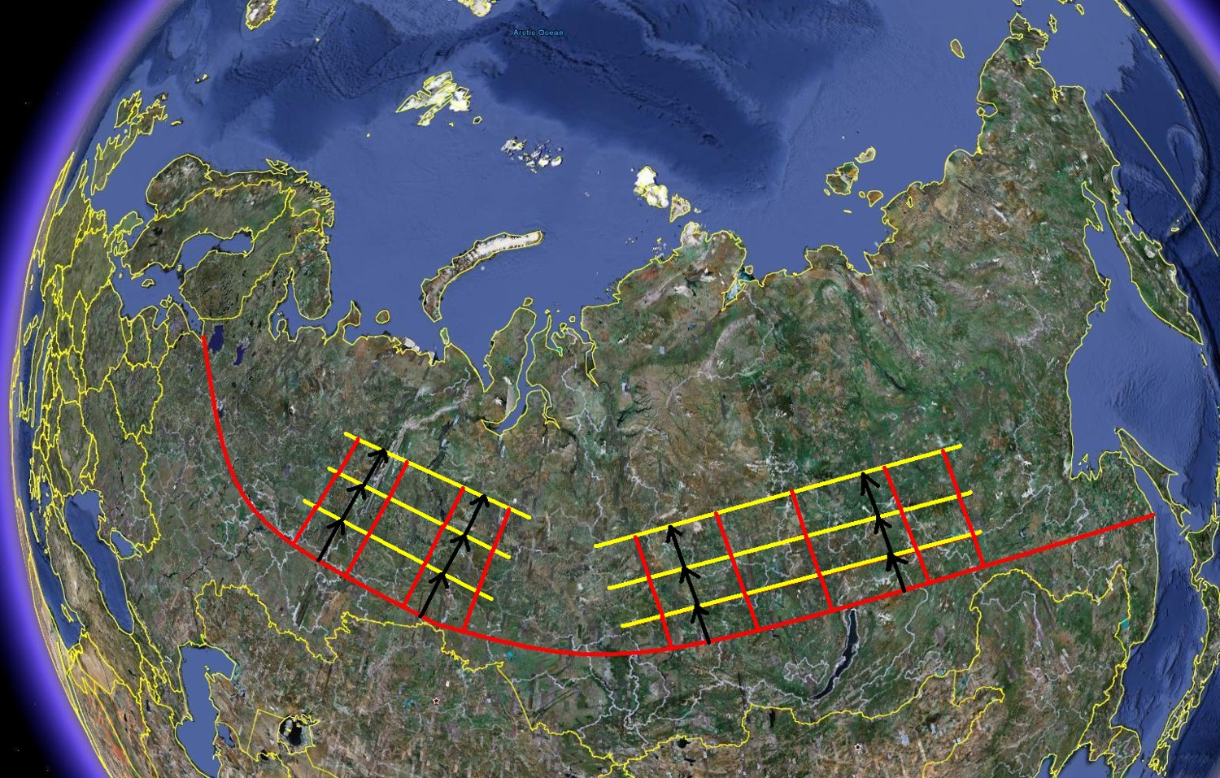
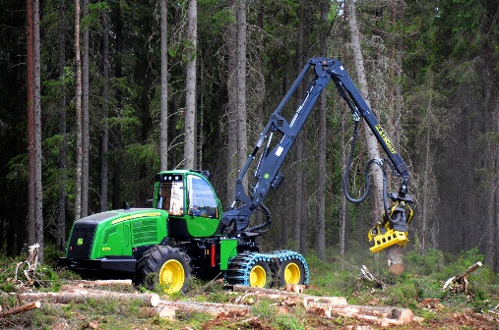
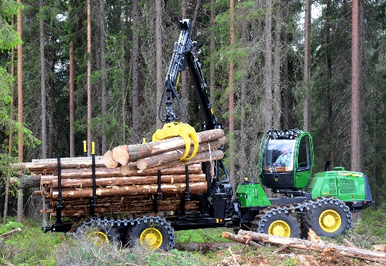
These models should have relevant scales and be possible to integrate in general optimization models with spatial and dynamic dimensions, where not only the ecological problems are in focus but all relevant economical and technical problems are included.

Slide 33
Lohmander (2011c) studies the dynamic forest, forest industry and bioenergy supply chain optimization problem in Sweden.
It is found that considerable sustainable economic gains are possible to obtain via increased utilization of the forest resources.

Slide 34
In Lohmander (2014b), a general model for the global climate, energy and forestry problem is developed and solved.
Several general conclusions are derived that connect optimal forestry decisions to the global warming conditions.

Slide 35
The Lohmander Energy, Forest, Fossil Fuels, CCS and Climate System Optimization Model

Slide 36
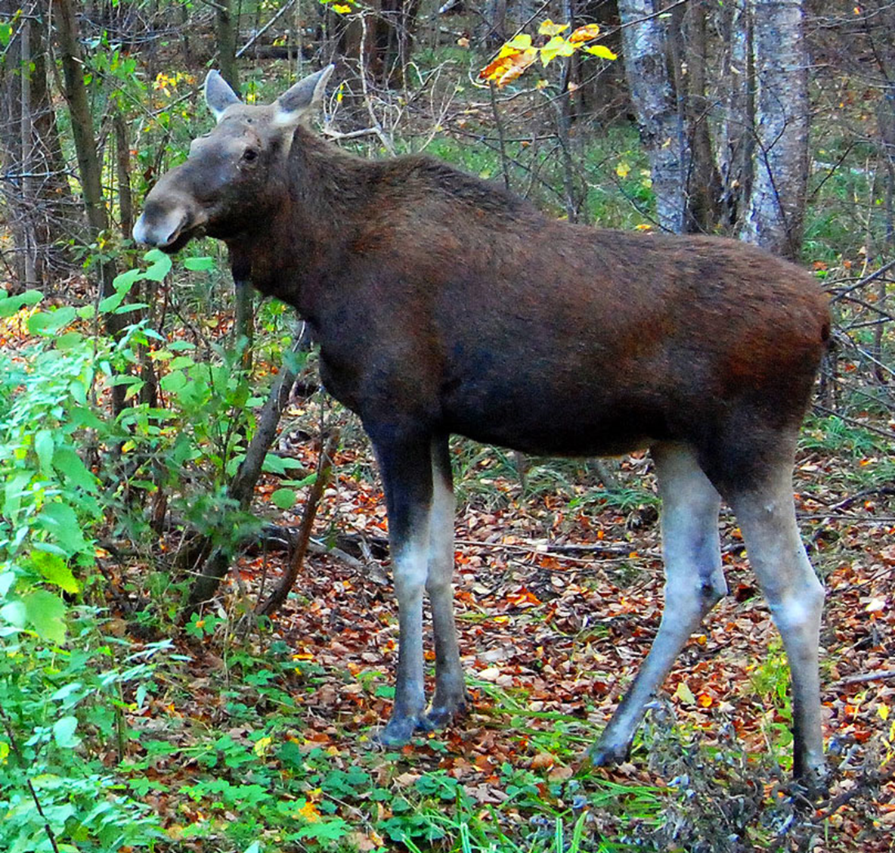
Rational management of hunting and wildlife considering forestry and other effects
Forests do not only contain trees and other plants, but also animals. Sweden has a large moose population, compared to most other parts of the boreal forest region.
This is partly an effect of the rotation forestry system with clear cuts and partly an effect of the very low number of large predators, such as grey wolf, and the Swedish hunting policy. In Sweden, the number of moose hunters is large.

Slide 37
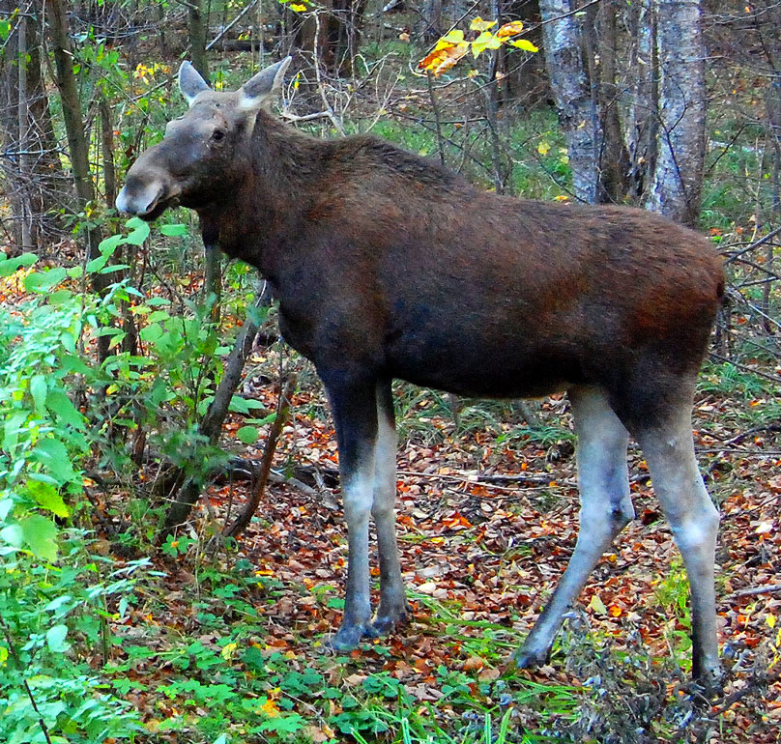

Slide 38
The value of the moose meat is considerable and the value of the hunting recreation is high.
On the other hand, the animals eat young pine trees, which has a negative effect on the economics of forestry.
Furthermore, many severe accidents are caused by moose. They randomly cross roads and are hit by cars, which often leads to killed and injured people and destroyed cars.

Slide 39
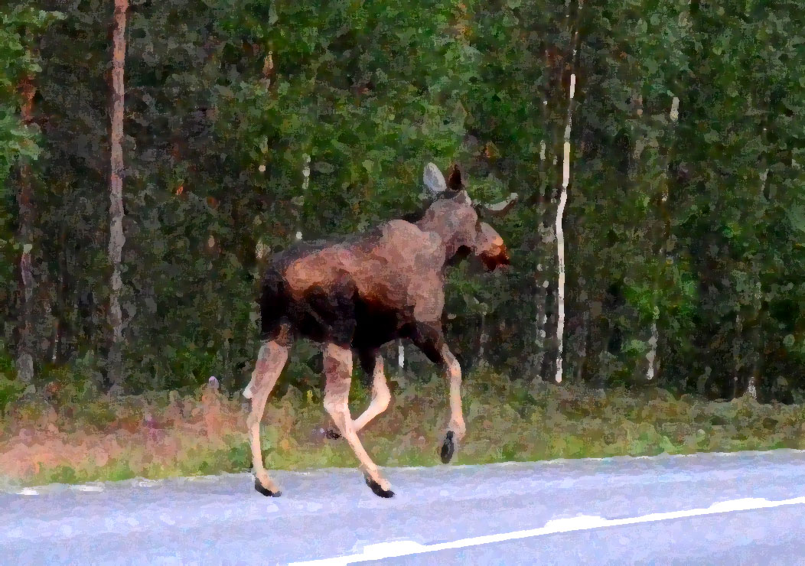

Slide 40
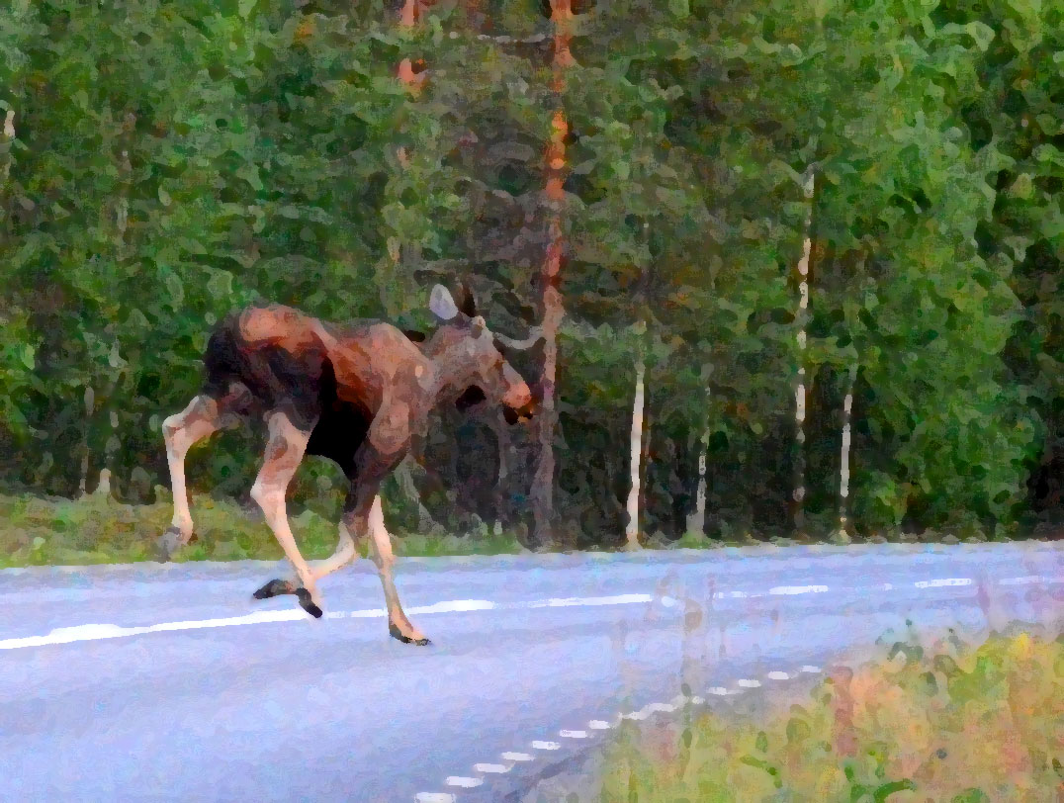

Slide 41
Lohmander (2011a), (2011d), (2017) and Lu and Lohmander (2009), analyze the optimal combination of forestry and moose management decisions.
When all revenues and costs are considered, it is found that the optimal size of the moose population is considerably lower than today.

Slide 42
Furthermore, it is important to adjust forest management decisions to the stochastic moose problems.
Mixed species plantations make it possible to sequentially adjust the species composition to possible moose damages, which increases the expected present value of forestry.
With single species pine plantations, all of the forest may be completely destroyed by moose, since these animals move around randomly and usually prefer to eat pine.

Slide 43
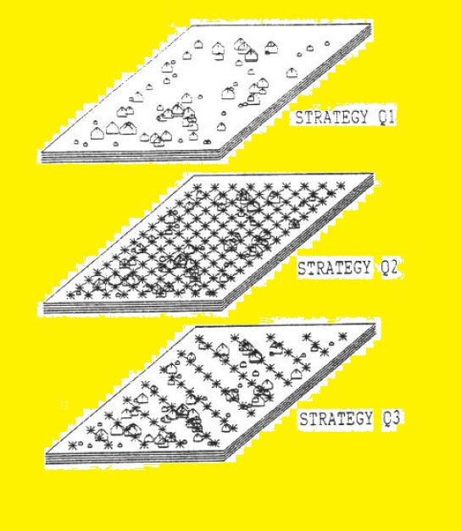

Slide 44
Rational forestry considering market imperfections
It is often assumed that the optimal solutions can easily be calculated in case all market prices and technological options are known.
In Sweden, almost all kinds of information is public and easily available in the form of statistical tables found in the internet.
The large number of statistical tables found at Swedish Forest Agency (2017) illustrates this.

Slide 45
However, all forest sector markets are not perfect markets.
The number of independent pulpwood buyers is very low.
The number of independent forest owners, selling all kinds of wood, is very high.
In such situations, a monopsony can be expected, which leads to pulpwood prices that are much lower than what they would be in a perfect market.
Furthermore, the market price is lower than the marginal value of the pulpwood in the forest industry.

Slide 46
The price of imported pulpwood (Paver) has been much
higher than the price of pulpwood in Sweden (Pswaver)

Slide 47
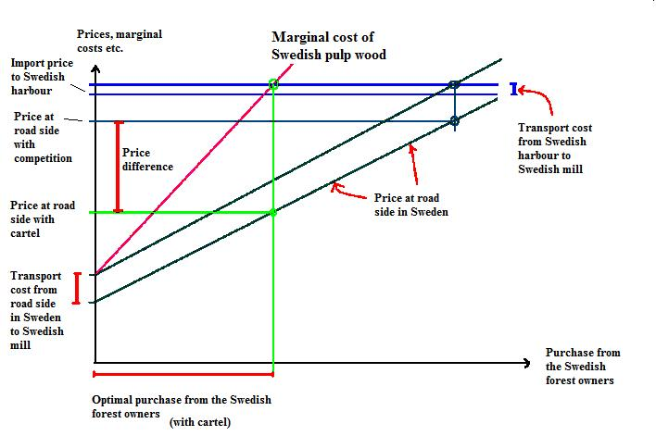

Slide 48
Since the market prices affect the activities in the forest sector, this leads to forest management decisions that do not optimize the total surplus in the economy.
Furthermore, the distribution of the surplus between the actors in the markets is changed and the profitability in forestry is reduced.
An introduction to these issues and very strong empirical evidence, based on public trade statistics, is given by Lohmander (2012).

Slide 49
Conclusions
This paper has introduced the reader to some of the forest management, forest research and forest policy topics that deserve special attention, in particular in Sweden and in several other parts of the boreal forest region.
It is not always easy to obtain the optimal solutions in forestry in complicated situations.
It is necessary that relevant and correct analyses and suitable empirical data are available.
However, it is also necessary that the research results are not neglected and forgotten.
The policy responsible organizations have to take the new scientific findings into account and modify the forest policies in the optimal way.

Slide 50
Acknowledgments
The author is grateful to Associate Professor Soleiman Mohammadi Limaei who arranged several forest excursions and meetings in Iran.
Furthermore, he arranged meetings and cooperation with seriously interested PhD students with detailed forest data from the Caspian forests.

Slide 51
References
Lohmander, P., 2007, Adaptive Optimization of Forest Management in a Stochastic World, in Weintraub A. et al (Editors), Handbook of Operations Research in Natural Resources, Springer, Springer Science, International Series in Operations Research and Management Science, New York, USA, pp 525-544.
Lohmander, P., 2011a, Hur många älgar har vi råd med?, Vi Skogsägare, Debatt, Nr 1.
Lohmander, P., 2011b, KEYNOTE: Economic optimization of sustainable energy systems based on forest resources with consideration of the global warming problem: International perspectives, SSAFR-2011, 14th Symposium for Systems Analysis
in Forestry, Abstracts, Maitencillo, Chile, March 8-11.
http://www.lohmander.com/Chile_2011/Chile_2011_Keynote_Lohmander.ppt

Slide 52
Lohmander, P., 2011c, Economic forest management with consideration of the forest and energy industries, BIT’s 1st World Congress on Bioenergy, Dalian World Expo Center, Dalian, China, April 25-30.
http://www.lohmander.com/ChinaPic11/LohmanderTalk.ppt
Lohmander, P., 2011d, Älgens ekonomi och den ekonomiskt optimala älgstammen, Skogen och Viltet, SLU, Umea, November 24. http://www.lohmander.com/LohmanderSkogenochViltet2011.pdf
Lohmander, P., 2012, Optimal Forest Management in Sweden with Consideration of the Forest and Energy Industries and Pulpwood Cartels, NCSU, North Carolina State University, Operations Research Dept., March 20.
http://www.lohmander.com/PLNCSU120320.pdf

Slide 53
Lohmander, P., 2014a, Ekonomiskt och miljömässigt rationellt hyggesfritt skogsbruk, (Eng) Economically and environmentally rational continuous cover forestry, Falu Gruva, Falun, Sweden, May 8.
http://www.Lohmander.com/PLFalun14m8.pdf
Lohmander, P., 2014b, With expanded bioenergy based on forest resources, we may simultaneously and sustainably reduce global warming, improve economic results, international relations and environmental conditions, BIT’S 4th Annual World Congress of Bioenergy, Qingdao International Convention Center, China.
http://www.Lohmander.com/PLWCBE2014A.pdf
Lohmander, P., 2015, Optimal continuous cover forest management: - Economic and environmental effects and legal considerations, LCES 2015 (& ICE 2015), BIT's 5th Low Carbon Earth Summit, Xi'an, China, September 24-26.
http://www.Lohmander.com/PL_LCES_2015.pdf
http://www.Lohmander.com/PL_LCES_Ap_2015.pdf

Slide 54
Lohmander, P., 2016a, Optimization of adaptive control functions in multidimensional forest management via stochastic simulation and grid search, 9th International Conference of the Iranian Society of Operations Research, IORC 2016, Shiraz University of Technology, Iran, April 27-30.
http://www.Lohmander.com/PL_Shiraz_CCF_16.pdf
http://www.Lohmander.com/PL_Shiraz_CCF_Paper_16.pdf
Lohmander, P., 2016b, Optimal stochastic control of spatially distributed interdependent production units, International Conference on Mathematics and Decision Science, International Center of Optimization and Decision Making & Guangzhou University, Guangzhou, China, September 12-15.
http://www.Lohmander.com/PL_ICODM_2016_CCF.pdf
Lohmander, P., 2017, Optimal stochastic control in continuous time with Wiener processes: - General results and applications to optimal wildlife management, KEYNOTE (forthcoming) at The 10th International Conference of Iranian Operations Research Society, Balbosar-Iran, May 3-5.

Slide 55
Lu, F., Lohmander, P., 2009, Optimal Decisions for Mixed Forests under Risk, Scientia Silvae Sinicae, Vol. 45, No. 11, Nov.
http://www.Lohmander.com/Lu_Lohmander_2009.pdf
Swedish Forest Agency, 2017, Swedish forests, forestry, forest laws and statistics. http://www.skogsstyrelsen.se/en/

Slide 56
Optimal forest management topics in the boreal forest region with special focus on Sweden KEYNOTE Version 170416 Peter Lohmander Professor Dr., Optimal Solutions in cooperation with Linnaeus University www.Lohmander.com & Peter@Lohmander.com

