Slide 1
A general dynamic function for the basal area of individual trees derived from a production theoretically motivated autonomous differential equation Version 170417 Peter Lohmander Professor Dr., Optimal Solutions in cooperation with Linnaeus University www.Lohmander.com & Peter@Lohmander.com

Slide 2
A general dynamic function for the basal area of individual trees derived from a production theoretically motivated autonomous differential equation Peter Lohmander
Abstract
A general dynamic function for the basal area of individual trees has been derived from a production theoretically motivated autonomous differential equation. The differential equation is:
and the general dynamic function is:
Keywords: Dynamic function, differential equation, basal area, forest growth

Slide 3
Introduction
The mathematical methods utilized in this paper are well presented by Braun (1983) and Simmons (1972).
Now, fundamental biological production theory will suggest a relevant differential equation.
We start with a small tree.

Slide 4
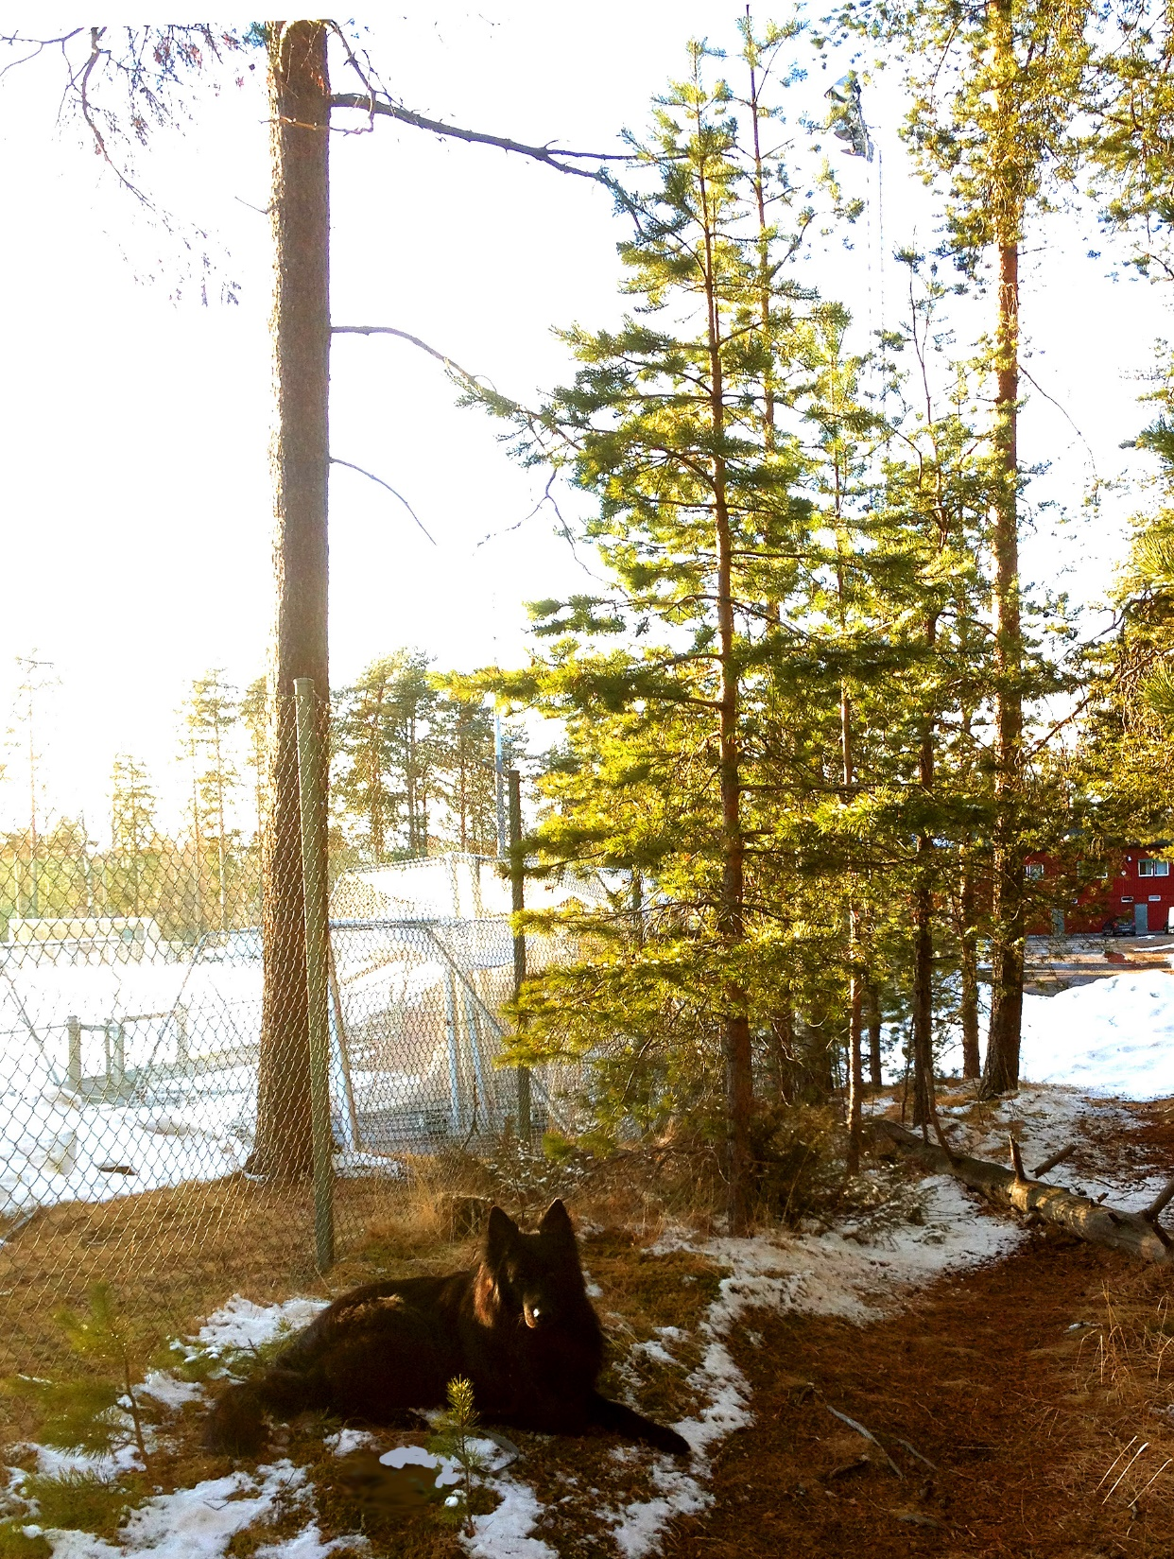
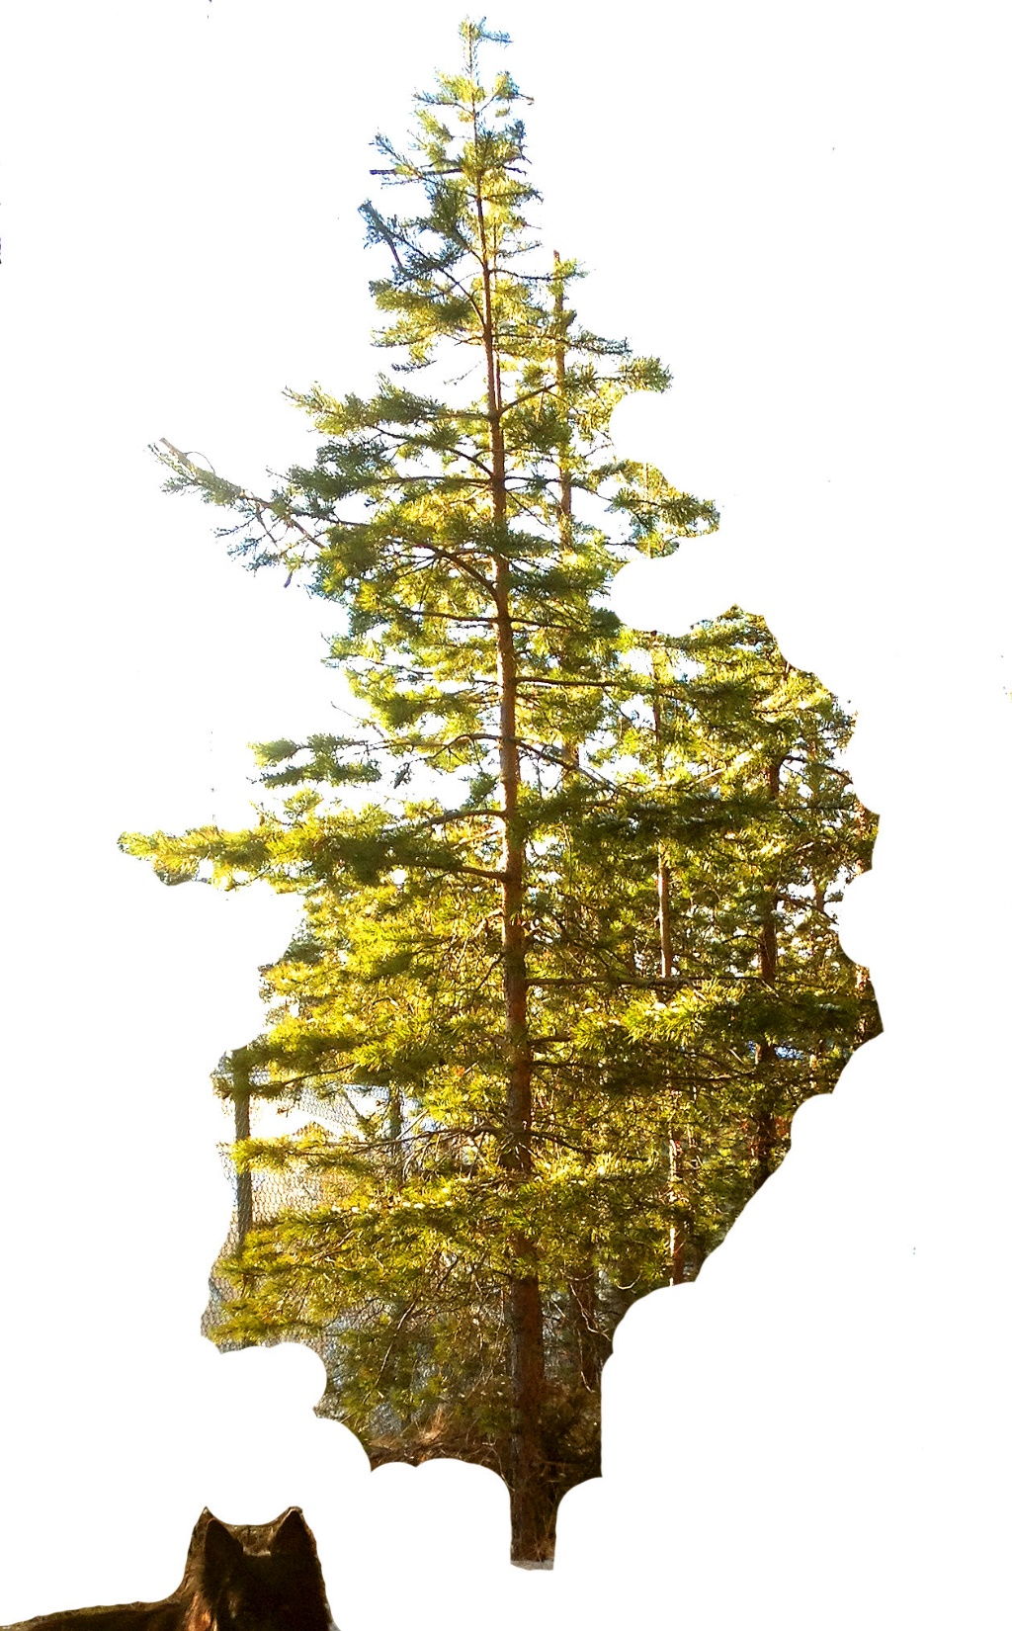
We start with a small tree.

Slide 5
Consider a stem segment, of height
of the tree. The stem segment is cylindrical with diameter
The leaves cover a cylinder with diameter

Slide 6
The sun light reaches the tree from the side.
is the volume of the stem segment.
is the basal area.

Slide 7
Volume increment is proportional to the photo synthesis level,
which in turn is proportional to the sun light projection area on the leaves,

Slide 8
We may conclude that:
Hence,
or

Slide 9
As the size of the tree increases, the production efficiency declines.
Furthermore, the value of
is often lower for large trees than for small trees.
A relevant function considering this is:

Slide 10
An illustration from the real world,
using Scots pine (Pinus silvestris),
from Sweden:

Slide 11
The small tree

Slide 12
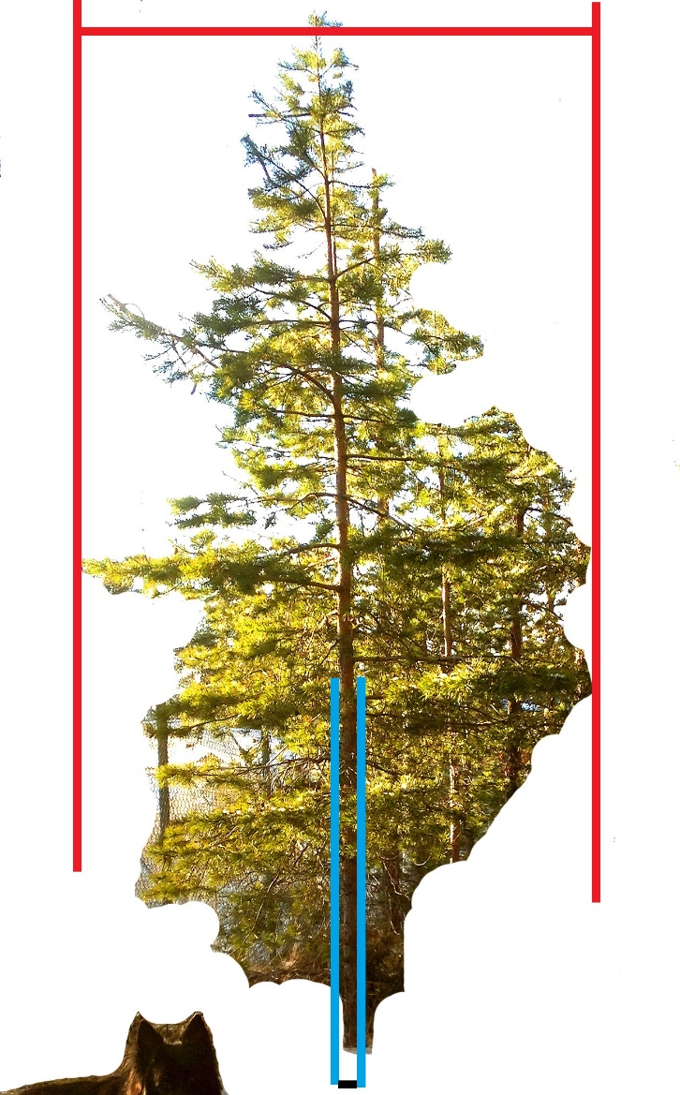
For the small tree:

Slide 13
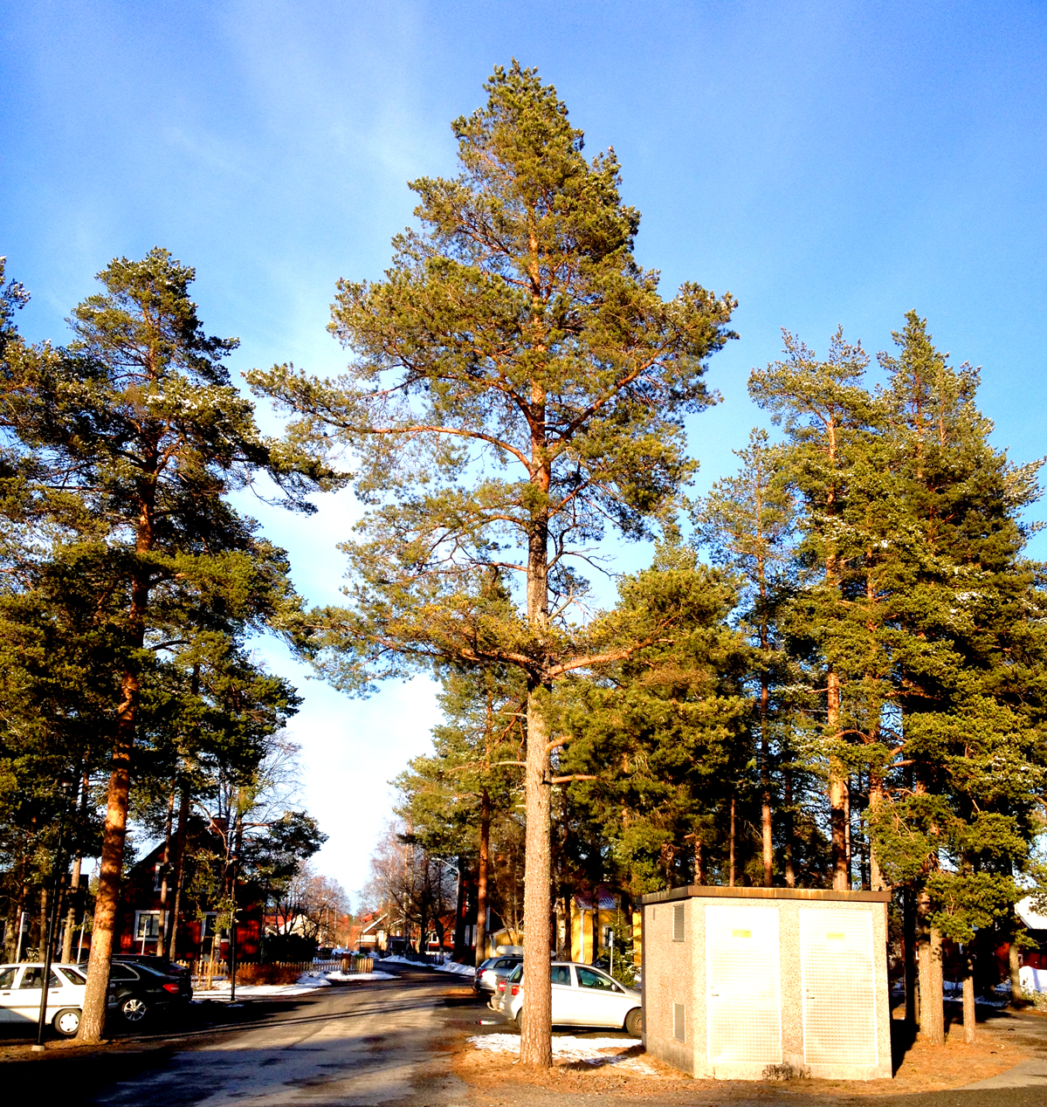
Let us investigate
a large tree.

Slide 14
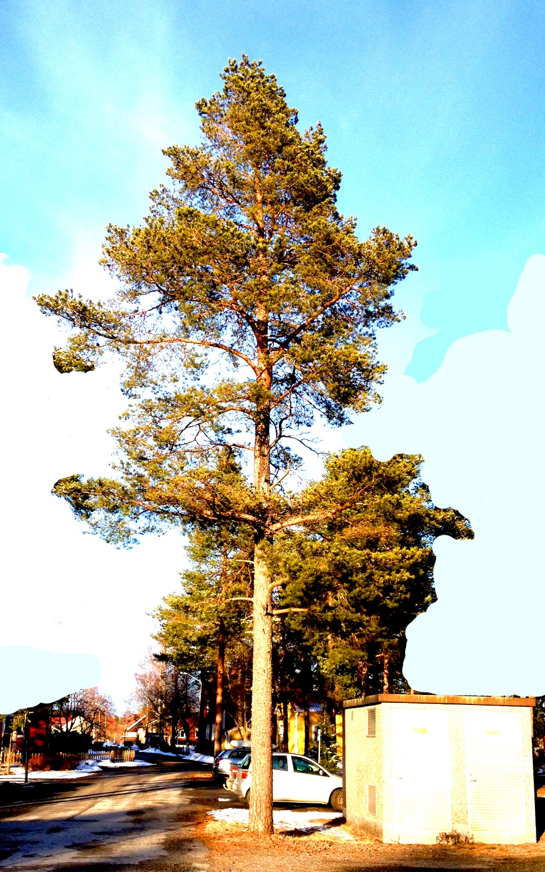
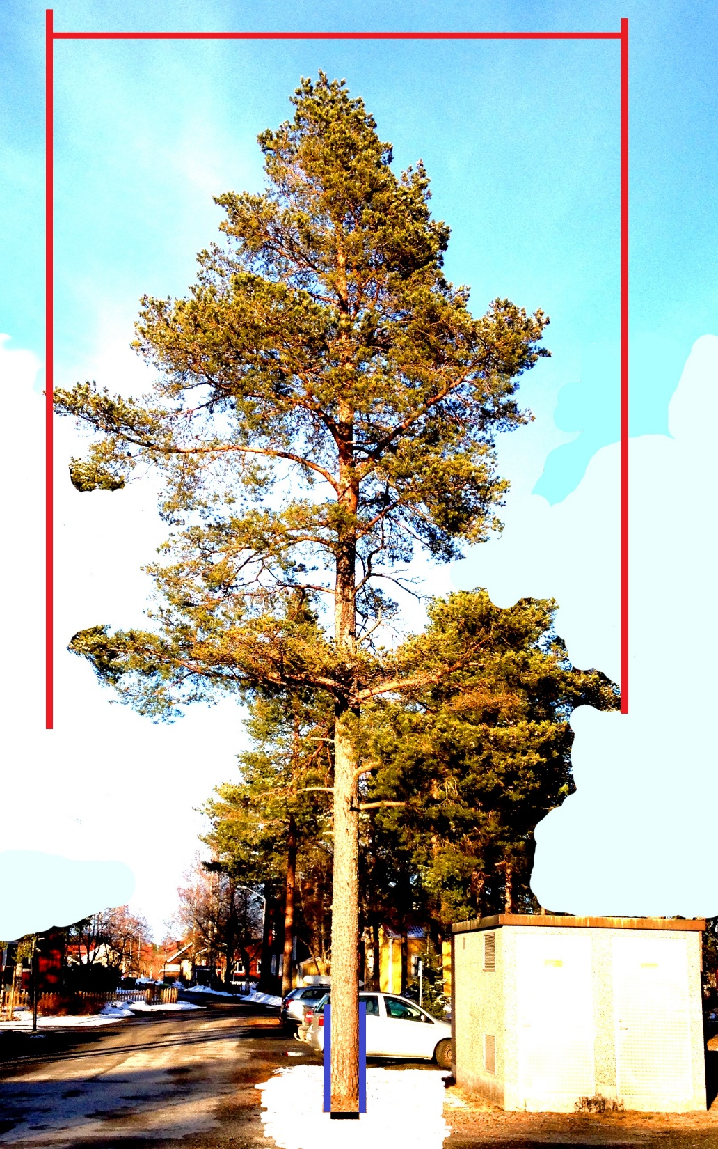

Slide 15
For the large tree:

Slide 16
If
then
is smaller for the large tree than for the small tree (in this case).
A relevant function considering this is:

Slide 17
Mathematical model development and analysis
The parameters can be estimated via this linear reformulation:

Slide 18
Integration gives

Slide 20
Let us investigate the left hand side, called

Slide 21
This confirmes that the integration was correct.

Slide 22
which leads to

Slide 23
Let
Then

Slide 24
Let
We get the simplified expression:
which can be transformed to:
or

Slide 25
which gives the desired equation

Slide 26
Let us determine
We utilize the initial condition:
which leads to
Hence,
and finally

Slide 27
Now, we know how to determine
.
Later, the sign and magnitude of
will be needed in the analysis. Do we know the sign of
?
Let us investigate the sign of

Slide 28
We assume that the value of
makes sure that the increment is strictly positive.
Then, we know that:
As a result, we know that

Slide 29
Do we know the something about
?
With this information, we know that

Slide 30
Now, we may determine
as an explicit function of
and the parameters.

Slide 31
Now, the dynamic properties of
will be determined.

Slide 32
We already know that
. Hence,
As a result, we find that

Slide 33
Hence, we know that, as
monotonically converges to

Slide 34
How does the function work?
Below, parameter values representing the following case are used.
Species: Maple (Acer velutinum)
Initial diameter: 10 cm.
Source: Hatami, Lohmander, Moayeri and Mohammadi Limaei (2017)
Competition: No.

Slide 35
Basal Area (Square Centimeter) as a function of time, t (Years)

Slide 36
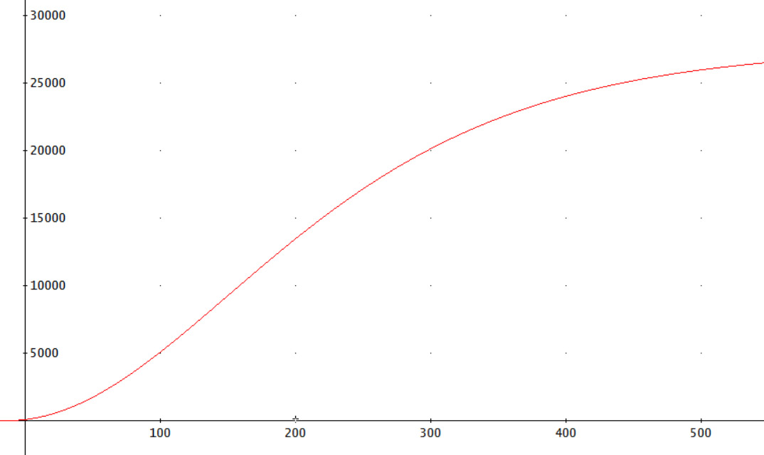
Basal Area (Square Centimeter)
Time (Year)

Slide 37
Diameter (Centimeter) as a function of time, t (Years)

Slide 38
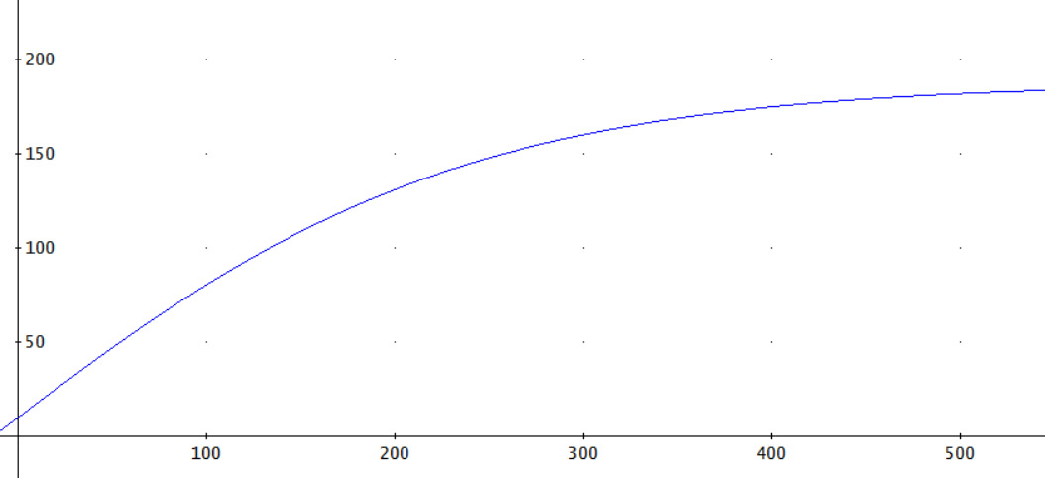
Diameter (Centimeter)
Time (Year)

Slide 39
Results
A general dynamic function for the basal area of individual trees has been derived from a production theoretically motivated autonomous differential equation.
The dynamic properties have been determined and monotone convergence has been proved.

Slide 40
Discussion
The production theoretically motivated autonomous differential equation has recently been tested with regression analysis, using two sets of forest data from the Caspian forests. Detailed reports will soon be available.
The parameters obtained the expected signs and the t-values indicated very high precision.
The adjusted R2-values, the very high F-values and the lack of unexplained trends in the residual graphs, indicated a relevant model.
The functional form has been found to work very well with empirical data from Iran and hopefully it will be possible to test it also on forest data from other regions of the world.

Slide 41
It is possible to use the model also under the influence of some forms of size dependent competition, via adjustments of the parameters
Further developements in this direction should be expected.
Presently, different forest research projects with a strong focus on empirical investigations are active, in Sweden and in Iran. Hopefully, the derived analytical model will be useful in these projects.

Slide 42
Conclusions
Differential equations can be very useful tools in forest management optimization.
It is however important that they have theoretical and empirical support.
Future efforts should be directed towards applications of the suggested and derived function within forest management problems in several regions of the world.

Slide 43
Acknowledgments
The author is grateful to Associate Professor Soleiman Mohammadi Limaei who arranged several forest excursions and meetings in Iran. Furthermore, he arranged meetings and cooperation with seriously interested PhD students with detailed forest data from the Caspian forests.
Thank you!

Slide 44
Acknowledgments
Professor Johan Bergh, at Linnaeus University in Sweden, coordinates a very interesting project on optimal continuous cover forestry and creates a very positive research environment.
Thank you!

Slide 45
A general dynamic function for the basal area of individual trees derived from a production theoretically motivated autonomous differential equation Version 170417 Peter Lohmander Professor Dr., Optimal Solutions in cooperation with Linnaeus University www.Lohmander.com & Peter@Lohmander.com

