Slide 1
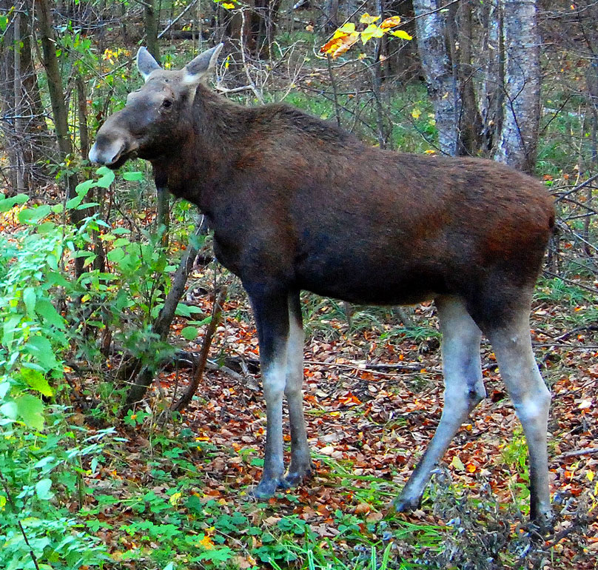
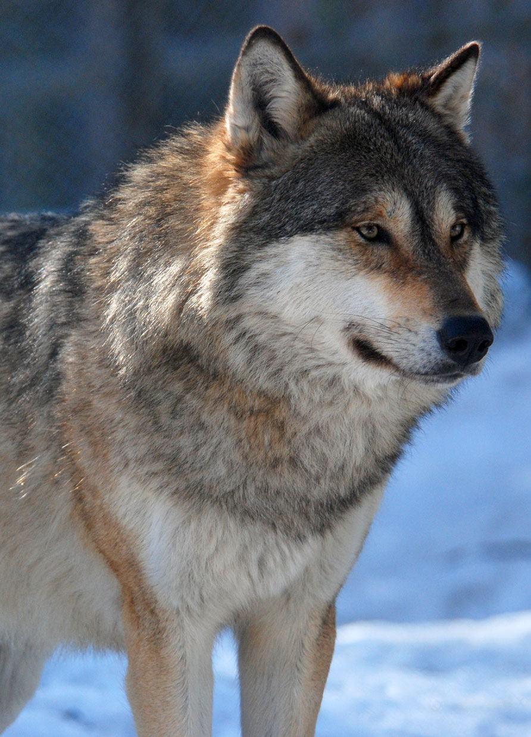

Wildlife Dynamics and Management Optimization via Statistics and Mathematics by
Peter Lohmander
Moose
Fifth International Webinar on
RECENT TRENDS IN STATISTICAL THEORY AND APPLICATIONS-2021 (WSTA-2021)
09:00 PM - 09:35 PM IST, June 30, 2021 (Day 2), TS 21
Organized by
Indian Society for Probability and Statistics (ISPS), Kerala Statistical Association (KSA) & Department of Statistics (School of Physical and Mathematical Sciences) University of Kerala, Trivandrum, India
Wolf
Professor Peter Lohmander
Optimal Solutions
Sweden

Slide 2
This presentation is based on the following three open access articles. More details can be obtained from the links found below.
[1] Lohmander, P., 2017. Optimal Stochastic Control in Continuous Time with Wiener Processes: General Results and Applications to Optimal Wildlife Management, Iranian Journal of Operations Research, Vol. 8, No. 2, 58-67. http://iors.ir/journal/article-1-541-en.pdf
[2] Lohmander, P., 2021. Dynamics, stability and sustainable optimal control in wolf-moose systems, International Robotics & Automation Journal, Volume 7, Issue 1, 2021, 24-33. https://medcraveonline.com/IRATJ/IRATJ-07-00223.pdf
[3] Lohmander, P., 2021. Optimal Adaptive Integer Pulse Control of Stochastic Nonlinear Systems: Application to the Wolf-Moose Predator Prey System, Asian Journal of Statistical Sciences, 1(1), 23-38. http://arfjournals.com/abstract/41816_article_no_3.pdf
Professor Dr Peter Lohmander
Peter@Lohmander.com
http://www.lohmander.com/Information/Ref.htm

Slide 3
Abstract
Wildlife Dynamics and Management Optimization via Statistics and Mathematics
By Peter Lohmander
Three alternative approaches to dynamic optimization of the management of moose populations are presented. First, a Wiener process and stochastic optimal control theory are used to determine an explicit function for the optimal adaptive hunting level, according to the methods described in Lohmander [1]. Then, the dynamical predator- prey system with wolf and moose populations is defined along the lines presented in Lohmander [2]. The dynamics is analyzed via simulation and the analytical solution to the linearized system, close to the system equilibrium. The system is found to be stable, but it converges very slowly. A deterministic steady state control optimization approach is applied to this system. However, the stochastic variations in the moose and wolf populations are considerable. For this reason, the final approach is the following, based on Lohmander [3]. A numerical approach to optimal adaptive integer pulse control of stochastic nonlinear systems is presented. For most stochastic nonlinear systems, optimal adaptive control rules cannot be derived with analytical methods. A robust optimization algorithm is created. The complete nonlinear adaptively controlled stochastic system is simulated during 100 years, for 100 alternative sequences of stochastic disturbances, for every feasible integer combination of adaptive control rules. The optimal adaptive control rules that maximize the expected value of the objective function are selected as the optimal adaptive control rules. The method is very general and can easily be applied to most adaptive nonlinear stochastic control problems, from technology, management or other fields. The method is tested and applied to the wolf-moose predator prey system. The parameters of this stochastic nonlinear dynamical system have recently been estimated from empirical data from Isle Royale in Lake Superior, USA. The objective function is the expected total present value of all hunting net revenues and the environmental value of preserving the wolf population. The value of the wolf population is a strictly increasing and strictly concave function of the population level. Periodically, the region is visited and the population levels are determined. If the population levels, one for each species, exceed the optimal control limits, then the populations are reduced to the control limits, via hunting. Then, the system is left to develop until the next period. Optimal population control limits and objective function values are determined for alternative levels of the wolf population value function. The average optimal moose hunting level is a decreasing function of the wolf population value parameter and an increasing function of the level of risk in the predator prey system. The average optimal wolf population level is an increasing function of the wolf population value parameter and a decreasing function of the level of risk in the predator prey system.

Slide 4
Three alternative approaches to dynamic optimization of the management of moose populations are presented.
First, a Wiener process and stochastic optimal control theory are used to determine an explicit function for the optimal adaptive hunting level, according to the methods described in Lohmander [1].
[1] Lohmander, P., 2017. Optimal Stochastic Control in Continuous Time with Wiener Processes: General Results and Applications to Optimal Wildlife Management, Iranian Journal of Operations Research, Vol. 8, No. 2, 58-67. http://iors.ir/journal/article-1-541-en.pdf

Slide 5
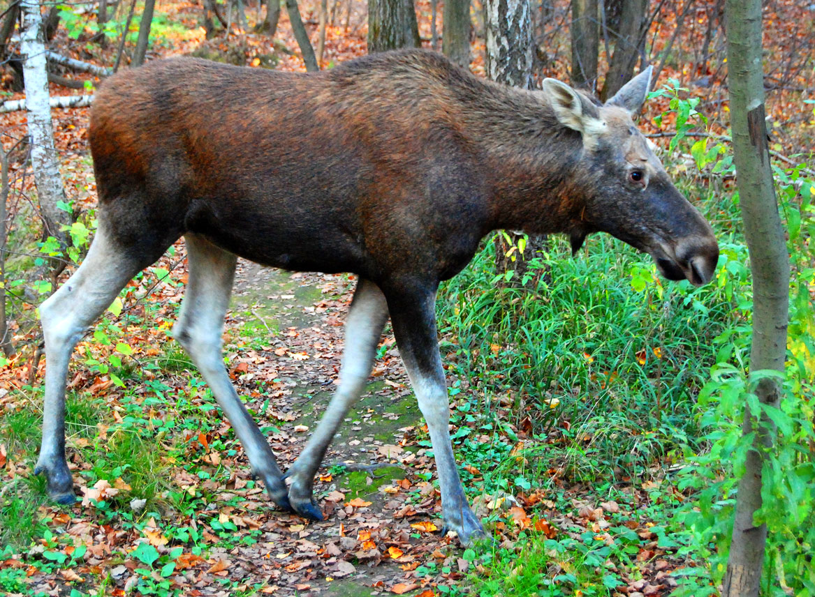
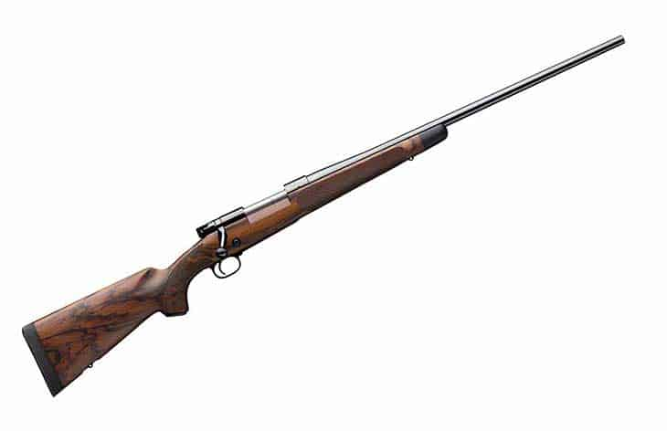
We maximize the objective function:

Slide 14
= 0
= 0
= 0

Slide 19
Then, the dynamical predator- prey system with wolf and moose populations is defined along the lines presented in Lohmander [2].
The dynamics is analyzed via simulation and the analytical solution to the linearized system, close to the system equilibrium.
The system is found to be stable, but it converges very slowly.
A deterministic steady state control optimization approach is applied to this system.
[2] Lohmander, P., 2021. Dynamics, stability and sustainable optimal control in wolf-moose systems, International Robotics & Automation Journal, Volume 7, Issue 1, 2021, pages 24-33. https://medcraveonline.com/IRATJ/IRATJ-07-00223.pdf

Slide 23
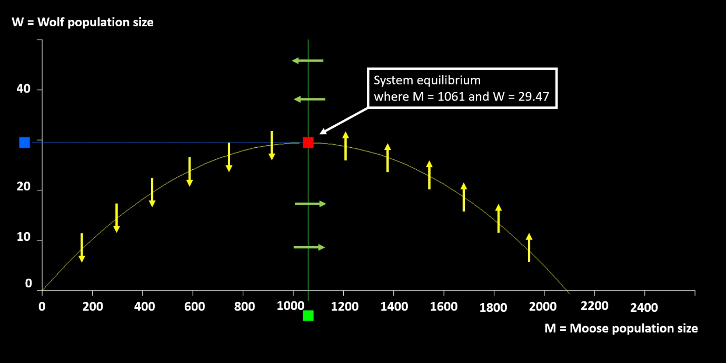

Slide 24
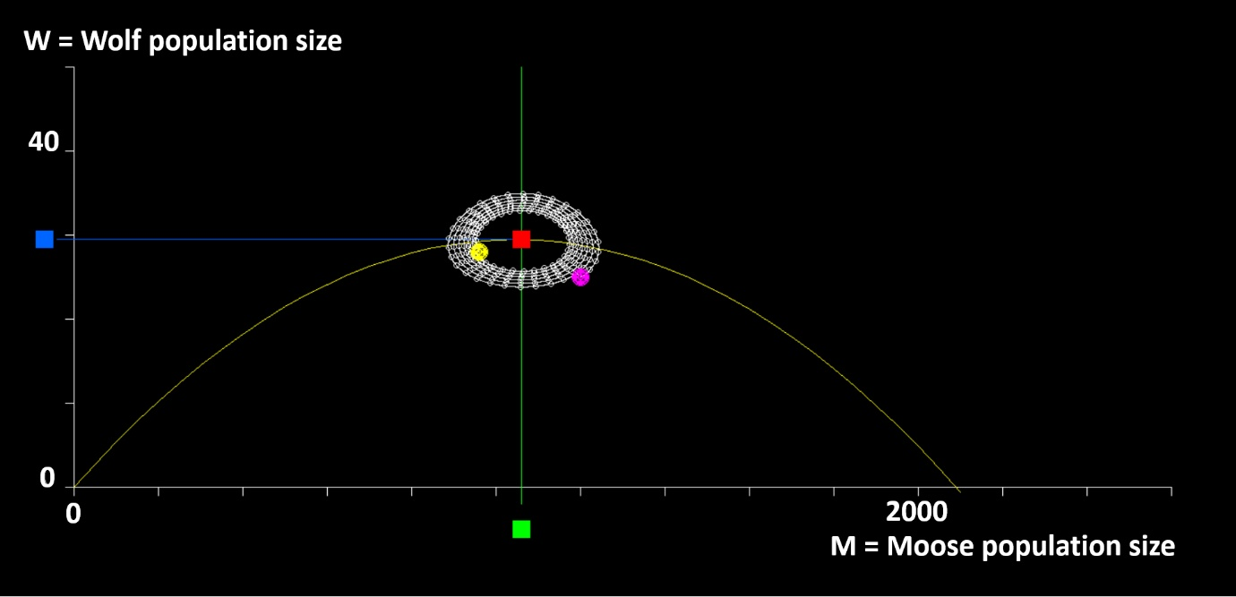

Slide 25
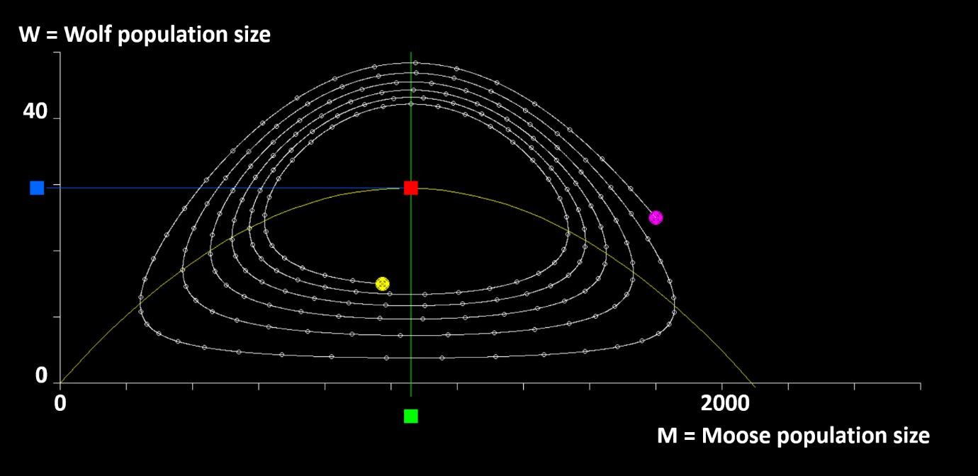

Slide 38
The size of the moose population that maximizes the net moose production per year.

Slide 40
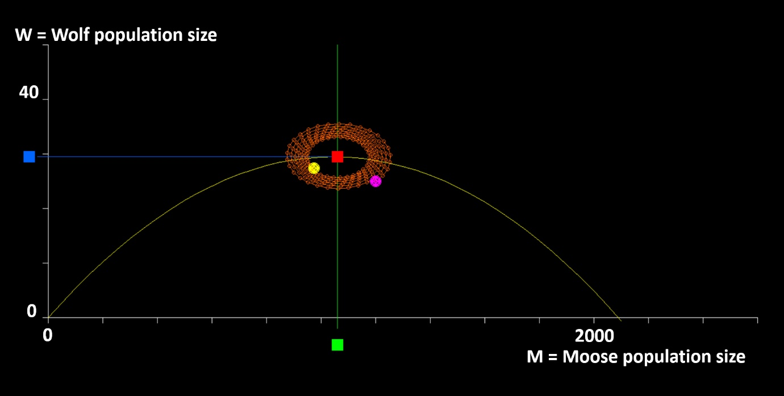

Slide 41
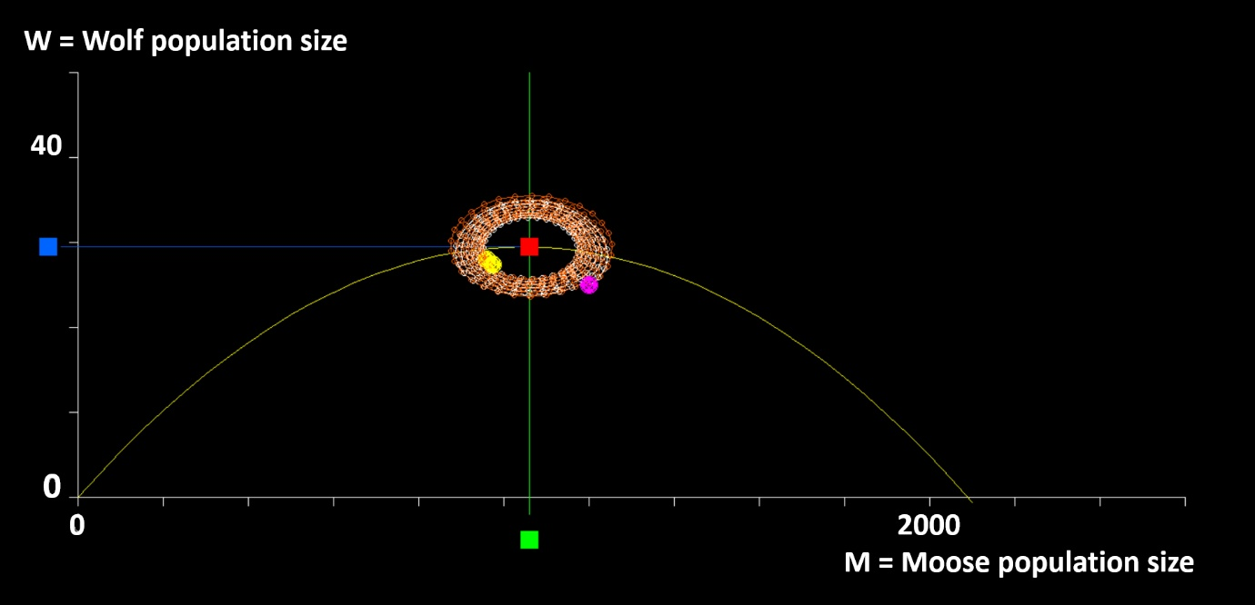

Slide 42
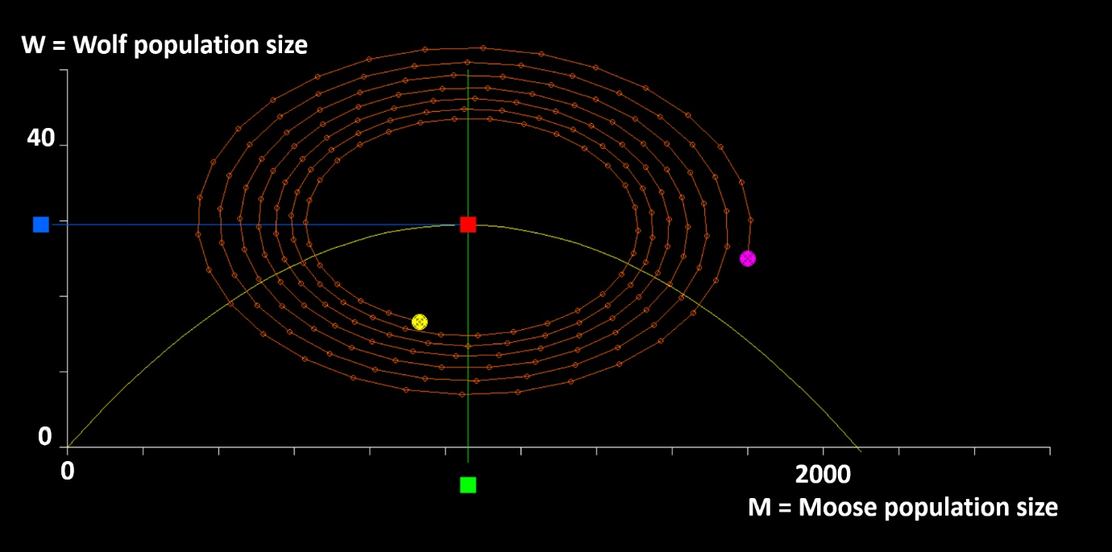

Slide 43
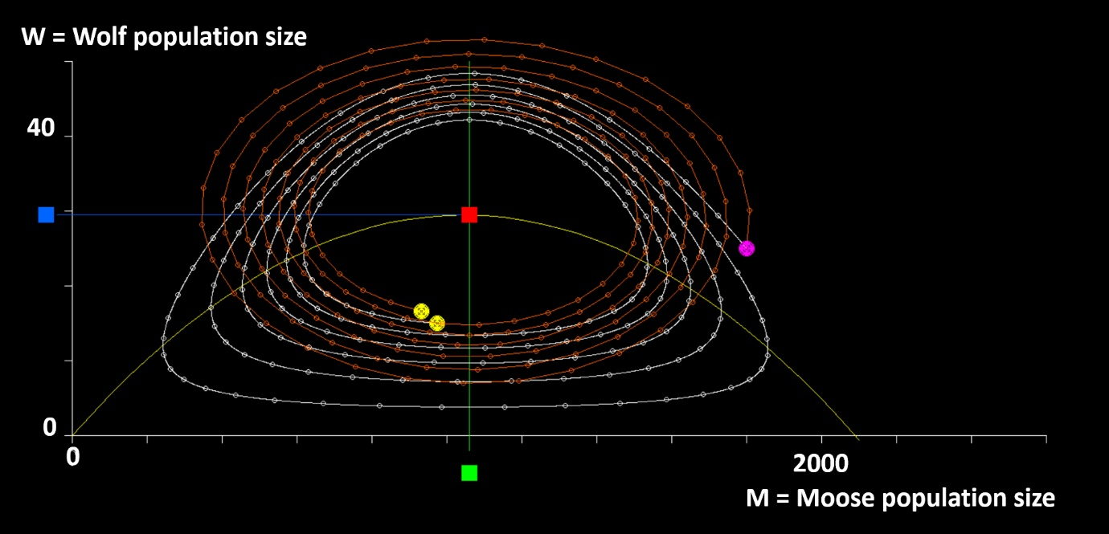

Slide 49


Slide 50
The stochastic variations in the moose and wolf populations are considerable. For this reason, the final approach is the following, based on Lohmander [3].
A numerical approach to optimal adaptive integer pulse control of stochastic nonlinear systems is presented.
For most stochastic nonlinear systems, optimal adaptive control rules cannot be derived with analytical methods.
A robust optimization algorithm is created. The complete nonlinear adaptively controlled stochastic system is simulated during 100 years, for 100 alternative sequences of stochastic disturbances, for every feasible integer combination of adaptive control rules. The optimal adaptive control rules that maximize the expected value of the objective function are selected as the optimal adaptive control rules.
[3] Lohmander, P., 2021. Optimal Adaptive Integer Pulse Control of Stochastic Nonlinear Systems: Application to the Wolf-Moose Predator Prey System, Asian Journal of Statistical Sciences, 1(1), 23-38. http://arfjournals.com/abstract/41816_article_no_3.pdf

Slide 51
The method is very general and can easily be applied to most adaptive nonlinear stochastic control problems, from technology, management or other fields.
The method is tested and applied to the wolf-moose predator prey system. The parameters of this stochastic nonlinear dynamical system have recently been estimated from empirical data from Isle Royale in Lake Superior, USA.
The objective function is the expected total present value of all hunting net revenues and the environmental value of preserving the wolf population.
The value of the wolf population is a strictly increasing and strictly concave function of the population level.

Slide 52
Periodically, the region is visited and the population levels are determined.
If the population levels, one for each species, exceed the optimal control limits, then the populations are reduced to the control limits, via hunting.
Then, the system is left to develop until the next period.

Slide 57
RISK
NO RISK

Slide 58
RISK
NO RISK

Slide 59
RISK
NO RISK

Slide 60
Average
population
level
Optimal control limit

Slide 61
NO RISK

Slide 62
RISK

Slide 63
RISK
NO RISK

Slide 64
NO RISK
RISK

Slide 65
NO RISK
RISK

Slide 66
What we have done:
Optimal population control limits and objective function values are determined for alternative levels of the wolf population value function.
Two, of many, central observations:
The average optimal moose hunting level is a decreasing function of the wolf population value parameter and an increasing function of the level of risk in the predator prey system.
The average optimal wolf population level is an increasing function of the wolf population value parameter and a decreasing function of the level of risk in the predator prey system.

Slide 67
Conclusions
Many different methods can be used to study the dynamics and to optimize the management of wild life populations.
This presentation includes three alternatives.
Please continue the process and try to find the most relevant approach to your particular problems!

Slide 68
Thank you very much for your time and a most interesting conference!
Professor Dr Peter Lohmander
Peter@Lohmander.com
http://www.lohmander.com/Information/Ref.htm

Slide 69
Wildlife Dynamics and Management Optimization via Statistics and Mathematics by
Peter Lohmander
Moose
Fifth International Webinar on
RECENT TRENDS IN STATISTICAL THEORY AND APPLICATIONS-2021 (WSTA-2021)
09:00 PM - 09:35 PM IST, June 30, 2021 (Day 2), TS 21
Organized by
Indian Society for Probability and Statistics (ISPS), Kerala Statistical Association (KSA) & Department of Statistics (School of Physical and Mathematical Sciences) University of Kerala, Trivandrum, India
Wolf
Professor Peter Lohmander
Optimal Solutions
Sweden

