Slide 1
Optimal adaptive stochastic control of large scale energy production under the influence of market risk Version 160316 Peter Lohmander Professor Dr., Optimal Solutions & Linnaeus University, Sweden www.Lohmander.com & Peter@Lohmander.com
Keynote presentation at:
The 9th International Conference of Iranian Operations Research Society
28-30 Apr. 2016, Shiraz, Iran
www.iscconferences.ir/IORC2016 & IORC2016@sutech.ac.ir

Slide 2
Optimal adaptive stochastic control of large scale energy production under the influence of market risk Peter Lohmander Abstract
The global energy market prices may be considered as stochastic processes. These prices may be strongly influenced (partly controlled) by large producers and cartels, since production levels influence the price level. Under such conditions, optimal dynamic production plans have to be optimized using adaptive controls, derived via stochastic control theory and/or stochastic dynamic programming. This paper presents alternative modelling options and a detailed analysis of a sample problem. It is possible to use stochastic dynamic programming as a master problem in combination with detailed multidimensional solutions to production and logistics problems for each state and stage. This can be done in finite time and also in infinite time, via stochastic dynamic programming in Markov chains with linear programming as a solution method. A sample problem is defined as a stochastic dynamic programming problem for optimal adaptive control of energy production under the influence of market risk and energy reserve constraints. General results concerning how the optimal adaptive production decisions and expected resource values are affected by increasing risk in the energy markets are reported. The main results are presented in connection to the present modelling results. General conclusions are presented and suggestions for future research are given.
Keywords: Optimal adaptive control; Stochastic dynamic programming; Market adapted oil production.

Slide 4
Optimal oil extraction

Slide 5
Optimal
domestic
oil logistics

Slide 6
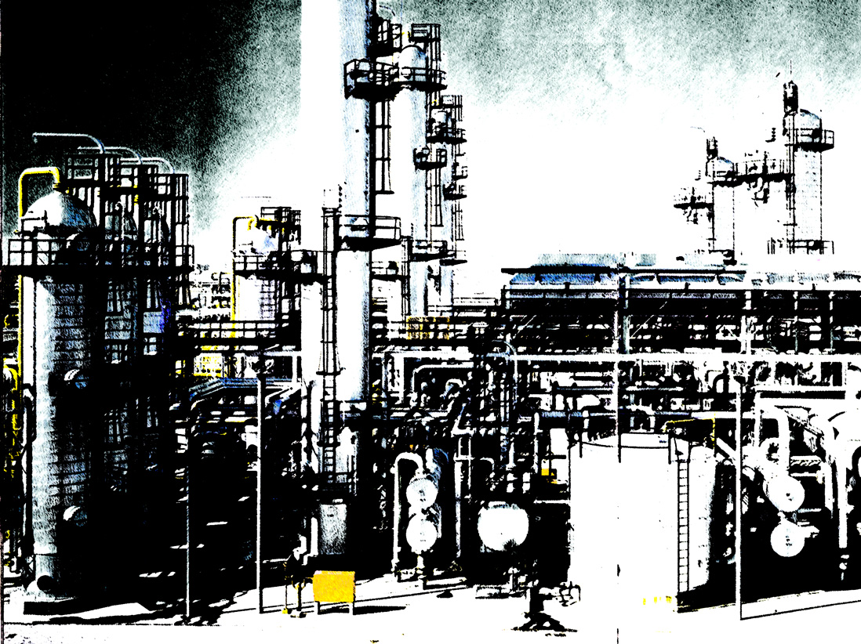
Optimal
oil
refining

Slide 7
Optimal international trade and
oil logistics

Slide 8
Optimal oil industry management

Slide 11
Inclusion of:
Linear and quadratic programming
sub problems
File = PL_OptOil_cases 160219, OptOil Cases, Peter Lohmander 2016-02-19

Slide 12
The global energy market prices may be considered as stochastic processes. Since the stochastic properties of these prices are of fundamental importance to optimal management of energy companies and to the economy in general, we start by investigating them.

Slide 13
Source of oil prices:
(The following graphs will show annual averages.)
https://www.eia.gov/dnav/pet/pet_pri_spt_s1_m.htm

Slide 14
Inflation adjustments via CPI:
http://www.bls.gov/cpi/cpid1601.pdf

Slide 19
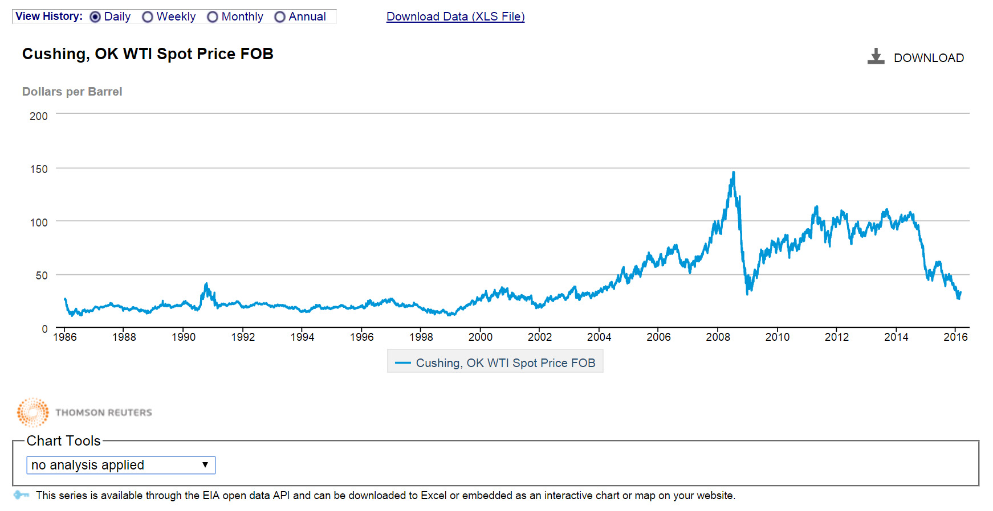
http://www.eia.gov/dnav/pet/hist/LeafHandler.ashx?n=PET&s=RWTC&f=D

Slide 20
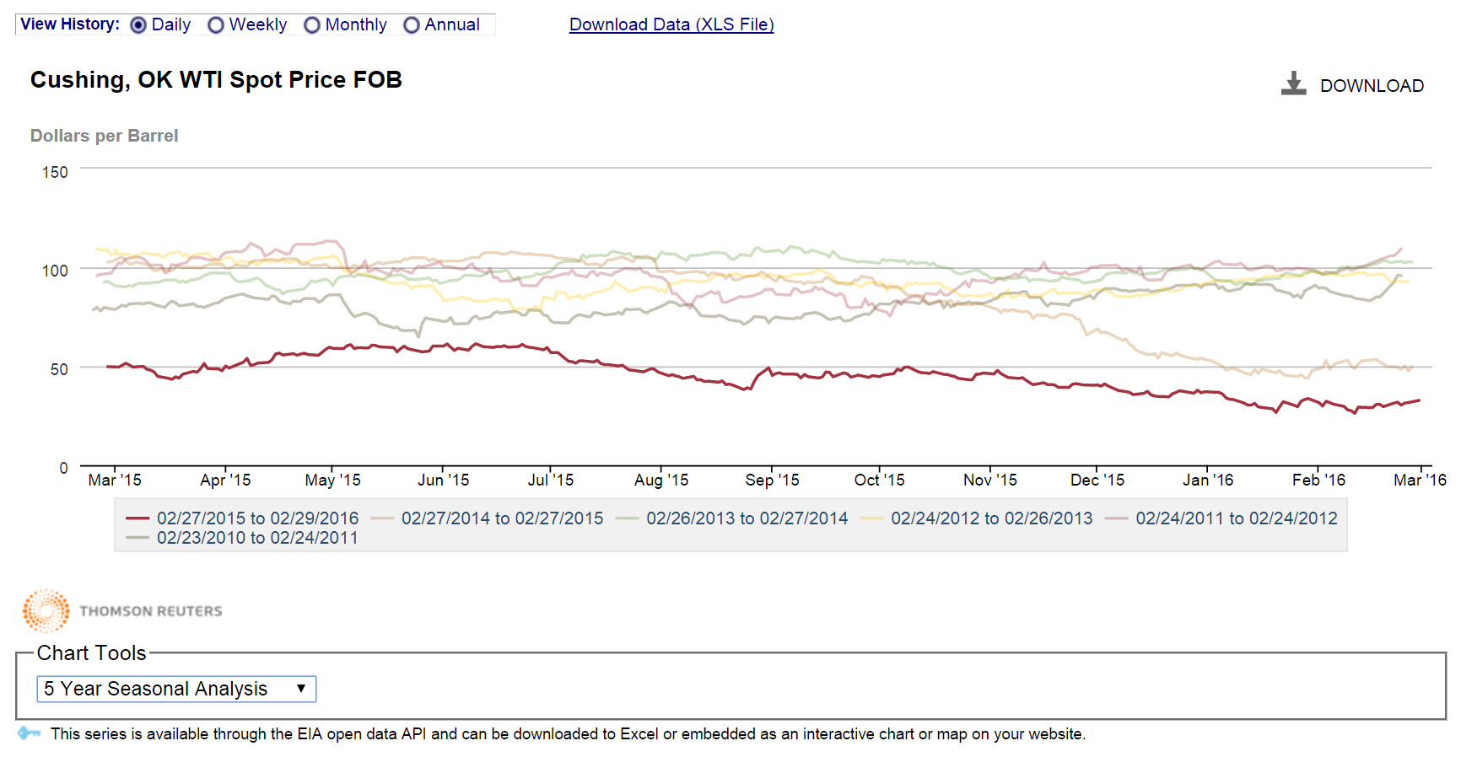

Slide 21
The global energy market prices may be considered as stochastic processes.

Slide 22
What method is used by EIA to calculate the probabilities?
Option prices are used to determine the parameters of a probability density function (and indirectly the probabilities of the oil price to be higher or lower than different limits.)
Of course, one could also use other methods. For instance, one could look at the distribution of errors of price predictions in earlier periods.

Slide 23
On the next pages, some sections are copied from:

Slide 24
Confidence intervals for expected prices can be calculated using a variety of alternative techniques, including estimates based on past price volatility, statistical analysis of past forecast errors, or estimates of parameter uncertainty in an econometric energy price forecasting equation.
Such backward-looking approaches, notwithstanding their merits, cannot reflect changes in current market conditions and expectations that may lead to greater or lesser uncertainty about the future at any given time.
The STEO (Short-Term Energy Outlook) will instead focus on a measure of uncertainty derived from the New York Mercantile Exchange (NYMEX) light sweet crude oil options and natural gas options markets.

Slide 25
EIA will derive confidence intervals around expected futures prices using the “implied volatilities” of these options. Implied volatility is nothing more than a standard deviation for expected returns embedded in the option’s price.
If an option’s price is observed in the market, then a pricing model can be “run backwards” to calculate the volatility embedded in that price. This represents a market-cleared estimate of implied volatility, i.e., a buyer and seller have agreed on the value of an option.

Slide 26
A particular type of random walk is assumed in the B-S-M and Black models, known as a geometric Wiener process.
In such a process, the likelihood of a 1-percent upward move in an asset’s price is equal to the likelihood of a 1-percent downward move over a very small time increment.
The most an asset can lose is 100% of its value (i.e., the price distribution is bounded at zero).
This means returns would be normally distributed, with constant volatility, while absolute prices would be log-normally distributed at the option’s expiry.

Slide 28
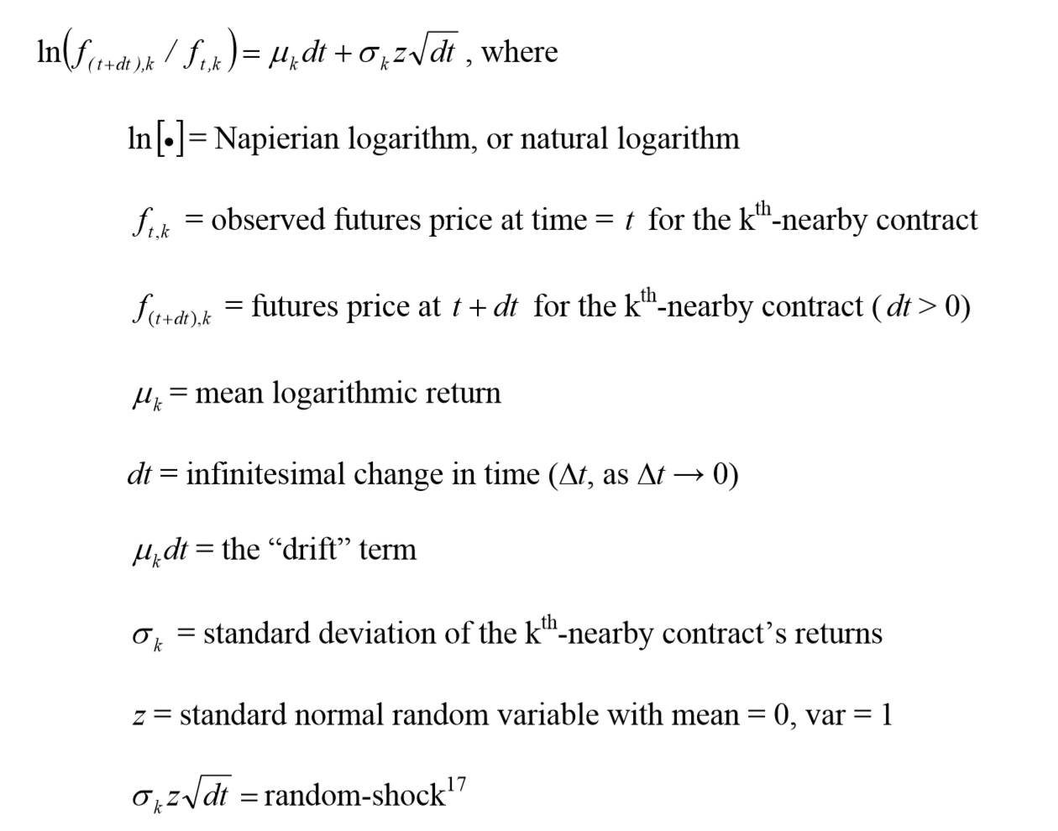

Slide 29
The lognormal assumption for asset prices, which translates into a normal assumption for log returns, has been a source of debate since at least the early 1960s.
Numerous researchers have noted the distribution of daily returns of many assets is leptokurtic, i.e., “fat-tailed” and peaked.

Slide 33
Option theory for uniform probability density functions by Peter Lohmander (Motivated by international prices of crude oil) The parameters of a uniform price probability density function may be derived via European call option prices. The rate of interest in the capital market is r and t is the time until the option expires.
exp(-rt)
Probability density function of the oil price
Option price
= Expected value
of the option
Strike Price
Oil price

Slide 34
Option price = Expected value of the option
We assume a uniform
probability
density function.
Expected price = m.
Maximum deviation,
up or down, is h.

Slide 35
The price of the option is a strictly decreasing
function of the strike price.

Slide 37
The option price is a strictly increasing function of the price
standard deviation, which is a strictly increasing function of h.

Slide 38
Let us derive the value of h (which can give the
standard deviation etc.) from the option price!

Slide 42
h = 4z
h = 4z
h = 0
(wrong)

Slide 43
This formula gives the ”spread parameter” h
of a uniform price probability density function.
m-h = lowest possible price
m+h = highest possible price
y = option price
q = strike price
m = expected price
r = rate of interest
t = time until expiration

Slide 44
https://www.eia.gov/forecasts/steo/uncertainty/pdf/uncertainty_past_wti.pdf
Obs!
The following two graphs are derived via
lognormal price probability density function
assumptions.
Comment by Peter Lohmander

Slide 45
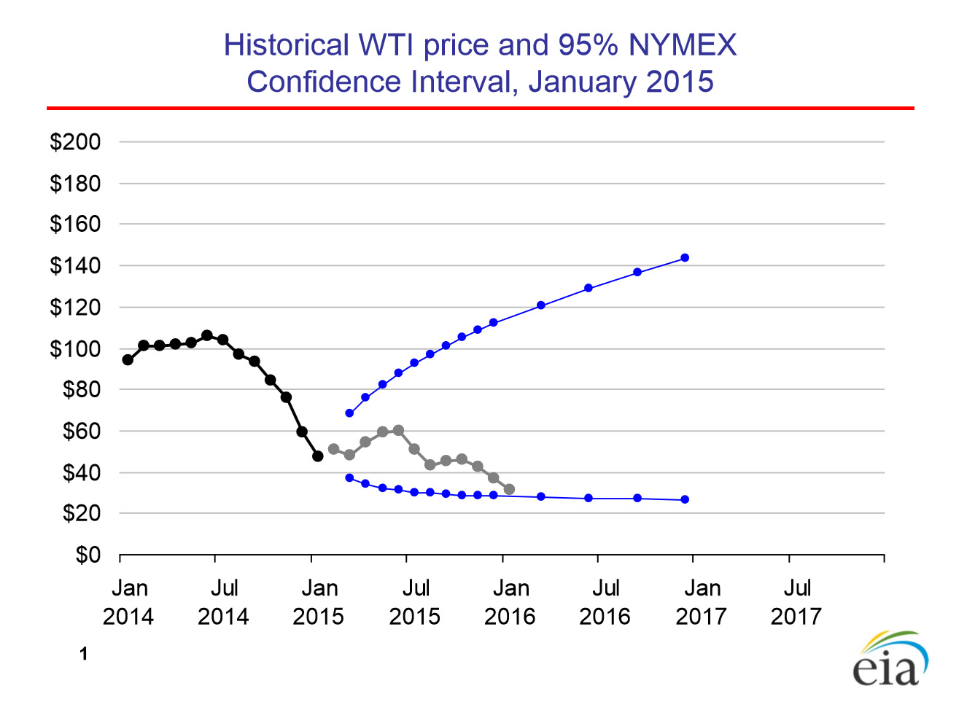

Slide 46
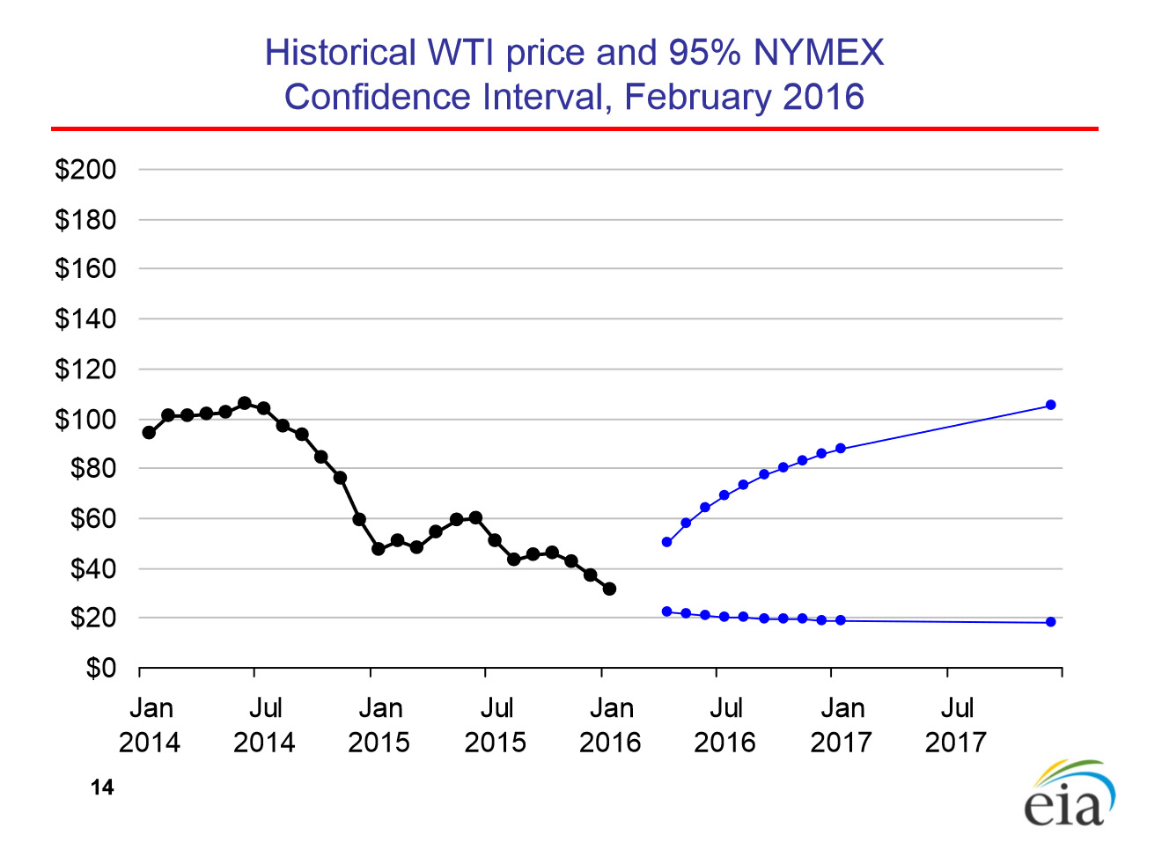

Slide 47
Please note that several alternative interpretations
of the graph on the next slide can be made.
Peter Lohmander

Slide 48
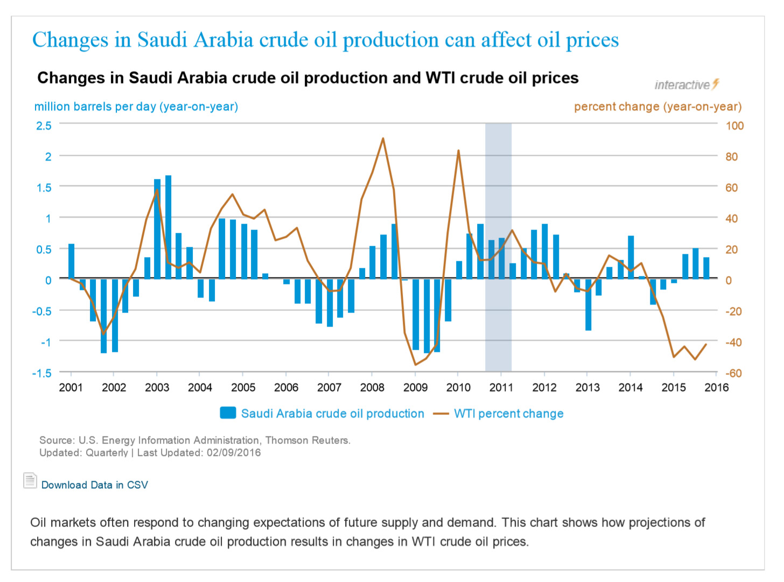
https://www.eia.gov/finance/markets/supply­-opec.cfm

Slide 49
Energy prices may be strongly influenced (partly controlled) by large producers and cartels, since production levels influence the price level.
Under such conditions, optimal dynamic production plans have to be optimized using adaptive controls, derived via stochastic control theory and/or stochastic dynamic programming.
This paper presents alternative modelling options and a detailed analysis of a sample problem.
It is possible to use stochastic dynamic programming as a master problem in combination with detailed multidimensional solutions to production and logistics problems for each state and stage.

Slide 50
This can be done in finite time and also in infinite time, via stochastic dynamic programming in Markov chains with linear programming as a solution method.

Slide 51
A sample problem is defined as a stochastic dynamic programming problem for optimal adaptive control of energy production under the influence of market risk and energy reserve constraints.

Slide 54
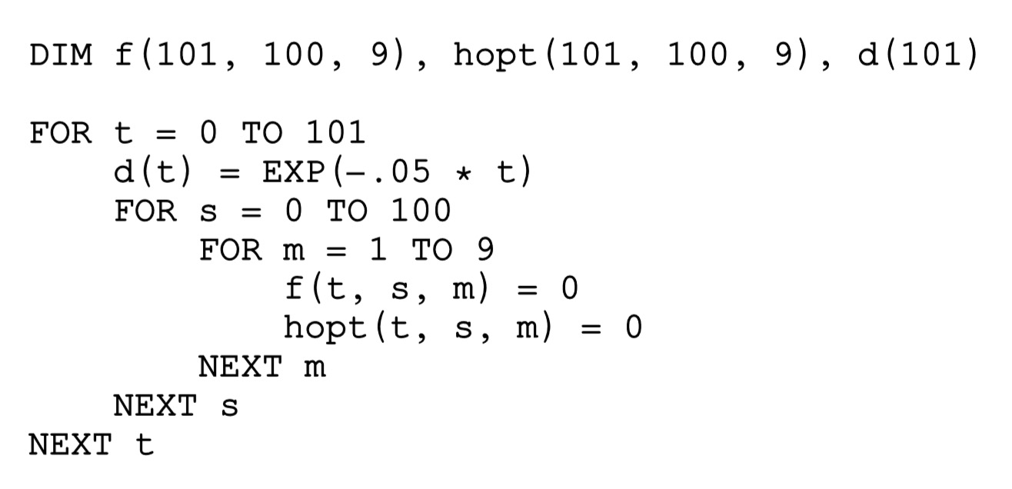

Slide 56
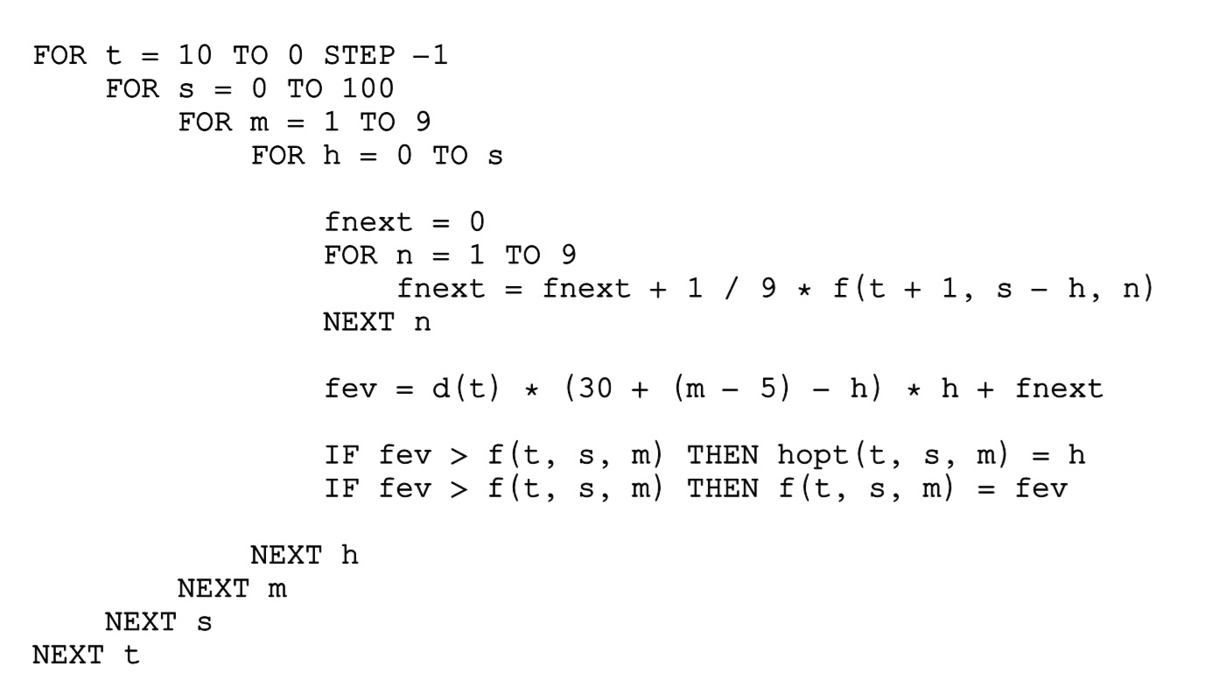

Slide 57
General results concerning how the optimal adaptive production decisions and expected resource values are affected by increasing risk in the energy markets are reported.
The main results are presented in connection to the present modelling results.

Slide 58
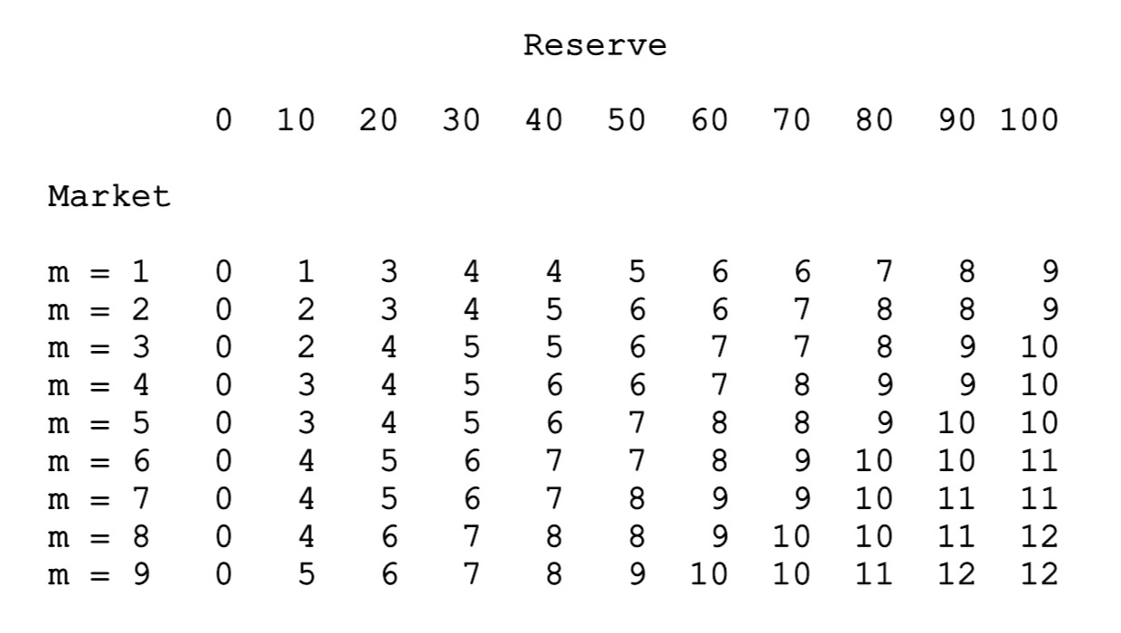
Table 1 – Optimal extraction table for t = 0. We find that the optimal extraction level is an increasing function of the market state and of the size of the remaining reserve.

Slide 59
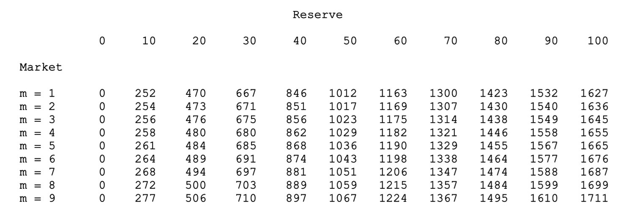
Table 2 – Optimal expected present value table for t = 0. The optimal expected present value is an increasing function of the market state and of the size of the remaining reserve.

Slide 60
Optimal decisions in period 0 and 5:
Table 3 contains similar information as Table 1. However, in Table 3, we have reached period 5.
The general tendencies are the same in period 0 and period 5, but in period 5 we should extract more of the resource than in period 0, in case the market state and the reserve level are the same.
This is understandable, since in period 5, the number of remaining periods is lower.
Hence, the probability that we will be able to sell the resource at a much higher price in the future is reduced.
Furthermore, if we plan to strongly increase extraction in the near future, this will reduce the price level very much.
For these reasons, it is better to extract more of the resource in period 5, even if the prices are not very good and even if we have not a very large remaining resource.

Slide 61
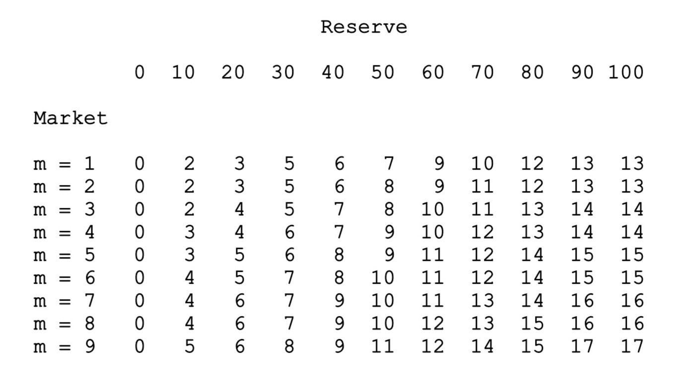
Table 3 – Optimal extraction table for t = 5.

Slide 62
Optimal expected present values in period 0 and 5:
Table 4 corresponds to Table 2, but we have now reached period 5.
The optimal expected present values are still increasing functions of the market state and the size of the remaining reserve, but all values are lower than the corresponding values in period 0.
There are several reasons for this:
Discounting during five years reduces all profits.
Furthermore, since a lower number of periods remain, the number of options to extract during very good market states has decreased.
Finally, the remaining reserve has to be distributed over a lower number of periods, which gives more negative effects on the price level.

Slide 63
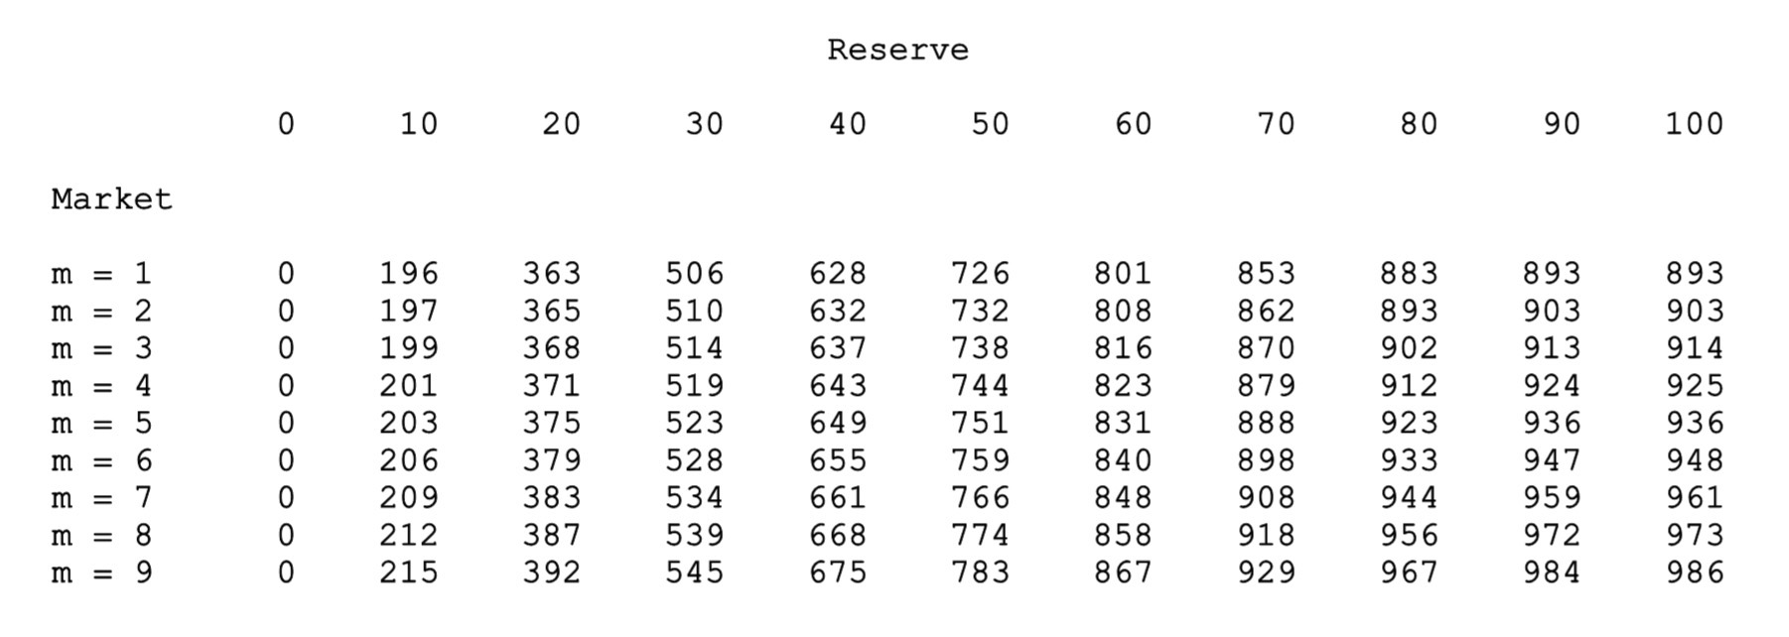
Table 4 – Optimal expected present value table for t = 5.

Slide 64
Optimal oil industry management

Slide 65
Inclusion of:
Linear and quadratic programming
sub problems
File = PL_OptOil_cases 160219, OptOil Cases, Peter Lohmander 2016-02-19

Slide 66
! OptOil 160219
Peter Lohmander ;
model:
sets:
time/1..7/: year,d;
stock/1..11/:;
market/1..9/:;
sm(stock, market):;
tsm(time, stock, market): f, hopt, prof;
endsets
submodel initial:
@for(time(t): year(t)=t-1;
d(t)=@exp(-.05*(t-1))
);
@for(tsm(t,s,m):
f(t,s,m) = 0;
hopt(t,s,m)=0;
prof(t,s,m)=0;
);
endsubmodel

Slide 67
submodel loc1:
max = locobj;
locobj = dloc*p*h + fnext;
h = hloc;
p = 30+(mloc-5)-h;
endsubmodel
submodel loc2:
max = locobj;
locobj = dloc*(p1*x1 + p2*x2) + fnext;
x1+x2 <= hloc;
x1 <= 2;
x2 <= 1;
p1 = 30+(mloc-5)-x1;
p2 = 26-0.5*x2;
endsubmodel

Slide 68
calc:
@set( 'TERSEO', 2);
@solve(initial);
TMAX = 7;
tloc = TMAX;
@while(tloc #GE#2:
tloc = tloc-1;
@write(@newline(1));
@for(stock(s):
hmax = s-1;
@for(market(m):
m1 = m;
h=-1;
@while(h #LT# hmax:
h = h+1;
fnext = 0;
m2 = 0;
@while(m2 #LT# 9:
m2 = m2 + 1;
fnext = fnext + 1/9*f(tloc+1, s-h, m2);
);
hloc = h;
mloc = m;
dloc = d(tloc);
@solve(loc2);
@ifc(locobj #GT# f(tloc,s,m):
f(tloc,s,m) = locobj;
hopt(tloc,s,m) = hloc);
);
);
);
);
The MAIN STDP LOOP
Since the format of this section is very small,
the next pages include the details in large format.

Slide 69
calc:
@set( 'TERSEO', 2);
@solve(initial);
TMAX = 7;
tloc = TMAX;
@while(tloc #GE#2:
tloc = tloc-1;
@write(@newline(1));
@for(stock(s):
hmax = s-1;

Slide 70
@for(market(m):
m1 = m;
h=-1;
@while(h #LT# hmax:
h = h+1;

Slide 71
fnext = 0;
m2 = 0;
@while(m2 #LT# 9:
m2 = m2 + 1;
fnext = fnext + 1/9*f(tloc+1, s-h, m2);
);

Slide 72
hloc = h;
mloc = m;
dloc = d(tloc);
@solve(loc2);
@ifc(locobj #GT# f(tloc,s,m):
f(tloc,s,m) = locobj;
hopt(tloc,s,m) = hloc);
);
);
);
);

Slide 73
@write (@NEWLINE(1));
@write ( 'OptOil by Peter Lohmander 2016-02-19', @Newline(1));
@write ( @newline(2),'Optimal expected present values', @Newline(2));
@for(time(t2):
@write ( @newline(1), 'Year = ', year(t2), @Newline(1));
@write ('Reserve = ');
@writefor(stock(s):@format(s-1, '5.0f'));
@write(@newline(2));
@for(market(m):
@write('Market = ', @format(m, '3.0f'));
@write(' ');
@writefor(stock(s): @format(f(t2,s,m), '5.0f'));
@write(@newline(1));
);
@write(@newline(1));
);

Slide 74
@write ( @newline(2),'Optimal extraction levels', @Newline(2));
@for(time(t2):
@write (@newline(1), 'Year = ', year(t2), @Newline(1));
@write ('Reserve = ');
@writefor(stock(s):@format(s-1, '5.0f'));
@write(@newline(2));
@for(market(m):
@write('Market = ', @format(m, '3.0f'));
@write(' ');
@writefor(stock(s): @format(hopt(t2,s,m), '5.0f'));
@write(@newline(1));
);
@write(@newline(1));
);
endcalc

Slide 75
CASE 1.
Price is stochastic and exogenous.
p = 30+(m-5)
p is not affected by the production level.
There is only one product: Crude oil.
There are no production constraints.
Optimal decisions:
If the price is above the "reservation price", you instantly extract everything.
In the final period, you extract everything, irrespective of the price level.

Slide 76
Optimal extraction levels
Year = 0
Reserve = 0 1 2 3 4 5 6 7 8 9 10
Market = 1 0 0 0 0 0 0 0 0 0 0 0
Market = 2 0 0 0 0 0 0 0 0 0 0 0
Market = 3 0 0 0 0 0 0 0 0 0 0 0
Market = 4 0 0 0 0 0 0 0 0 0 0 0
Market = 5 0 1 2 3 4 5 6 7 8 9 10
Market = 6 0 1 2 3 4 5 6 7 8 9 10
Market = 7 0 1 2 3 4 5 6 7 8 9 10
Market = 8 0 1 2 3 4 5 6 7 8 9 10
Market = 9 0 1 2 3 4 5 6 7 8 9 10

Slide 77
Year = 5
Reserve = 0 1 2 3 4 5 6 7 8 9 10
Market = 1 0 1 2 3 4 5 6 7 8 9 10
Market = 2 0 1 2 3 4 5 6 7 8 9 10
Market = 3 0 1 2 3 4 5 6 7 8 9 10
Market = 4 0 1 2 3 4 5 6 7 8 9 10
Market = 5 0 1 2 3 4 5 6 7 8 9 10
Market = 6 0 1 2 3 4 5 6 7 8 9 10
Market = 7 0 1 2 3 4 5 6 7 8 9 10
Market = 8 0 1 2 3 4 5 6 7 8 9 10
Market = 9 0 1 2 3 4 5 6 7 8 9 10

Slide 78
Optimal expected present values
Year = 0
Reserve = 0 1 2 3 4 5 6 7 8 9 10
Market = 1 0 29 59 88 117 146 176 205 234 263 293
Market = 2 0 29 59 88 117 146 176 205 234 263 293
Market = 3 0 29 59 88 117 146 176 205 234 263 293
Market = 4 0 29 59 88 117 146 176 205 234 263 293
Market = 5 0 30 60 90 120 150 180 210 240 270 300
Market = 6 0 31 62 93 124 155 186 217 248 279 310
Market = 7 0 32 64 96 128 160 192 224 256 288 320
Market = 8 0 33 66 99 132 165 198 231 264 297 330
Market = 9 0 34 68 102 136 170 204 238 272 306 340

Slide 79
CASE 2.
Price is stochastic and partly endogenous.
p = 30+(m-5)-h
There is only one product: Crude oil.
There are no production constraints.
Optimal decisions:
The optimal extraction level is an increasing function of the state of the market and of the size of the remaining reserve.
In the final period, you extract everything, irrespective of the price level.

Slide 80
Optimal extraction levels
Year = 0
Reserve = 0 1 2 3 4 5 6 7 8 9 10
Market = 1 0 0 0 0 0 1 1 1 1 1 2
Market = 2 0 0 0 0 1 1 1 1 2 2 2
Market = 3 0 0 0 1 1 1 2 2 2 2 2
Market = 4 0 0 1 1 1 2 2 2 2 3 3
Market = 5 0 1 1 1 2 2 2 3 3 3 3
Market = 6 0 1 1 2 2 2 3 3 3 3 4
Market = 7 0 1 2 2 2 3 3 3 4 4 4
Market = 8 0 1 2 2 3 3 3 4 4 4 4
Market = 9 0 1 2 3 3 3 4 4 4 5 5

Slide 81
Optimal expected present values
Year = 0
Reserve = 0 1 2 3 4 5 6 7 8 9 10
Market = 1 0 28 55 81 107 132 157 181 205 228 251
Market = 2 0 28 55 81 107 133 158 182 206 230 253
Market = 3 0 28 55 82 108 134 159 184 208 232 255
Market = 4 0 28 56 83 109 135 161 186 210 234 258
Market = 5 0 29 57 84 111 137 163 188 213 237 261
Market = 6 0 30 58 86 113 139 165 191 216 240 264
Market = 7 0 31 60 88 115 142 168 194 219 244 268
Market = 8 0 32 62 90 118 145 171 197 223 248 272
Market = 9 0 33 64 93 121 148 175 201 227 252 277

Slide 82
CASE 3.
submodel loc2:
max = locobj;
locobj = d*(p1*x1 + p2*x2) + fnext;
x1+x2 <= h;
p1 = 30+(m-5)-x1;
p2 = 26-0.0*x2;
endsubmodel
There are two products, x1 (Crude oil) and x2 (refined).
p1 is highly dependent on the stochastic market and very volume sensitive.
p2 is constant and insensitive to production volume.
There are no capacity limitations.

Slide 83
Optimal decisions (in Case 3):
If the remaining reserve level is very high, you should extract large quantitites and produce large volumes of x2.
If the remaining reserve level is low, you should use most of it for x1, waiting for good levels of p1.
In the final period, you extract everything, irrespective of price.

Slide 84
Optimal extraction levels
Year = 0
Reserve = 0 1 2 3 4 5 6 7 8 9 10
Market = 1 0 0 0 0 1 2 3 4 5 6 7
Market = 2 0 0 0 1 1 2 3 4 5 6 7
Market = 3 0 0 0 1 1 2 3 4 5 6 7
Market = 4 0 0 1 1 2 2 3 4 5 6 7
Market = 5 0 1 1 1 2 2 3 4 5 6 7
Market = 6 0 1 1 2 2 3 3 4 5 6 7
Market = 7 0 1 2 2 2 3 3 4 5 6 7
Market = 8 0 1 2 2 3 3 4 4 5 6 7
Market = 9 0 1 2 3 3 3 4 4 5 6 7

Slide 85
Optimal expected present values
Year = 0
Reserve = 0 1 2 3 4 5 6 7 8 9 10
Market = 1 0 28 55 81 107 133 159 185 211 237 263
Market = 2 0 28 55 82 108 134 160 186 212 238 264
Market = 3 0 28 55 82 108 134 160 186 212 238 264
Market = 4 0 28 56 83 110 136 162 188 214 240 266
Market = 5 0 29 57 84 111 137 163 189 215 241 267
Market = 6 0 30 58 86 113 140 166 192 218 244 270
Market = 7 0 31 60 88 115 142 168 194 220 246 272
Market = 8 0 32 62 90 118 145 172 198 224 250 276
Market = 9 0 33 64 93 121 148 175 201 227 253 279

Slide 86
CASE 4.
submodel loc2:
max = locobj;
locobj = d*(p1*x1 + p2*x2) + fnext;
x1+x2 <= h;
p1 = 30+(m-5)-x1;
p2 = 26-0.5*x2;
endsubmodel
There are two products, x1 (Crude oil) and x2 (refined).
p1 is highly dependent on the stochastic market and very volume sensitive.
p2 is not stochastic but sensitive to production volume.
There are no capacity limitations.

Slide 87
Optimal decisions (in Case 4):
If the remaining reserve level is very high, you should produce rather high volumes of x2.
If the remaining reserve level is low, you should use most of it for x1, waiting for good levels of p1.
In the final period, you extract everything, irrespective of price.

Slide 88
Optimal extraction levels
Year = 0
Reserve = 0 1 2 3 4 5 6 7 8 9 10
Market = 1 0 0 0 0 1 1 2 2 2 3 3
Market = 2 0 0 0 1 1 1 2 2 3 3 3
Market = 3 0 0 0 1 1 2 2 3 3 3 4
Market = 4 0 0 1 1 2 2 2 3 3 4 4
Market = 5 0 1 1 1 2 2 3 3 4 4 4
Market = 6 0 1 1 2 2 3 3 3 4 4 5
Market = 7 0 1 2 2 2 3 3 4 4 5 5
Market = 8 0 1 2 2 3 3 4 4 4 5 5
Market = 9 0 1 2 3 3 3 4 4 5 5 6

Slide 89
Optimal expected present values
Year = 0
Reserve = 0 1 2 3 4 5 6 7 8 9 10
Market = 1 0 28 55 81 107 133 158 183 207 231 256
Market = 2 0 28 55 82 108 133 158 183 208 233 257
Market = 3 0 28 55 82 108 134 160 185 210 234 258
Market = 4 0 28 56 83 110 136 161 186 211 236 261
Market = 5 0 29 57 84 111 137 163 189 214 239 263
Market = 6 0 30 58 86 113 140 166 191 216 241 266
Market = 7 0 31 60 88 115 142 168 194 220 245 270
Market = 8 0 32 62 90 118 145 172 198 223 248 273
Market = 9 0 33 64 93 121 148 175 201 227 253 278

Slide 90
submodel loc2: CASE 5.
max = locobj;
locobj = d*(p1*x1 + p2*x2) + fnext;
x1+x2 <= h;
x1 <= 2;
x2 <= 1;
p1 = 30+(m-5)-x1;
p2 = 26-0.5*x2;
endsubmodel
There are two products, x1 (Crude oil) and x2 (refined).
p1 is highly dependent on the stochastic market and very volume sensitive.
p2 is not stochastic but sensitive to production volume.
The production levels of of x1 and x2 have capacity constraints.

Slide 91
Optimal decisions (in Case 5):
If the remaining reserve level is very high, you should produce x2 at the capacity limit.
If the remaining reserve level is low, you should use most of it for x1, waiting for good levels of p1.
In the final period, you extract as much as possible,
considering the capacity limitations, irrespective of price.
In periods close to the final period, the expected optimal present values are strongly reduced by the production capacity limitations, in case the remaining reserve is large.

Slide 92
Optimal extraction levels
Year = 0
Reserve = 0 1 2 3 4 5 6 7 8 9 10
Market = 1 0 0 0 0 1 1 2 2 2 2 2
Market = 2 0 0 0 1 1 2 2 2 2 3 3
Market = 3 0 0 0 1 1 2 2 3 3 3 3
Market = 4 0 0 1 1 2 2 3 3 3 3 3
Market = 5 0 1 1 1 2 2 3 3 3 3 3
Market = 6 0 1 1 2 2 2 3 3 3 3 3
Market = 7 0 1 2 2 2 2 3 3 3 3 3
Market = 8 0 1 2 2 2 2 3 3 3 3 3
Market = 9 0 1 2 2 2 2 3 3 3 3 3

Slide 93
Year = 5
Reserve = 0 1 2 3 4 5 6 7 8 9 10
Market = 1 0 1 2 3 3 3 3 3 3 3 3
Market = 2 0 1 2 3 3 3 3 3 3 3 3
Market = 3 0 1 2 3 3 3 3 3 3 3 3
Market = 4 0 1 2 3 3 3 3 3 3 3 3
Market = 5 0 1 2 3 3 3 3 3 3 3 3
Market = 6 0 1 2 3 3 3 3 3 3 3 3
Market = 7 0 1 2 3 3 3 3 3 3 3 3
Market = 8 0 1 2 3 3 3 3 3 3 3 3
Market = 9 0 1 2 3 3 3 3 3 3 3 3

Slide 94
Optimal expected present values
Year = 0
Reserve = 0 1 2 3 4 5 6 7 8 9 10
Market = 1 0 28 55 81 107 132 157 182 206 229 253
Market = 2 0 28 55 82 108 133 158 183 207 231 254
Market = 3 0 28 55 82 108 134 159 184 209 233 256
Market = 4 0 28 56 83 110 136 161 186 211 235 258
Market = 5 0 29 57 84 111 137 163 188 213 237 260
Market = 6 0 30 58 86 113 139 165 190 215 239 262
Market = 7 0 31 60 88 115 141 167 192 217 241 264
Market = 8 0 32 62 90 117 143 169 194 219 243 266
Market = 9 0 33 64 92 119 145 171 196 221 245 268

Slide 95
Year = 5
Reserve = 0 1 2 3 4 5 6 7 8 9 10
Market = 1 0 20 39 57 57 57 57 57 57 57 57
Market = 2 0 20 40 59 59 59 59 59 59 59 59
Market = 3 0 21 41 60 60 60 60 60 60 60 60
Market = 4 0 22 42 62 62 62 62 62 62 62 62
Market = 5 0 23 44 63 63 63 63 63 63 63 63
Market = 6 0 23 45 65 65 65 65 65 65 65 65
Market = 7 0 24 47 67 67 67 67 67 67 67 67
Market = 8 0 25 48 68 68 68 68 68 68 68 68
Market = 9 0 26 50 70 70 70 70 70 70 70 70

Slide 96
General conclusions
Stochastic dynamic programming is a fantastic method that can be used in many highly relevant problems, in particular with stochastic market prices and adaptive production decisions.
A common opinion is however that the “curse of dimensionality” makes it impossible to handle relevant real world problems with this method. For this reason, several attempts have been made to develop alternative approaches.
In the light of this situation, the author suggests the use of stochastic dynamic programming as a master problem combined with linear programming or quadratic programming solutions to optimal decisions at each stage and state.
This makes it possible to keep the real stochastic structure of the problem and to optimize the relevant adaptive production level decisions.
At the same time, any level of detail can be handled in the many production and logistics oriented decisions at lower levels.
These approaches are found here: Lohmander [5] and [9].

Slide 97
Suggestions for future research
Use the presented approach to optimization. Peter Lohmander is personally interested to cooperate with these projects:
For alternative cases, with consideration of market structure, in particular concerning coordination within OPEC and other market actors:
Develop a complete optimization model for management of oil and other relevant resources, using relevant price processes for crude oil and refined products, local data for oil fields, oil extraction equipment, logistics, refining and other relevant data.
Determine optimal investments in refining capacities.
Determine optimal investments in pipelines, other infrastructure and oil tankers.
Determine optimal management of the oil industry.

Slide 98
References (1)
Gao W., Hartley P.R., Sickles, R.C., Optimal dynamic production from a large oil field in Saudi Arabia, Empirical Economics, September 2009, Volume 37, Issue 1, pp 153-184, http://link.springer.com/article/10.1007%2Fs00181-008-0227-9
Lohmander, P., Continuous extraction under risk, IIASA, International Institute for Applied Systems Analysis, Systems and Decisions Sciences, WP-86-16, March 1986, http://www.iiasa.ac.at/Admin/PUB/Documents/WP-86-016.pdf , http://www.lohmander.com/WP-86-016.pdf
Lohmander, The economics of forest management under risk, Swedish University of Agricultural Sciences, Dept. of Forest Economics, Report 79, 1987 (Doctoral dissertation), 311p
Lohmander, P., Continuous extraction under risk, SYSTEMS ANALYSIS - MODELLING - SIMULATION, Vol. 5, No. 2, 131-151, 1988, http://www.Lohmander.com/PL_SAMS_5_2_1988.pdf

Slide 99
References (2)
Lohmander, P., Stochastic dynamic programming with a linear programming subroutine: Application to adaptive planning and coordination in the forest industry enterprise, in Lohmander P. (editor), SCANDINAVIAN FOREST ECONOMICS, No. 31, 51p, 1989, http://www.Lohmander.com/Lohmander_STPLP_1990.pdf
Lohmander, P., A quantitative adaptive optimization model for resource harvesting in a stochastic environment, SYSTEMS ANALYSIS - MODELLING - SIMULATION, Vol. 7, No. 1, 29-49, 1990, http://www.Lohmander.com/PL_SAMS_7_1_1990.pdf
Lohmander, P., The optimal dynamic production and stock levels under the influence of stochastic demand and production cost functions: Theory and application to the pulp industry enterprise, SYSTEMS ANALYSIS - MODELLING - SIMULATION, Vol.10, Issue 2, 1992, http://www.Lohmander.com/Lohmander_SAMS_10_1992.pdf
Lohmander, P., Decision optimization with stochastic simulation subroutines: Relation to analytical optimization of capacity investment and production, presented at the "4'th International Conference of Systems Analysis and Simulation 1992", SYSTEMS ANALYSIS - MODELLING - SIMULATION, Vol. 10, 279-314, 1993, http://www.Lohmander.com/PL_SAMS_10_1993.pdf

Slide 100
References (3)
Lohmander, P., Stochastic Dynamic Optimization of Forest Industry Company Management, INFORMS International Meeting 2007, Puerto Rico, Power Point Presentation, http://www.Lohmander.com/SDO.ppt
Lohmander, P., Adaptive Optimization of Forest Management in a Stochastic World, in Weintraub A. et al (Editors), Handbook of Operations Research in Natural Resources, Springer, Springer Science, International Series in Operations Research and Management Science, New York, USA, pp 525-544, 2007
Lohmander, P., Guidelines for Economically Rational and Coordinated Dynamic Development of the Forest and Bio Energy Sectors with CO2 constraints, Proceedings from the 16th European Biomass Conference and Exhibition, Valencia, Spain, 02-06 June, 2008 (In the version in the link, below, an earlier misprint has been corrected. ) http://www.Lohmander.com/Valencia2008.pdf
Lohmander, P., Methodology for optimization of coordinated forestry, bioenergy and infrastructure investments with focus on Russian Federation, Plenary Report and Abstract, Forests of Eurasia, Publishing House of Moscow State Forest University, September 19 - 25, 2010, http://www.lohmander.com/Moscow10/Moscow10_PL.pdf , http://www.lohmander.com/Moscow_2010/Lohmander_Moscow_2010.ppt

Slide 101
References (4)
Lohmander, P., Optimization of the forest and bioenergy supply chain in Sweden, SSAFR-2011, 14th Symposium for Systems Analysis in Forestry, Maitencillo, Chile, March 8-11, 2011, http://www.lohmander.com/Chile_2011/Chile_2011_Chain_Lohmander.ppt
Lohmander, P., Methodology for optimization of coordinated forestry, bioenergy and infrastructure investments with focus on Russian Federation, Moscow State Forestry University Forest Bulletin, ISSN 1727-3749, No 84, Issue 1, 2012, http://www.lohmander.com/PLMosc12.pdf
Lohmander, P., Optimal present resource extraction under the influence of future risk, The 8th International Conference of Iranian Operations Research Society, Department of Mathematics, Ferdowsi University of Mashhad, Mashhad, Iran, 21-22 May 2015, http://www.Lohmander.com/PL_IRAN_A_ABS_2015.pdf , http://www.Lohmander.com/PL_IRAN_A_2015.pptx
Lohmander, P., Optimal continuous natural resource extraction with increasing risk in prices and stock dynamics, WCBE 2015, BIT's 5th Annual World Congress of Bioenergy 2015, Xi'an, China, September 24-26, 2015, http://www.Lohmander.com/PL_WCBE_2015.pptx

Slide 102
References (5)
Ramade, F., Ecology of natural resources, John Wiley & Sons Ltd, 1984
Wen Z., Durlofsky L.J., Van Roy B., Aziz K., Use of approximate dynamic programming for production optimization, The 2011 SPE Reservoir Simulation Symposium held in Woodlands, Texas, U.S.A., 21-23 February 2011, Stanford University, Stanford, California, 94305 USA, http://web.stanford.edu/~bvr/pubs/reservoirADP.pdf

Slide 103
Optimal adaptive stochastic control of large scale energy production under the influence of market risk Version 160316 Peter Lohmander Professor Dr., Optimal Solutions & Linnaeus University, Sweden www.Lohmander.com & Peter@Lohmander.com
Keynote presentation at:
The 9th International Conference of Iranian Operations Research Society
28-30 Apr. 2016, Shiraz, Iran
www.iscconferences.ir/IORC2016 & IORC2016@sutech.ac.ir

