Slide 1
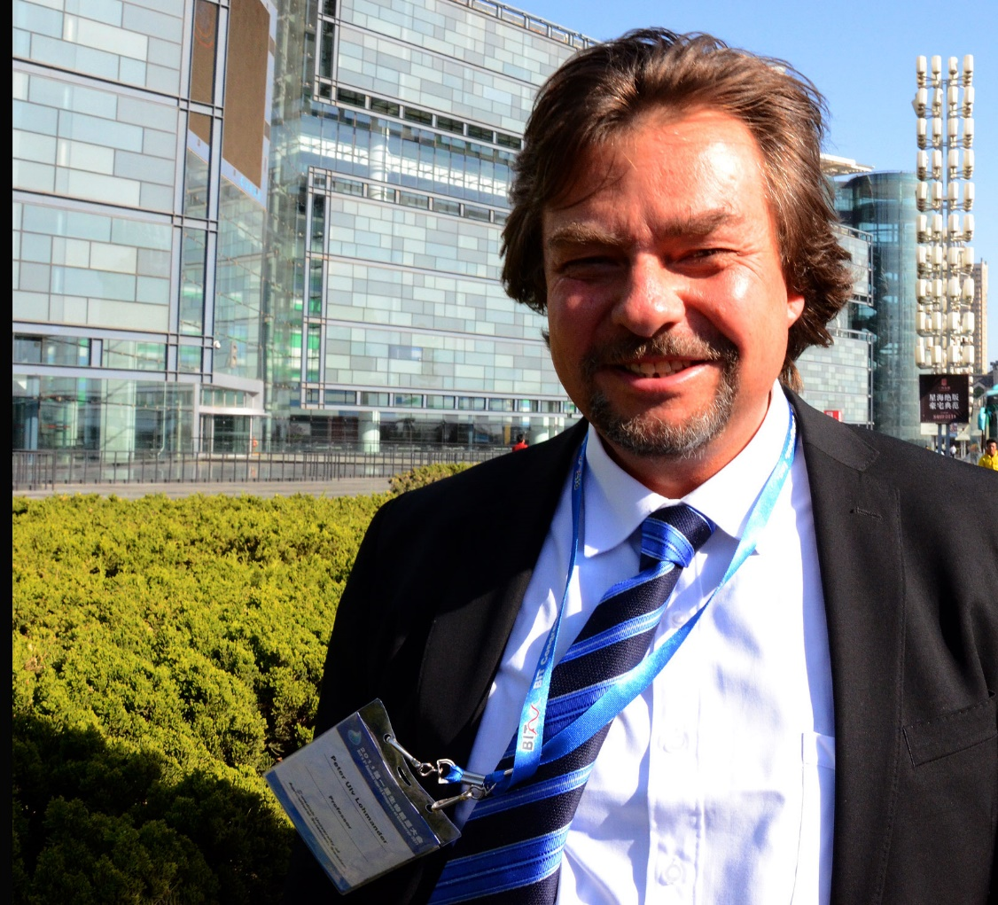
Optimal continuous cover forest management: - Economic and environmental effects and legal considerations
Professor Dr Peter Lohmander
http://www.Lohmander.com
Peter@Lohmander.com
BIT's 5th Low Carbon Earth Summit
(LCES 2015 & ICE-2015)
Theme: "Take Actions for Rebuilding a Clean World"
September 24-26, 2015
Venue: Xi'an, China

Slide 2
Optimal continuous cover forest management: - Economic and environmental effects and legal considerations Professor Dr Peter Lohmander Abstract
Forest management can be performed in many different ways. Decisions in forestry affect economic results, the flow of bioenergy raw materials, the CO2 balance of the world, species diversity, recreation options for humans and much more. Technological development sequentially and rapidly changes most of the parameters of relevance to forestry. Some of the fundamental decision problems concern: Continuous Cover Forestry (CCF) or Plantation Forestry (PF), the Stand Density (SD), the Harvest Interval (HI), Single Species Forestry (SSF) or Multi Species Forestry (MSF). With present prices, costs, technology and initial forest conditions in many dominating forest countries, CCF is often a better choice than PF when we optimize the economic present values. CCF is also a better choice than PF from several environmental perspectives. The optimal levels of SD and HI are affected by all parameters. MSF can give environmental benefits in relation to SSF. MSF can also give economically valuable options to sequentially adjust forest production to future market changes. MSF is less sensitive to species specific damages and is more flexible to changing environmental conditions. Therefore, the expected present value of MSF is often higher than the expected present value of SSF. The forest laws in different countries, also neighbour countries such as Finland and Sweden, with almost the same prices, costs, technology and forest conditions, are very different with respect to the fundamental decisions: CCF or PF, SD, HI and SSF or MSF. The economic and environmental development of the world would benefit from more rational forest management. Several forest laws need to be adjusted in order to make rational decisions legal.

Slide 3
Background:
In order to solve the global warming problem and other environmental and economic problems with global implications,
it is necessary that the most relevant and important sustainable management options are well investigated and formulated.

Slide 4
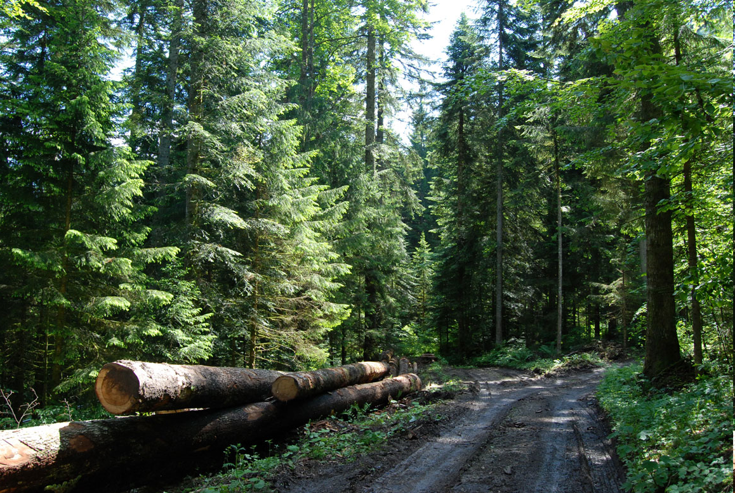
The forests are of particular importance, since they store large amounts of carbon and can produce a sustainable flow of biomass.

Slide 5
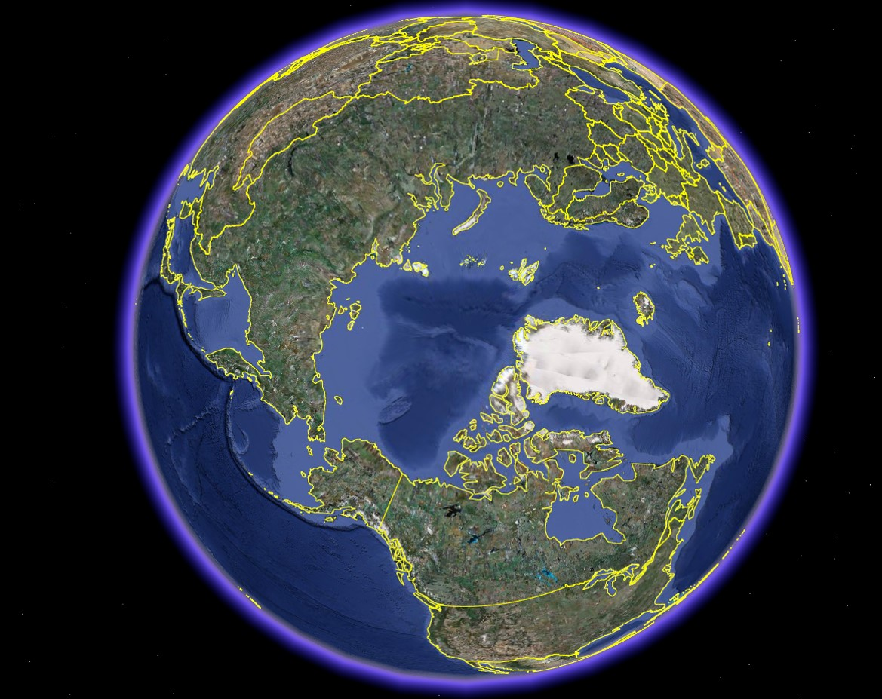
The most important
sustainable
management
options are found
where we presently
have very large
forest resources
with low degrees
of utilization.

Slide 6
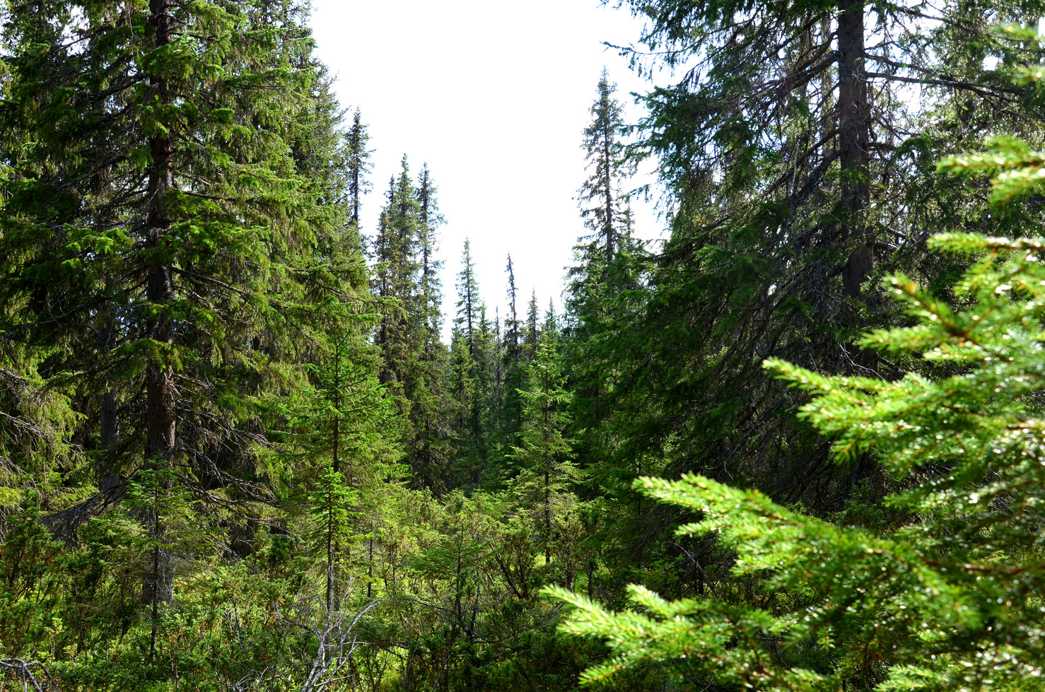

Slide 7
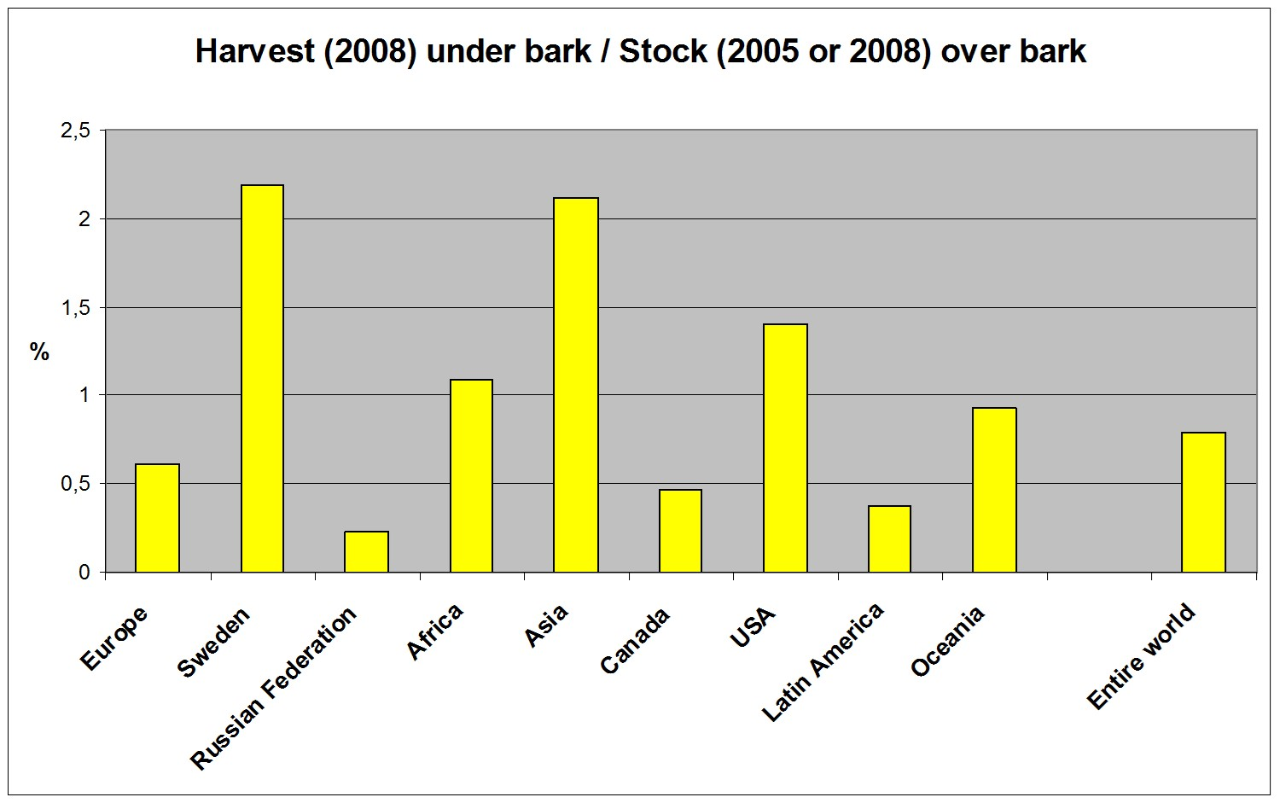
OBS!

Slide 8
181
69
156
Harvest Mm3 ub, 2008M (ubm3

Slide 9
A simple calculation based on official statistics shows that the sustainable forest production potential in Russian Federation is more than 2900 million cubic metres (over bark) per year. The harvest (year 2008) was only 181 million cubic metres (under bark).
http://www.lohmander.com/RuMa09/Lohmander_Presentation.ppt
http://www.iiasa.ac.at/Research/FOR/forest_cdrom/english/for_fund_en.html

Slide 10
Very large forest areas in the north,
in particular in
Russian Federation
and Canada,
are covered by
more or less natural forests, where trees
of different sizes and ages grow together.

Slide 11
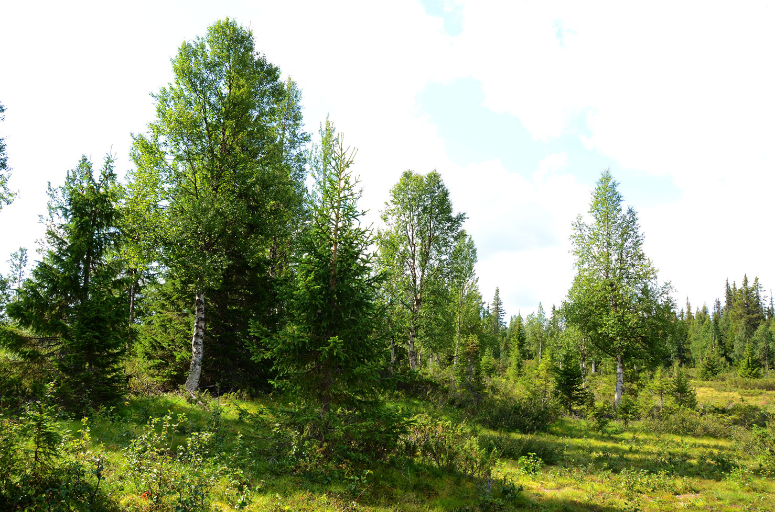
Many species prefer continuous cover forests to plantation forests.
The environmental values may be high also with stand densities that periodically
are rather low.

Slide 12
Forest growth model development should focus on growth in forests, where trees of different sizes and ages grow together.
The models should be robust and flexible and make it possible to investigate the effects of alternative dynamic controls (harvest volumes over time).

Slide 13
Optimal forest management

Slide 14
Forest management can be performed in many different ways.
Decisions in forestry affect economic results, the flow of bioenergy raw materials, the CO2 balance of the world, species diversity, recreation options for humans and much more.

Slide 15
Some of the fundamental decision problems concern:
Continuous Cover Forestry (CCF) or Plantation Forestry (PF),
the Stand Density (SD),
the Harvest Interval (HI),
Single Species Forestry (SSF) or Multi Species Forestry (MSF).

Slide 16
With present prices, costs, technology and initial forest conditions in many dominating forest countries, CCF is often a better choice than PF when we optimize the economic present values.
CCF is also a better choice than PF from several environmental perspectives.
The optimal levels of SD and HI are affected by all parameters.

Slide 17
MSF can give environmental benefits in relation to SSF.
MSF can also give economically valuable options to sequentially adjust forest production to future market changes.
MSF is less sensitive to species specific damages and is more flexible to changing environmental conditions.
Therefore, the expected present value of MSF is often higher than the expected present value of SSF.

Slide 18
Similar countries with very different forest laws

Slide 19
The forest laws in different countries, also neighbour countries such as Finland and Sweden, with almost the same prices, costs, technology and forest conditions, are very different with respect to the fundamental decisions: CCF or PF, SD, HI and SSF or MSF.
The economic and environmental development of the world would benefit from more rational forest management.
Several forest laws need to be adjusted in order to make rational decisions legal.

Slide 20
Present value
h = The first harvest volume
R(h) = Profit from the first harvest
P(.) = Price per cubic metre
(reduced by variable cost per
cubic metre)
in future harvests
Q(.) = Harvest volume per hectare
in future harvests
c = Set up cost per harvest
occation
r = Rate of interest
v = volume per hectare
v0
v1
0
time
0
t

Slide 21
In Finland, continuous cover forest management can be optimized without constraints.
In Sweden, there are several constraints in the forest act. For instance, the volume always has to stay above
a specified lower limit. If the volume is below the limit, you have to make a clearcut.
WITH Swedish constraints, forestry with clearcuts often is the economically optimal choice.
WITHOUT Swedish constraints, continuous cover forestry is very often the economically optimal choice.
v = volume per hectare
v0
v1
0
time
0
t

Slide 23
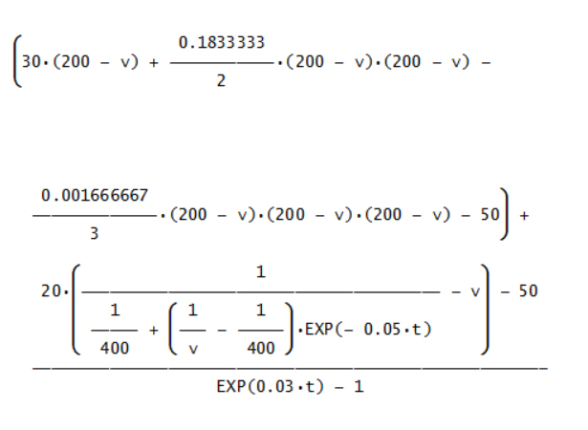
Example:
Graphical
illustrations
based on
specified
functions
and
parameters

Slide 24
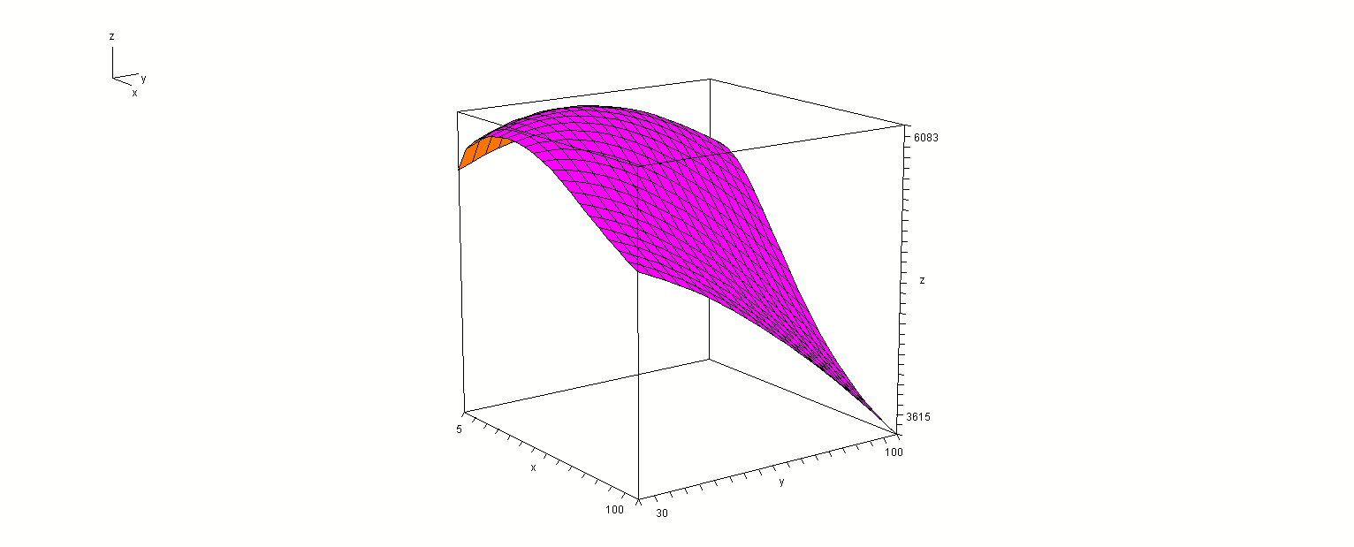
Present
value
t
v1

Slide 25
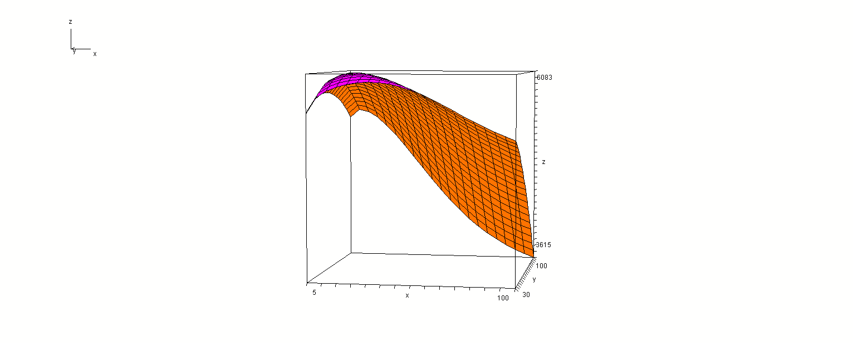
Present
value
v1
t

Slide 26
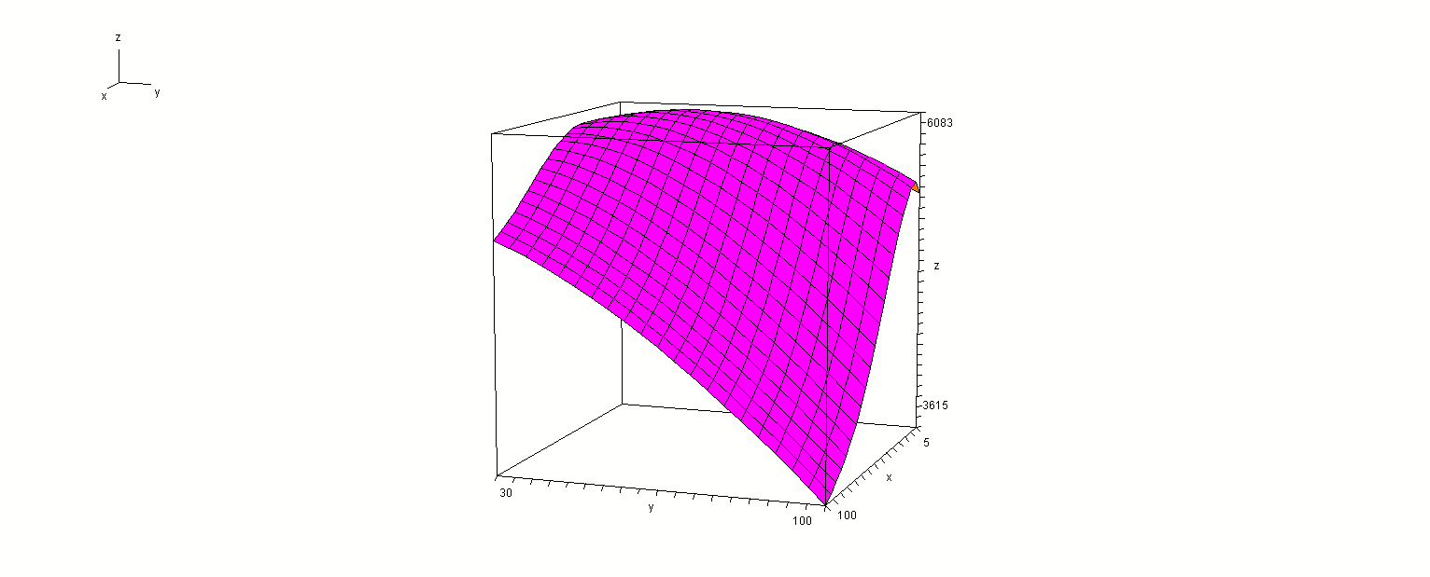
Present
value
t
v1

Slide 27
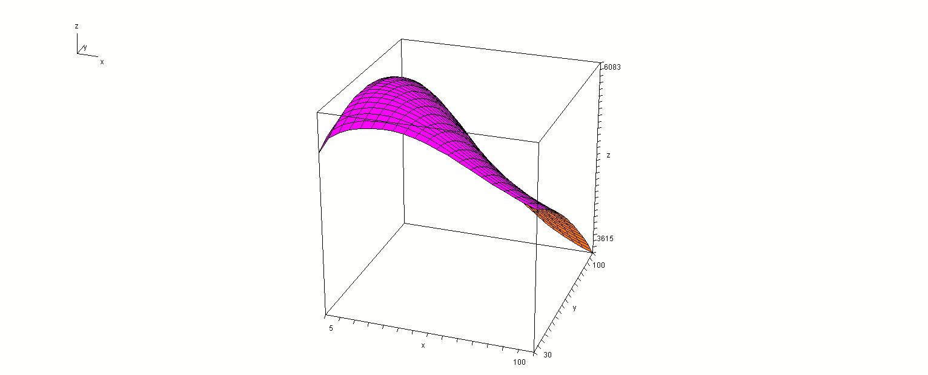
Present
value
v1
t

Slide 29
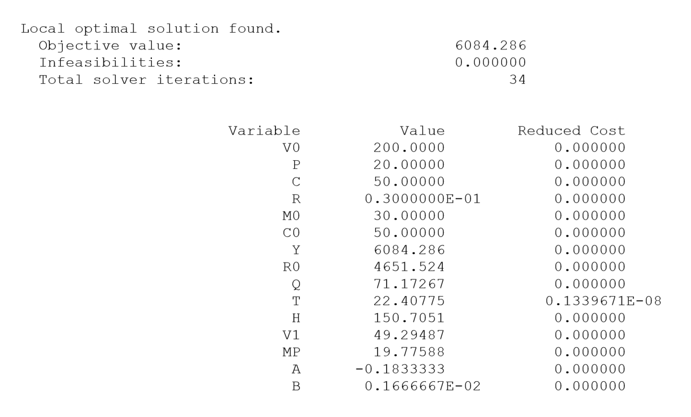
Maximum
present
value
The optimal value of V1 is far below the Swedish constraint.

Slide 30
Optimal continuous cover forest management First, we study: One dimensional optimization in the time interval dimension (of relevance when the stock level after harvest is determined by law or can not be determined for some other reason)

Slide 33
Optimal principle in the time dimension:

Slide 34
How is the optimal time interval affected if the parameter c marginally increases (ceteres paribus)?

Slide 35
A unique maximum is assumed in the time interval dimension
Conclusion:
The optimal time interval is a strictly increasing function of c.

Slide 36
How is the optimal time interval affected if the parameter r marginally increases (ceteres paribus)?
Conclusion:
The optimal time interval is
a strictly decreasing function
of the parameter r.

Slide 37
How is the optimal time interval affected if the future prices marginally increase (ceteres paribus)?

Slide 38
Conclusion:
The optimal time interval is a strictly decreasing function of the parameter p.

Slide 39
Optimal continuous cover forest management Now, we study: One dimensional optimization in the volume dimension (of relevance when the time interval is determined by law or can not be determined for some other reason)

Slide 41
Optimal principle in the volume dimension:

Slide 42
How is the optimal volume affected if one parameter marginally increases (ceteres paribus)?
- The optimal volume is not affected by changes of c.
- The optimal volume is a strictly decreasing function of r.
- The optimal volume is a strictly increasing function of p.

Slide 43
Observation:
If the volume is constrained (by law or something else), we may study the effects of the volume constraint on the optimal time interval, via one dimensional optimization.

Slide 44
Observation (extended):
If the time interval is constrained (by law or something else), we may study the effects of the time interval constraint on the volume, via one dimensional optimization.

Slide 45
Optimal continuous cover forest management Now, we study: Two dimensional optimization in the volume AND time interval dimensions

Slide 47
The first order optimum conditions:

Slide 48
Assumption: A unique maximum exists. The following conditions hold:

Slide 50
Comparative statics analysis based on two dimensional optimization:

Slide 58
Conclusions:
The forest laws in different countries, also neighbour countries such as Finland and Sweden, with almost the same prices, costs, technology and forest conditions, are very different.
If constraints that make continuous cover forest management less profitable than clear cut forestry are removed, we can expect better economic results and environmental improvements.
The analyses have shown how optimal decisions in forestry can be determined and how these optimal decisions are affected by parameter changes.
Several laws need to be adjusted in order to make rational forestry decisions legal.
The economic and environmental development of the world would benefit from more rational forest management.

Slide 59
References
http://www.lohmander.com/Information/Ref.htm
Lohmander, P. (Chair) TRACK 1: Global Bioenergy, Economy and Policy, BIT’s 2nd World Congress on Bioenergy, Xi'an, China, April 25-28, 2012 http://www.Lohmander.com/Schedule_China_2012.pdf http://www.Lohmander.com/PLWCBE12intro.ppt Lohmander, P., Economic optimization of sustainable energy systems based on forest resources with consideration of the global warming problem: International perspectives, BIT’s 2nd World Congress on Bioenergy, Xi'an, China, April 25-28, 2012 http://www.Lohmander.com/WorldCongress12_PL.pdf http://www.Lohmander.com/WorldCongress12_PL.doc http://www.Lohmander.com/PLWCBE12.ppt

Slide 60
Lohmander, P., Lectures at Shandong Agricultural University, April 29 - May 1, 2012, Jinan, China, http://www.Lohmander.com/PLJinan12.ppt
Lohmander, P. (Chair) TRACK: Finance, Strategic Planning, Industrialization and Commercialization, BIT’s 1st World Congress on Bioenergy, Dalian World Expo Center, Dalian, China, April 25-30, 2011 http://www.bitlifesciences.com/wcbe2011/fullprogram_track5.asp http://www.lohmander.com/PRChina11/Track_WorldCongress11_PL.pdf http://www.lohmander.com/ChinaPic11/Track5.ppt Lohmander, P., Economic forest management with consideration of the forest and energy industries, BIT’s 1st World Congress on Bioenergy, Dalian World Expo Center, Dalian, China, April 25-30, 2011 http://www.lohmander.com/PRChina11/WorldCongress11_PL.pdf http://www.lohmander.com/ChinaPic11/LohmanderTalk.ppt

Slide 61
There is a mathematical appendix available that contains all of the derivations.

Slide 62
Optimal continuous cover forest management: - Economic and environmental effects and legal considerations
Professor Dr Peter Lohmander
http://www.Lohmander.com
Peter@Lohmander.com
BIT's 5th Low Carbon Earth Summit
(LCES 2015 & ICE-2015)
Theme: "Take Actions for Rebuilding a Clean World"
September 24-26, 2015
Venue: Xi'an, China

