Slide 1
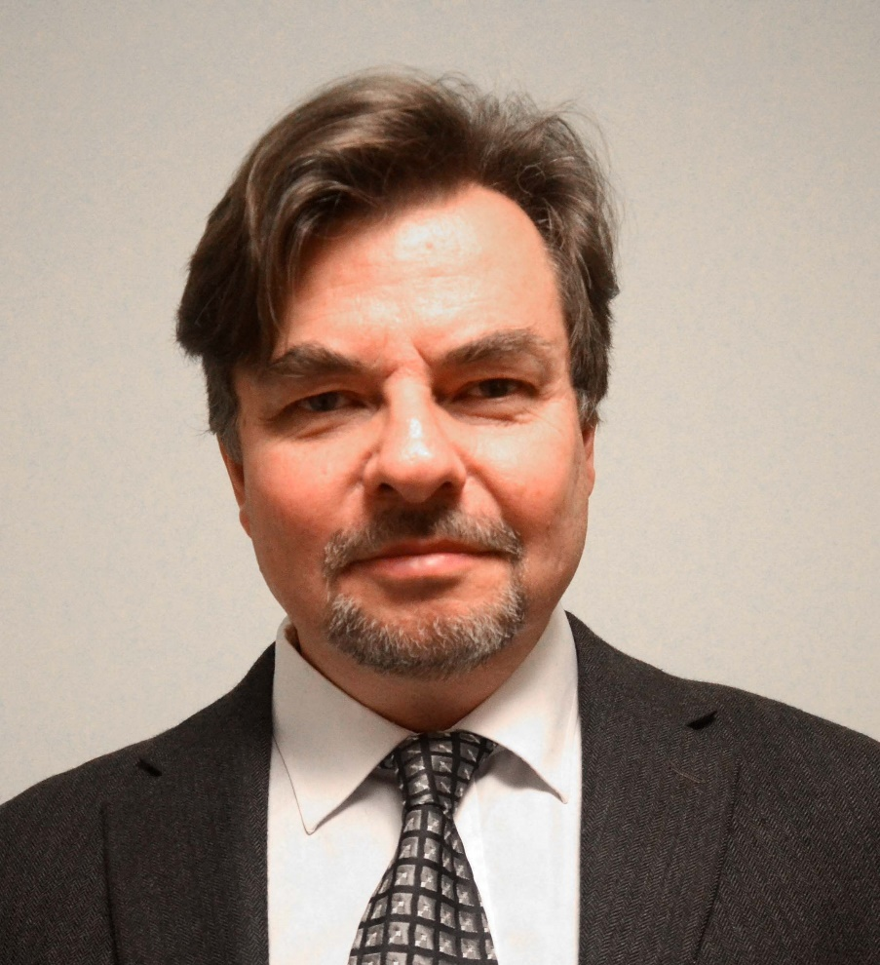
Bioenergy feedstock from forests:
Optimal dynamic supply under constraints and risk
Professor Dr Peter Lohmander
SLU, Sweden, http://www.Lohmander.com
Peter@Lohmander.com
BIT’s 4th Annual World Congress of Bioenergy
Theme: Roadmap Toward 2020
September 21-23
Qingdao International Convention Center, Qingdao, China

Slide 2
Bioenergy feedstock from forests:
Optimal dynamic supply under constraints and risk
Professor Dr. Peter Lohmander, SLU, Sweden, http://www.Lohmander.com Peter@Lohmander.com
The forests of the world represent a very important and large bioenergy feedstock. Only marginal fractions of the huge potential bioenergy supply from the forests have been used until now.
The optimal sustainable utilization of the forest feedstock over time cannot be determined without explicit consideration of different levels of infrastructure investments, alternative harvesting methods, joint production of several forest products and environmental effects.
The present utilization of forests for energy is much lower than optimal because of several reasons such as:
1. Forest laws and regulations are often historical compromises and are irrational with respect to present and future forest production economics. Since technology and prices change over time, earlier laws and regulations are presently almost never economically rational.
2. Forest laws and regulations are often irrational with respect to environmental effects.
3. Forestry, infrastructure, logistics, energy plants and forest products industries must be simultaneously optimized in order to find the global optimum. However, since the strong interdependencies are often neglected and partial analyses are used, the truly best solution is usually not obtained.
General functions for the optimal dynamic forest feedstock utilization under constraints and risk should be determined with analytical methods. Alternative versions of such problems are solved and the empirical relevance is demonstrated using statistical information in local, regional and global scales.

Slide 3
The forests of the world represent a very important and large bioenergy feedstock.
Only marginal fractions of the huge potential bioenergy supply from the forests have been used until now.

Slide 4
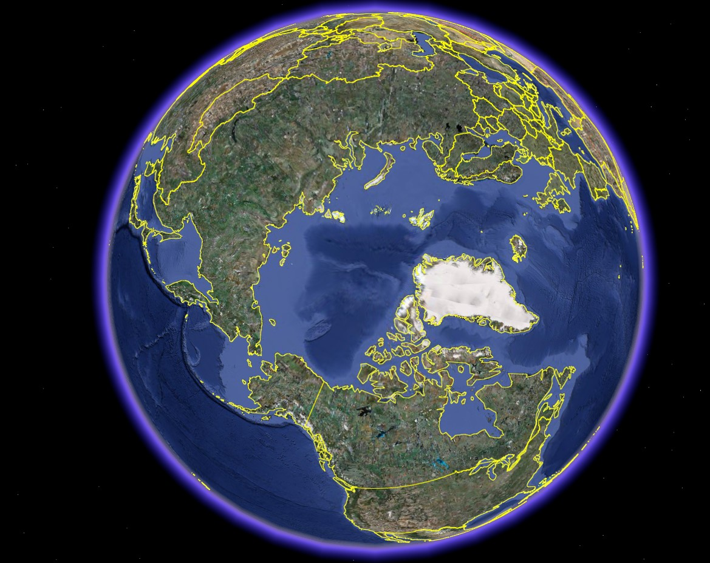

Slide 5
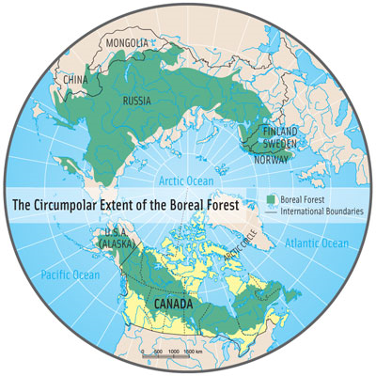

Slide 6

Sweden
Russian Fed.
Canada

Slide 7
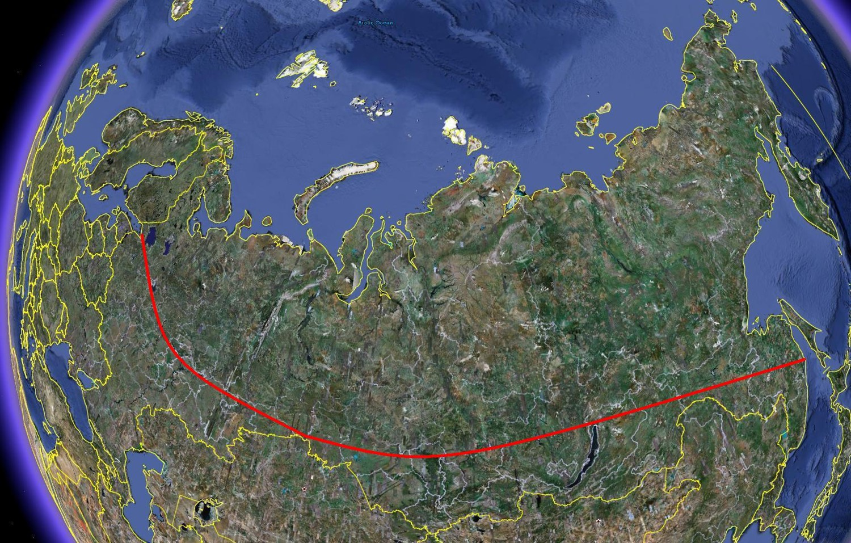

Slide 8
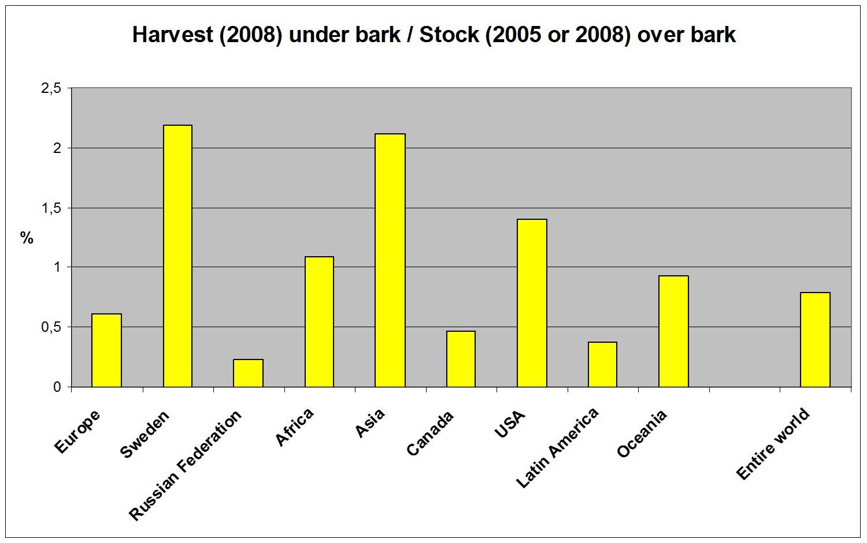

Slide 9
809
23
261
(NR)
Forest area
(Million hectares)

Slide 10
Forest area (million hectares):
REL
Sweden: 23.000 (SVO, 2009) (1.0)
Russian Federation: 808.790 (FAO, 2005) (35.2)
Canada (non res.): 260.643 (Canfi 2001) (11.3)

Slide 11
3.2
80.5
29.4 or 33
Stock
(Billion m3)

Slide 12
Forest stock (million cubic metres):
REL
Sweden: 3 155 (SVO, 2008) (1.0)
Russian Federation: 80 479 (FAO, 2005) (25.5)
Canada: 29 384 (Canfi 2001) (9.3)
Canada 32 983 (FAO 2005) (10.5)

Slide 13
181
69
156
Harvest Mm3 ub, 2008M (ubm3

Slide 14
Forest harvest (million cubic metres, 2008):
REL
Sweden: 69.0 (FAO, 2008) (1.0)
Russian Federation: 181.4 (FAO, 2008) (2.6)
Canada: 155.5 (FAO, 2008) (2.3)

Slide 15
Source: FAOSTAT
Adaptions by Peter Lohmander.

Slide 17
A simple calculation based on official statistics shows that the sustainable forest production potential in Russian Federation is more than 2900 million cubic metres (over bark) per year.
The harvest (year 2008) was only
181 million cubic metres (under bark).
http://www.lohmander.com/RuMa09/Lohmander_Presentation.ppt
http://www.iiasa.ac.at/Research/FOR/forest_cdrom/english/for_fund_en.html

Slide 18
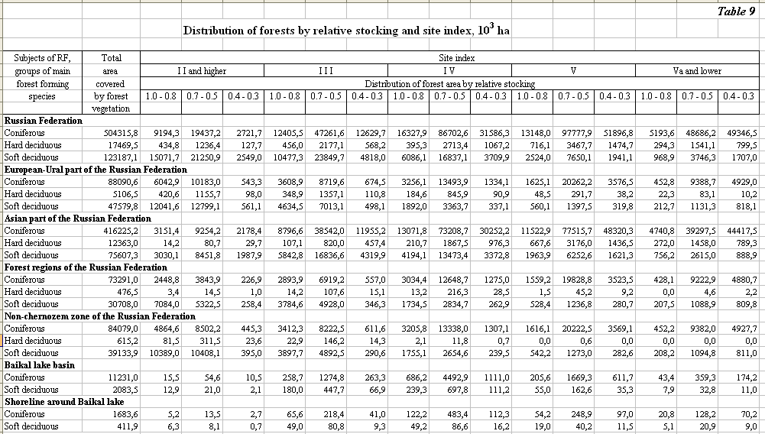
Source:
http://www.iiasa.ac.at/Research/FOR/forest_cdrom/english/for_fund_en.html
(From Roslesinforg, 2003, VNIILM, 2003)

Slide 19
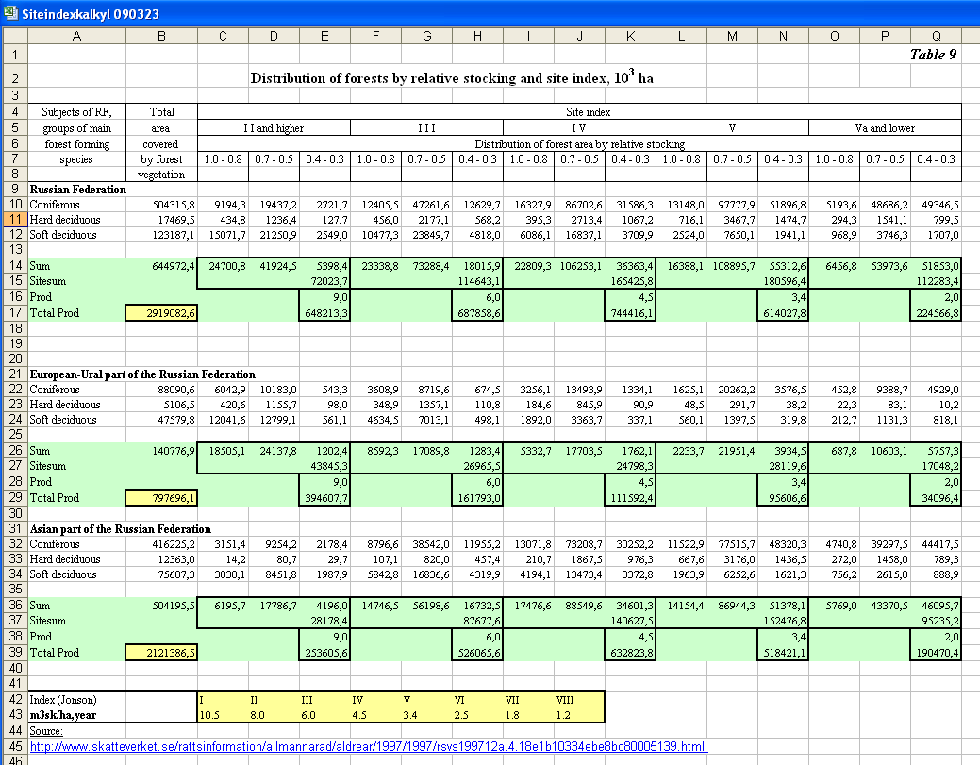
Calculation of the long run sustainable production level

Slide 20
Rough approximation:
All of the sustainable forest production potential in Russian Federation
(2900 million cubic metres, over bark, per year) is transformed to energy.
(In reality, some fraction will probably be used for other purposes.)
With 2 TWh/Mm3, we get:
5 800 TWh/year.

Slide 21
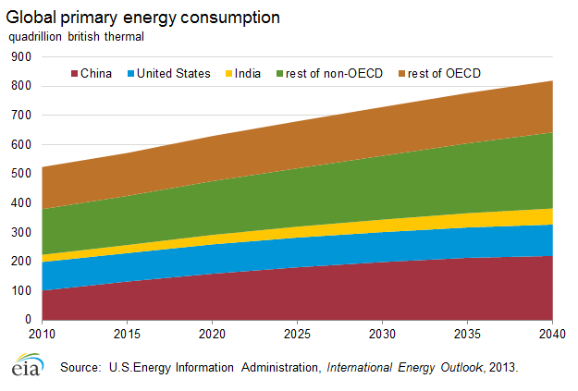
Observations:
100 quadrillion ”british
thermal” corresponds to
29 300 TWh.
In 2014, according to
the graph, the global
primary energy
consumption is
160 000 TWh.
The potential energy
production in the Russian
forests ( 5 800 TWh) is
3.6% of the global
primary energy
consumption in 2014,
or 20% of the primary
energy cnsumption in
China in 2014.
http://www.eia.gov/countries/cab.cfm?fips=ch
http://www.conversion-website.com/energy/British-thermal-unit-IT-to-terawatt-hour.html

Slide 22
Energy consumption in EU
Gross inland consumption of energy within the EU-28 in 2012 was 1 683 million tonnes of oil equivalent (toe).
http://epp.eurostat.ec.europa.eu/statistics_explained/index.php/Consumption_of_energy
This corresponds to: 19 573 TWh
(= 3.4 times the forest energy potential in Russian Federation)
1 terawatt hour (TWh) is equal to 85984.522785899 ton of oil equivalent (TOE)
http://www.conversion-website.com/energy/ton-of-oil-equivalent-to-terawatt-hour.html

Slide 23
China is the world's largest power generator, surpassing the United States in 2011.
Net power generation was an estimated 4,476 TWh in 2011.

Slide 24
Observation:
The graph does
not include any
forest fuels.

Slide 25
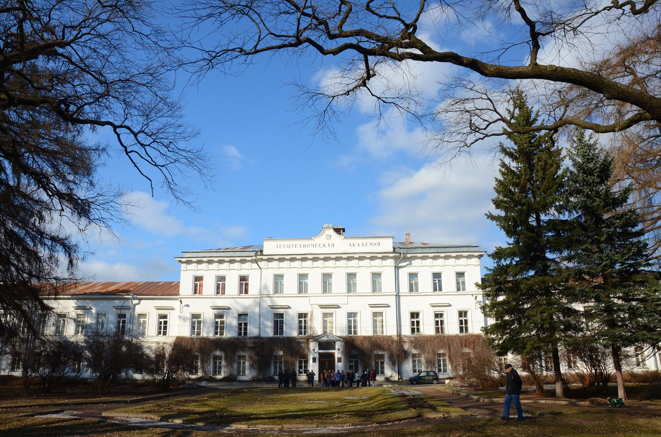
Saint Petersburg Forest Technical University
(Former name ”SPbFTA”)
April 12, 2012

Slide 26
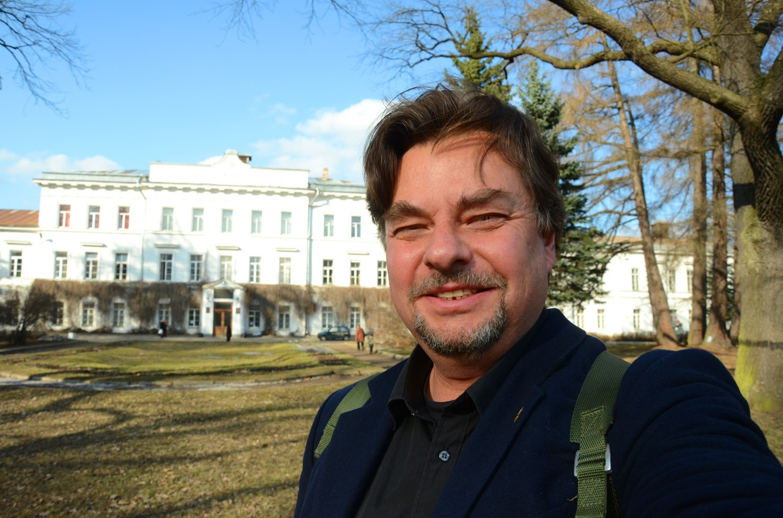

Slide 27
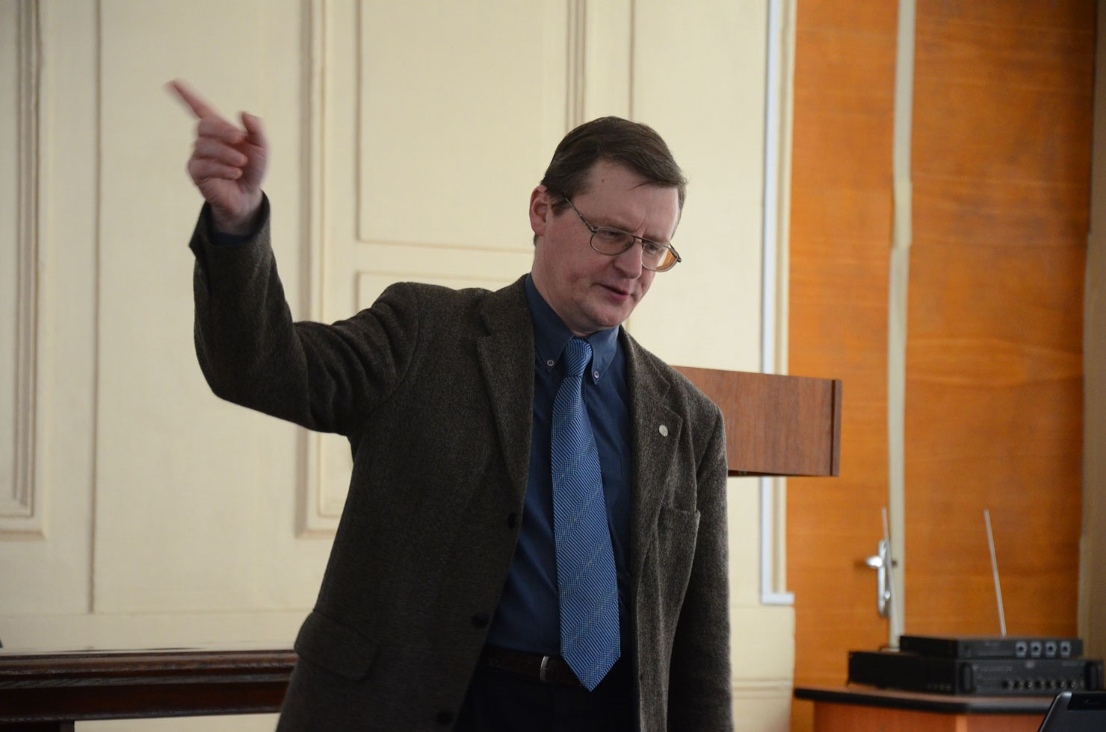
Dr. Evgeny Kuznetsov
Ass. Professor,
Forestry Department,
FTU

Slide 28
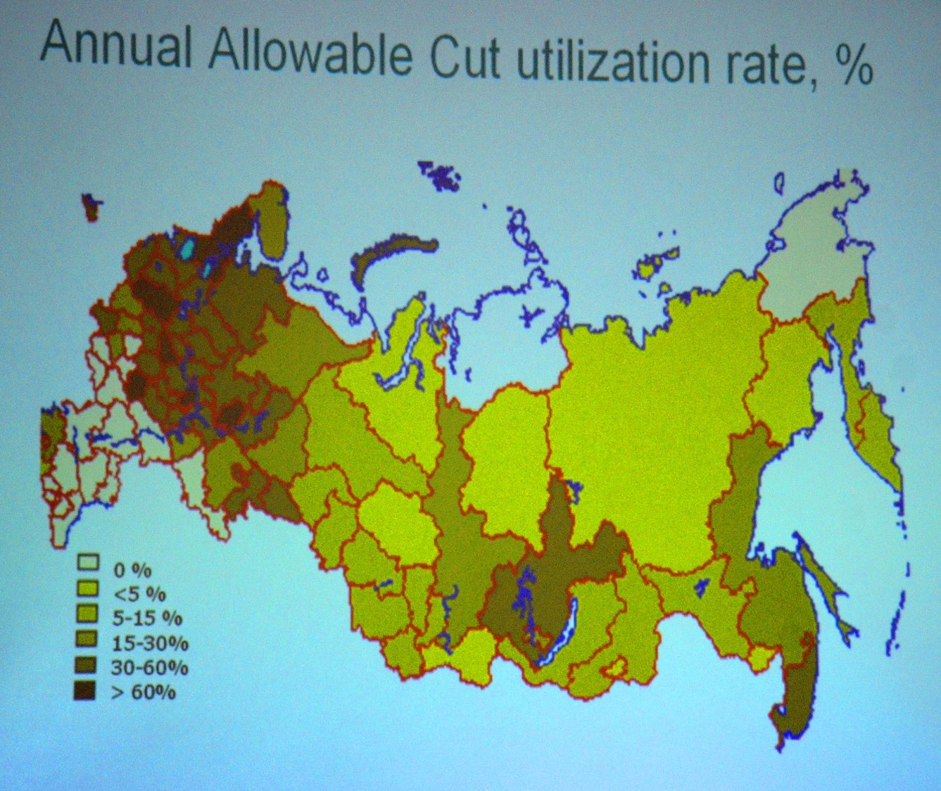

Slide 29
Furthermore,
the ”Annual Allowable Cut”
in Russian Federation
is much lower
than the production potential.
Hence, the
”Production possibility Utilization Rate”
is much lower than the
”Annual Allowable Cut Utilization Rate”.

Slide 30
Conclusion:
The sustainable bioenergy supply from the forests of Russian Federation can increase very much.

Slide 31
Focus on Canada

Slide 32
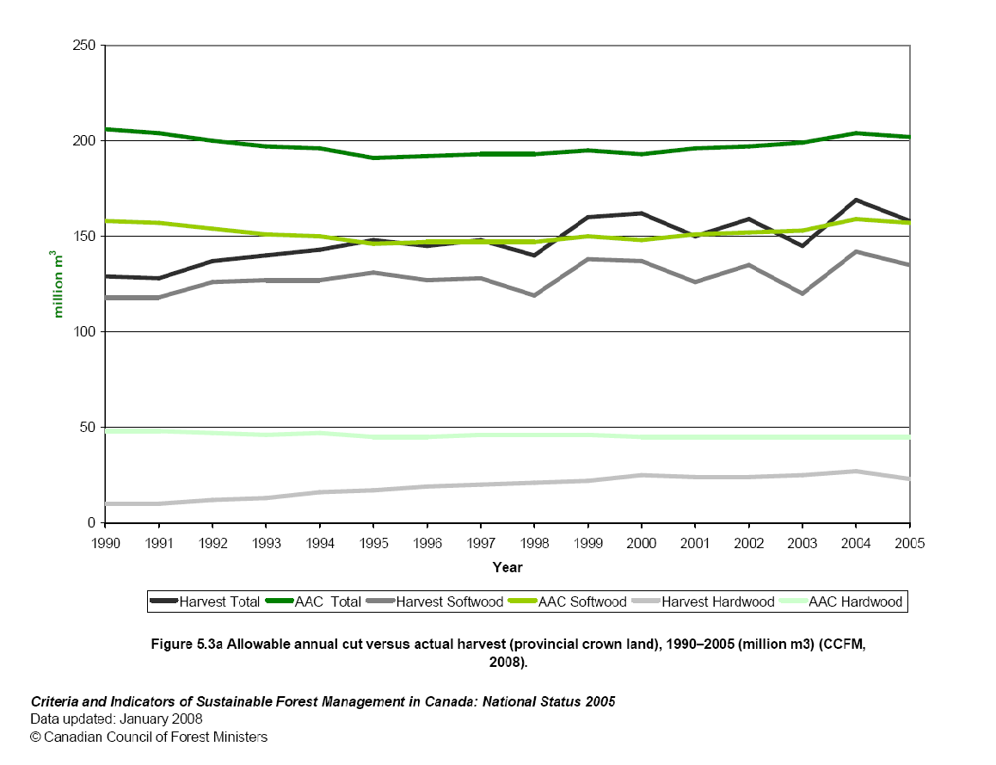
http://www.ccfm.org/ci/rprt2005/English/pdf/5.3a.pdf

Slide 33
http://www.canadaforests.nrcan.gc.ca/articletopic/14
A global endowment
Article Date: 2005-09-01
About 750 000 hectares—or 0.2 percent of the total boreal forest
—are harvested each year.
The part not managed for timber production is either
unavailable because it has been designated as
protected areas and reserves,
or currently considered inaccessible.
Unlike the forests of the United States, Scandinavia and the
majority of other nations,
most of Canada's forests (93 percent) are publicly owned.
The remaining 7 percent are held by private owners.

Slide 34
The ”Annual Allowable Cut”
in Canada is much lower
than the production potential.
Hence, the
”Production possibility Utilization Rate”
is much lower than the
”Annual Allowable Cut Utilization Rate”.

Slide 35
Conclusion:
The sustainable bioenergy supply from the forests of Canada can increase very much.

Slide 36
General conclusion (Russian Federation and Canada)
The forests represent a very important and large bioenergy feedstock.
Only marginal fractions of the huge potential bioenergy supply from the forests have been used until now.

Slide 37
The optimal sustainable utilization of the forest feedstock over time can not be determined without explicit consideration of different levels of:
- infrastructure investments,
- alternative harvesting methods,
- joint production of several forest products
- and environmental effects.

Slide 38
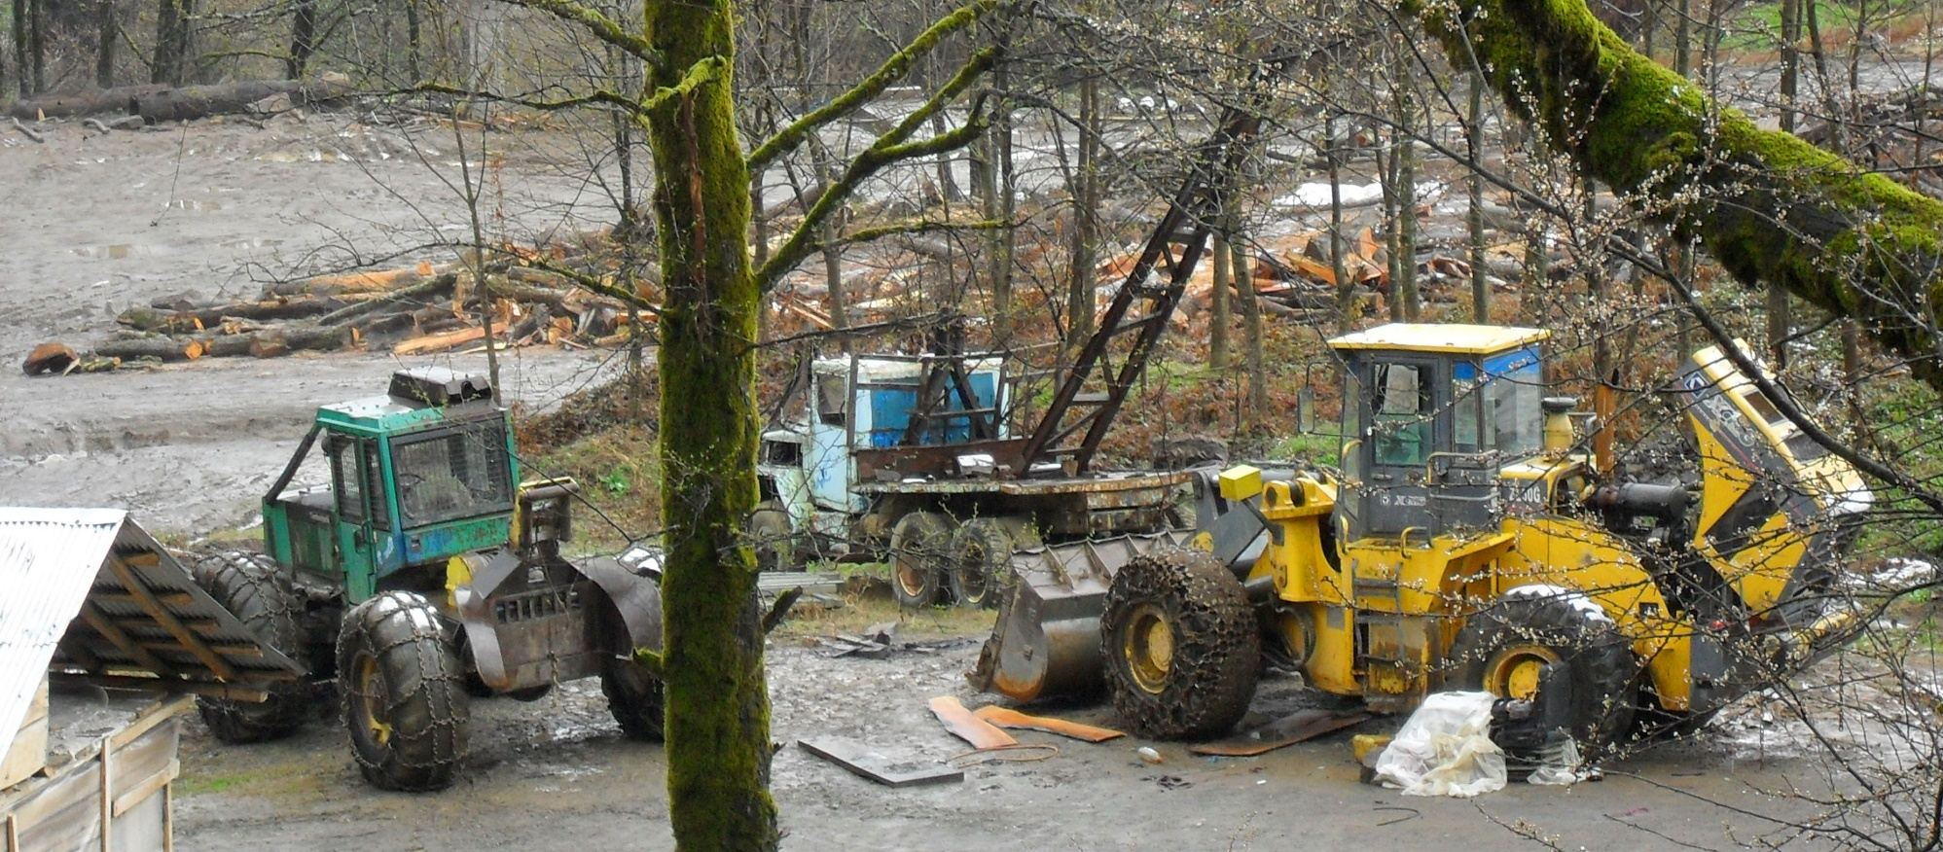
The present utilization of forests for energy is much lower than optimal because of several reasons such as:
Forest laws and regulations are often historical compromises and are irrational with respect to present and future forest production economics. Since technology and prices change over time, earlier laws and regulations are presently almost never economically rational.
Forest machines
In Iran

Slide 39
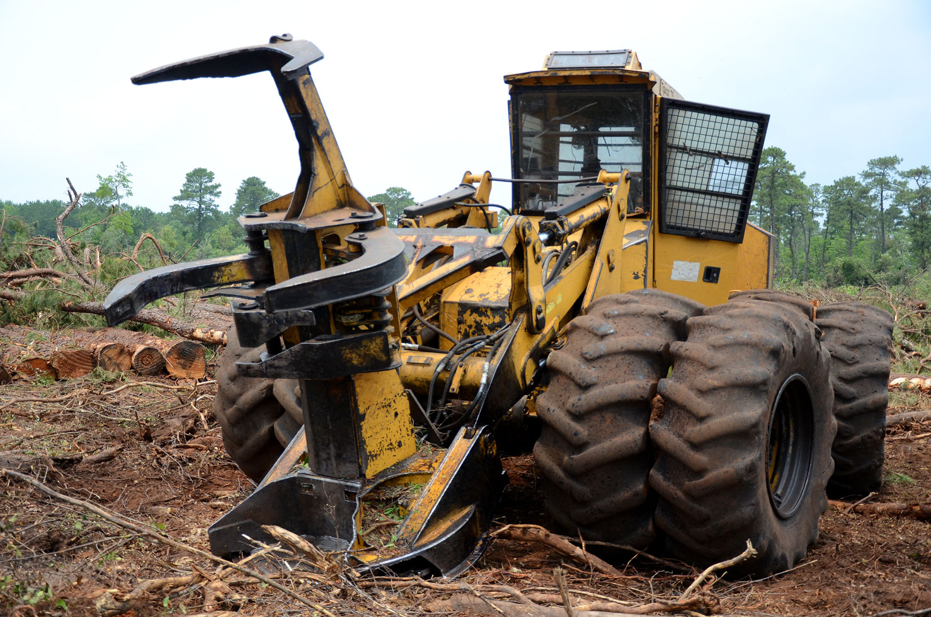
Forestry in North Carolina, USA

Slide 40
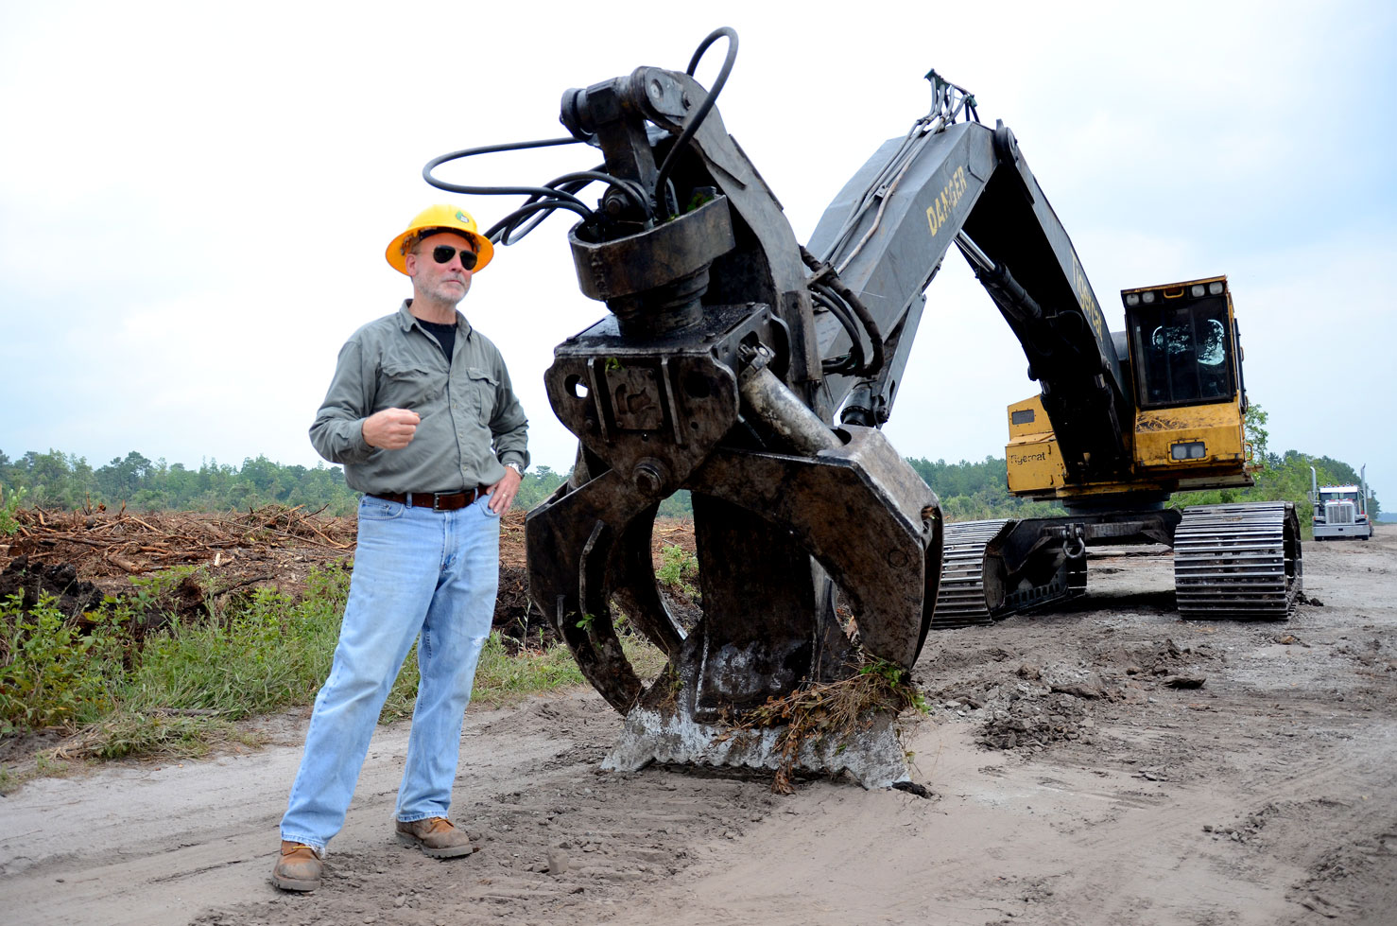
Forestry in
North Carolina,
USA

Slide 41
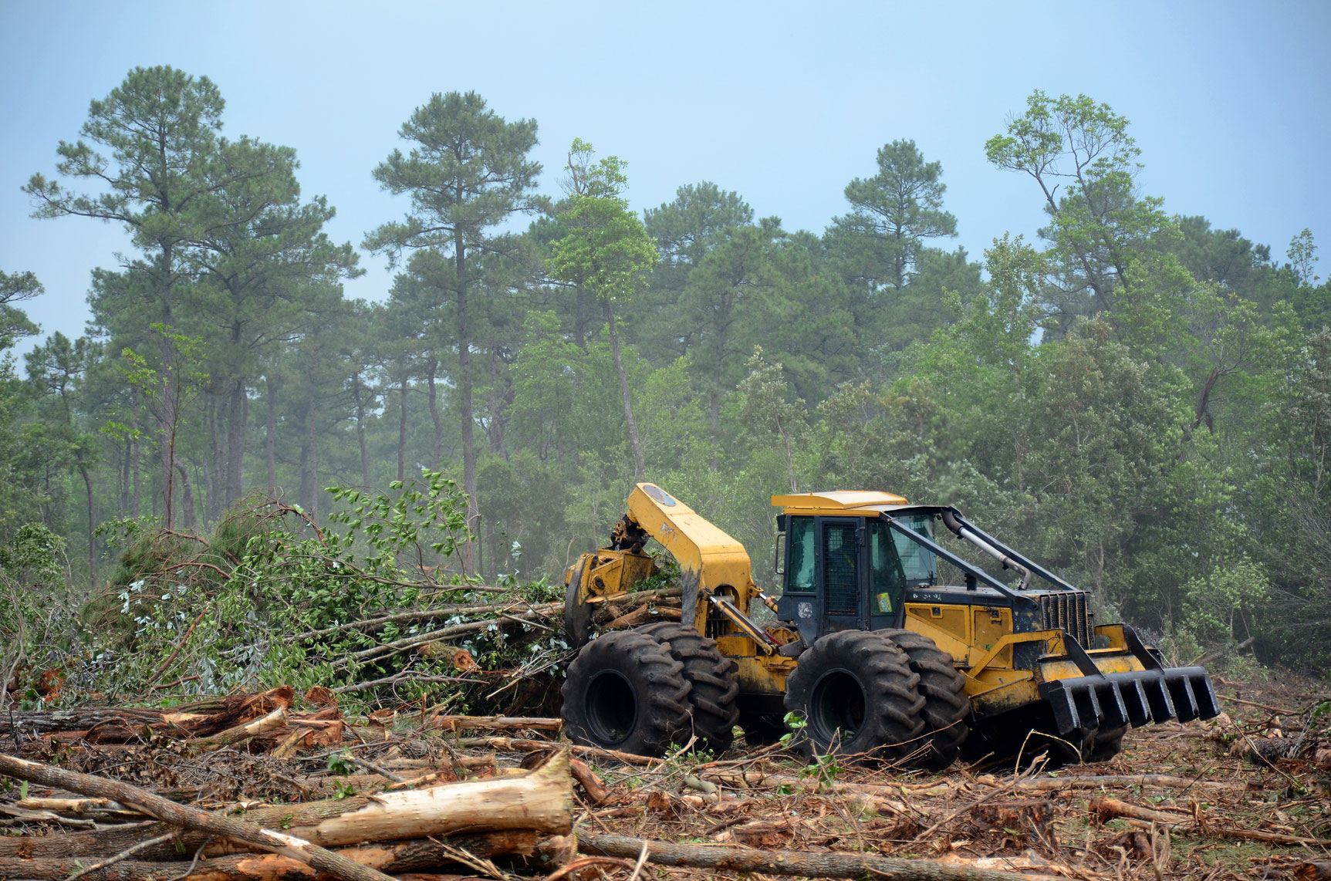
Forestry in North Carolina, USA

Slide 42
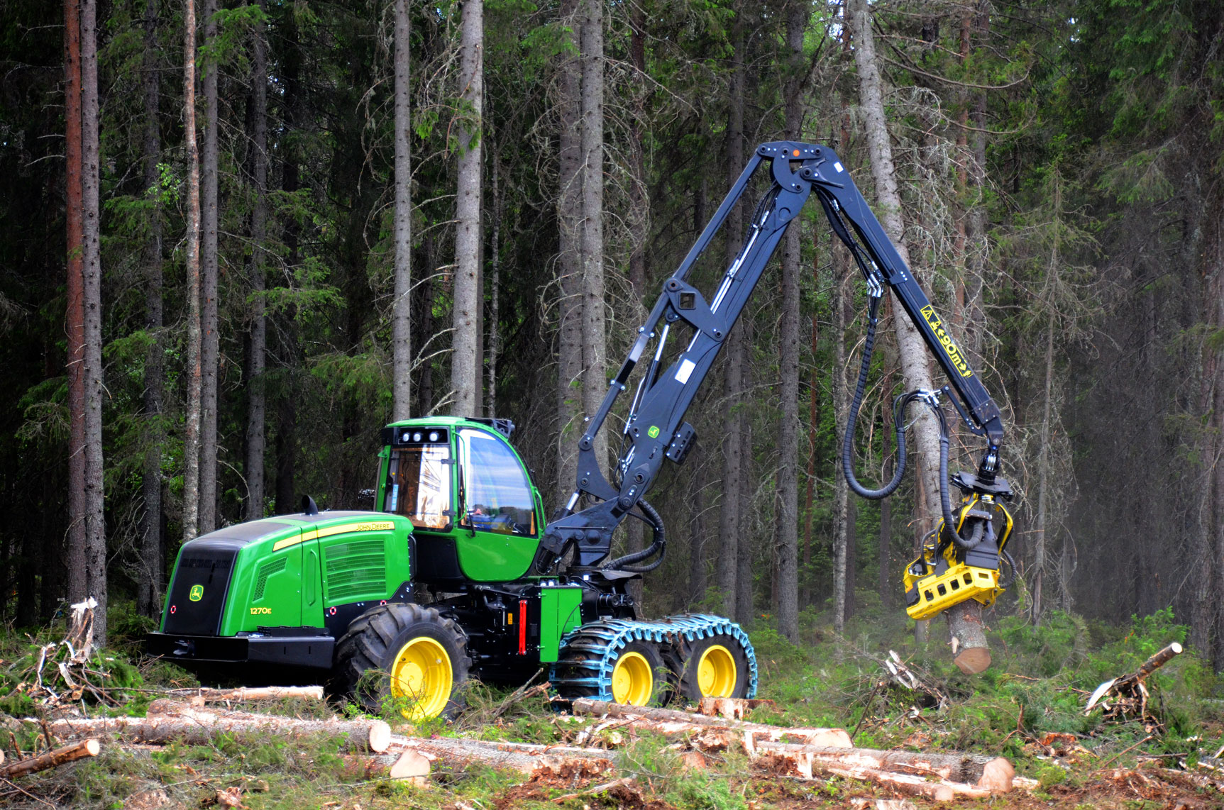
Forestry in Sweden

Slide 43
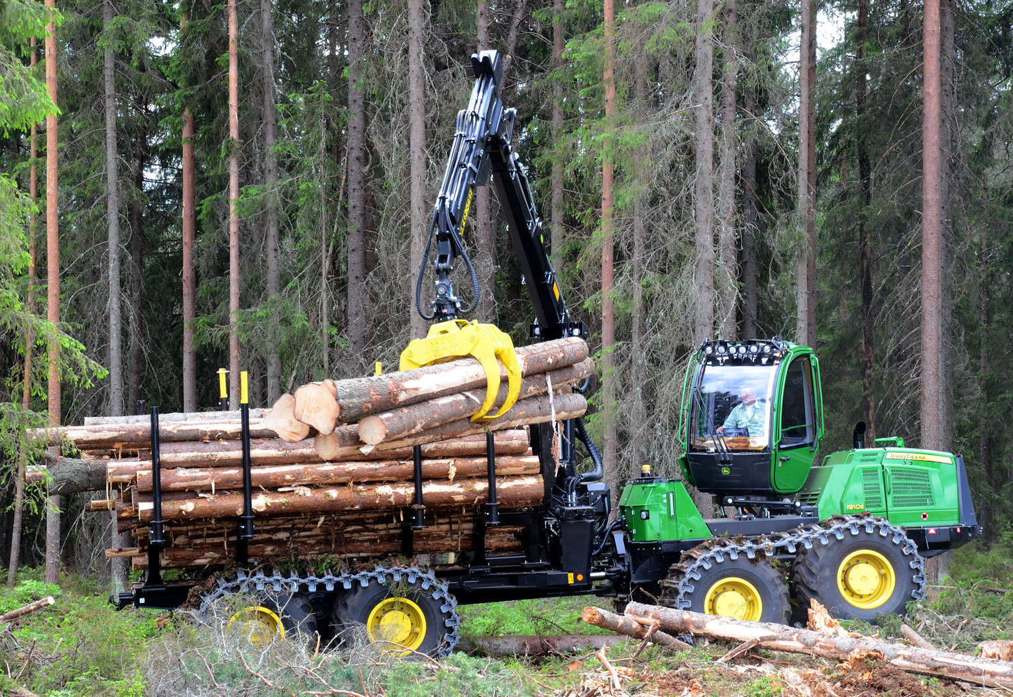
Forestry in Sweden

Slide 44
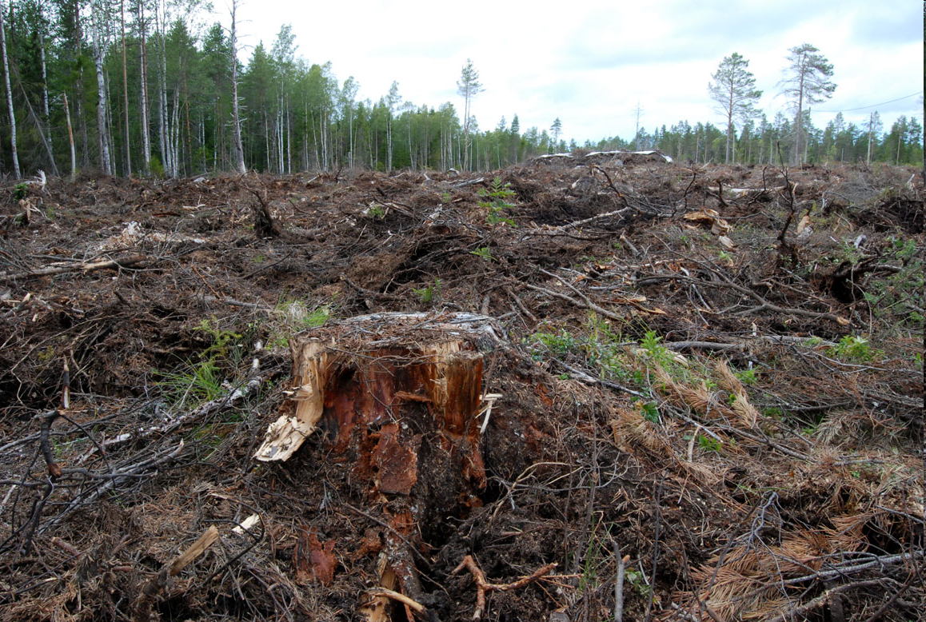
Forestry with clearcuts in Sweden (10 km S Umeå).

Slide 45
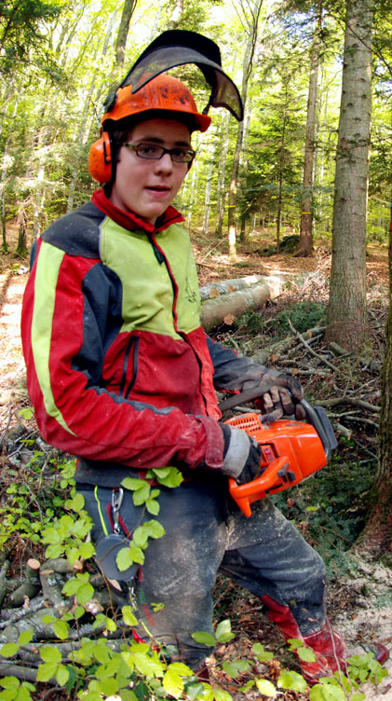
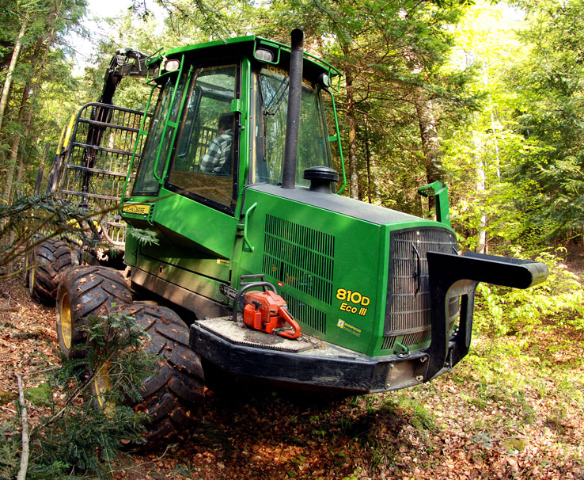
Forestry
in
Switzerland

Slide 46
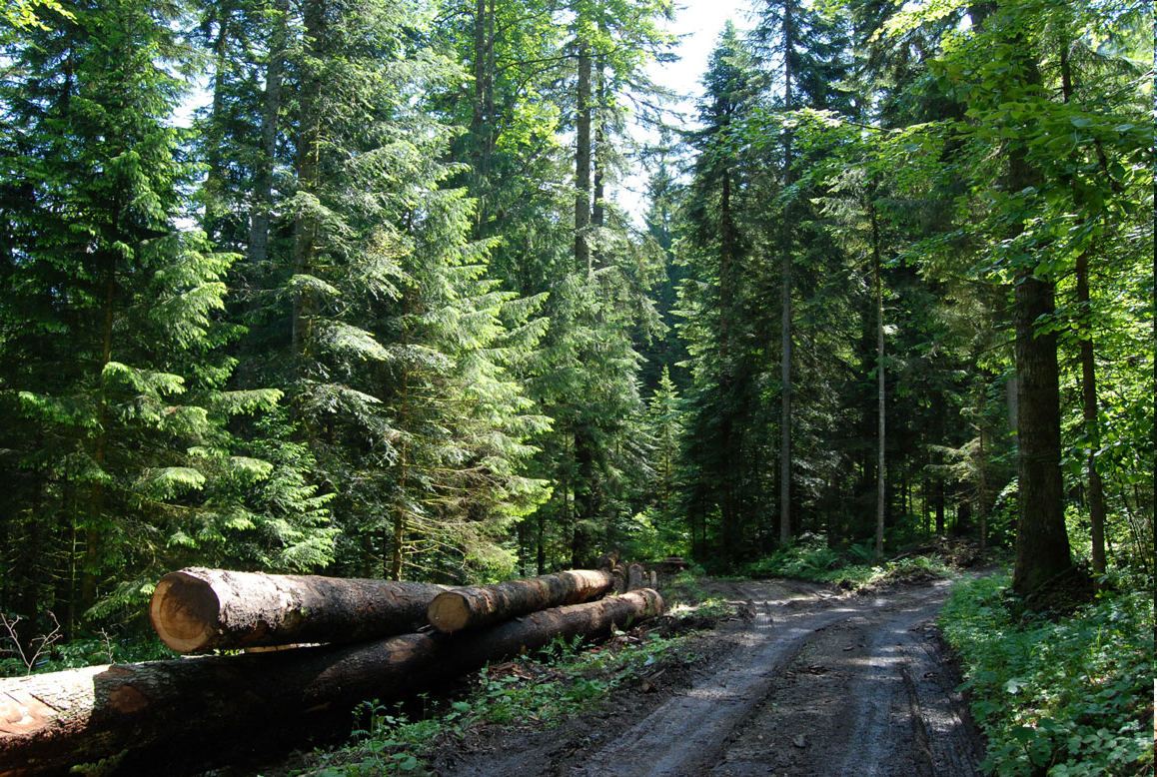
Continuous cover forestry in Neuchâtel, Switzerland.

Slide 47
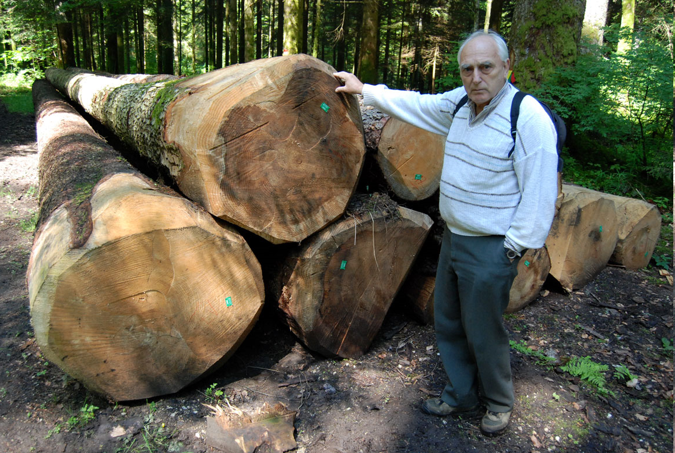
Continuous cover forestry in Switzerland and Professor Dr. J.P. Shütz, ETH.

Slide 48
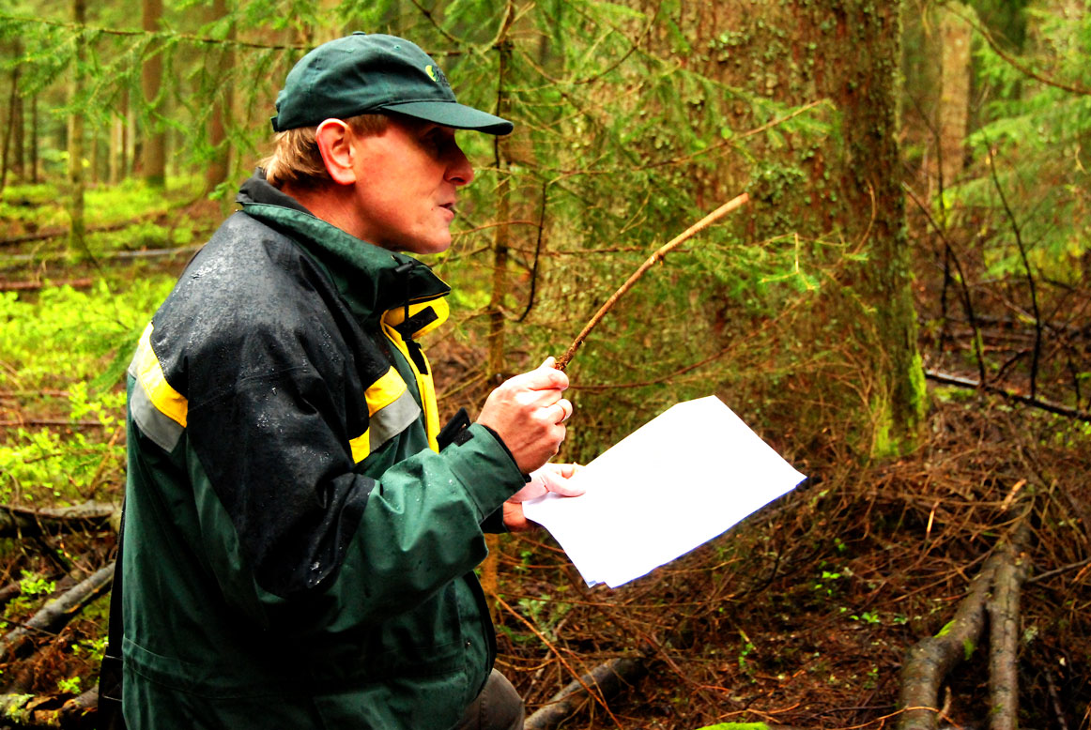
Forestry in Germany

Slide 49
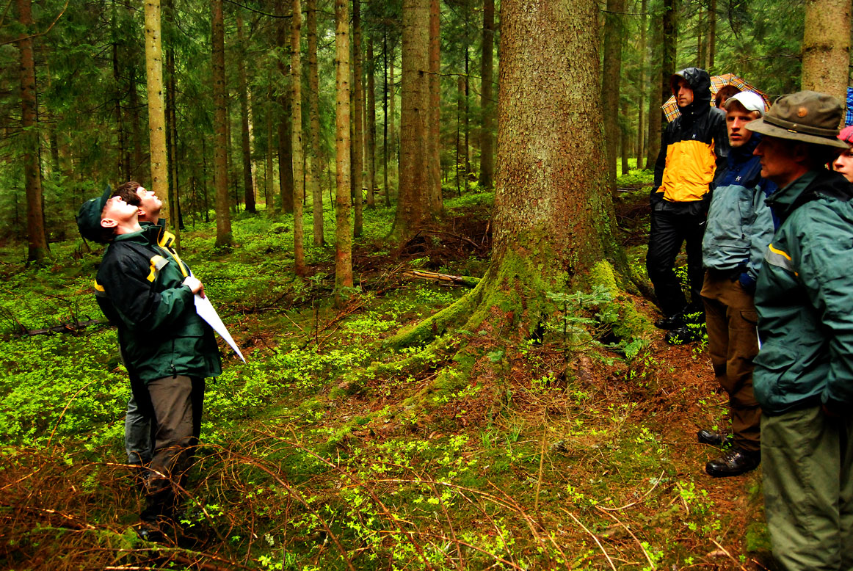
Forestry in Germany

Slide 50
Prices change and the changes can not be perfectly predicted.

Slide 51
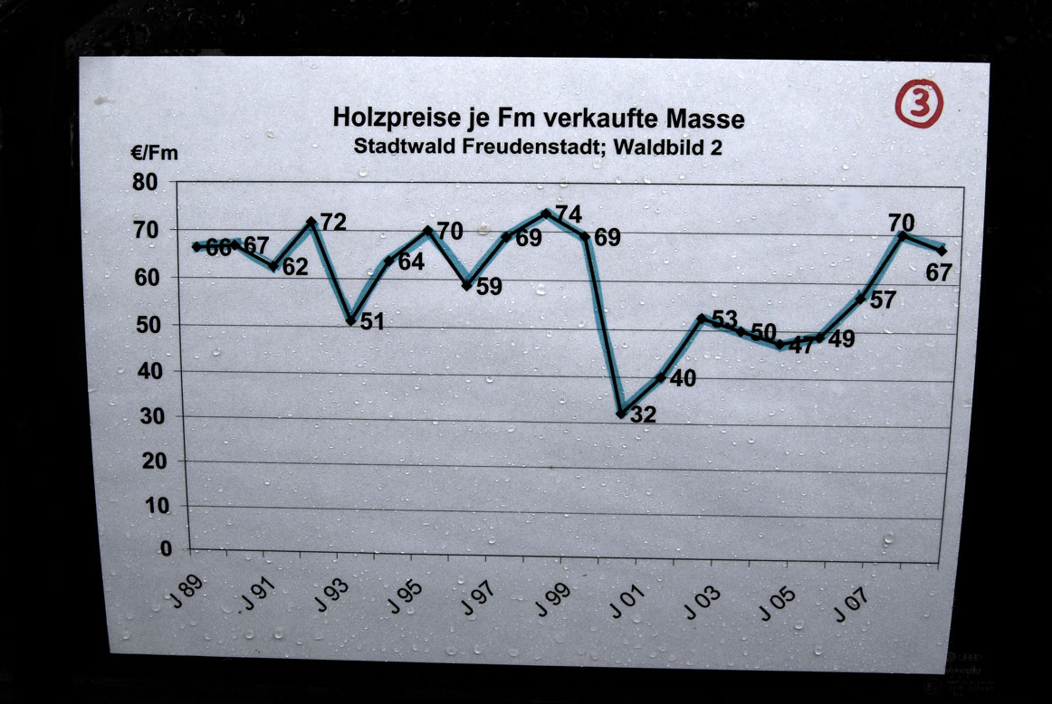
Roundwood prices in Germany
The dramatic price drop was a result of the storm Lothar and the unexpected extra supply of windthrown wood.

Slide 54
The present utilization of forests for energy is much lower than optimal because of several reasons such as:
2. Forest laws and regulations are often irrational with respect to environmental effects and economic results.

Slide 55
In Sweden, forest owners are not allowed to keep a lower growing stock level
than according to the graph.
It can be shown that the economically optimal stock level usually is much
lower than the limit in the graph.
The forest owners are however
allowed to harvest all trees
(to make clear cuts).
With lower stock levels, continuous cover forestry could give better economic results and a more favourable environmental development.

Slide 56
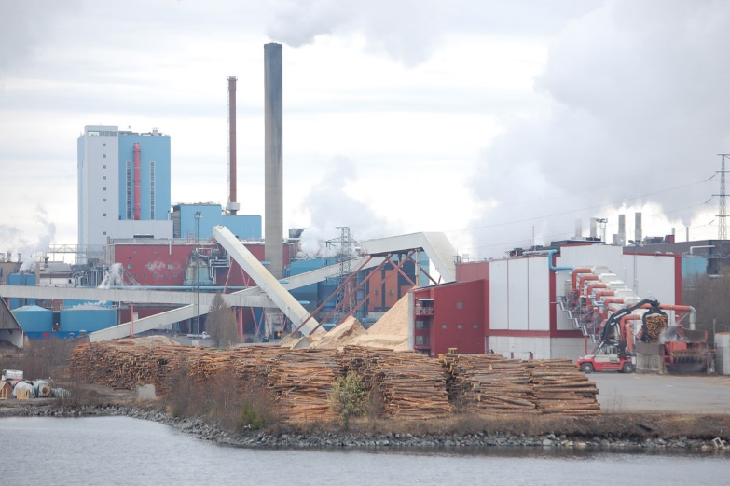

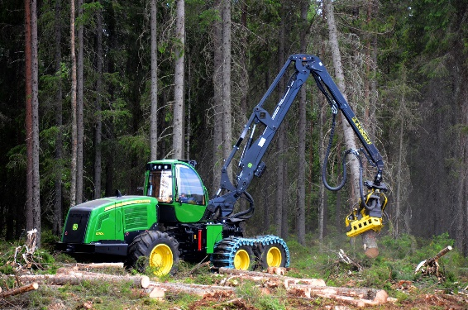
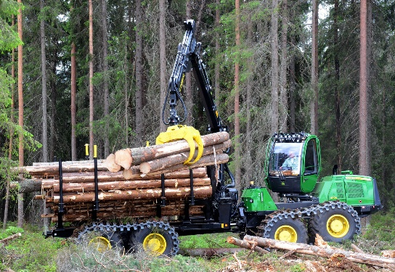
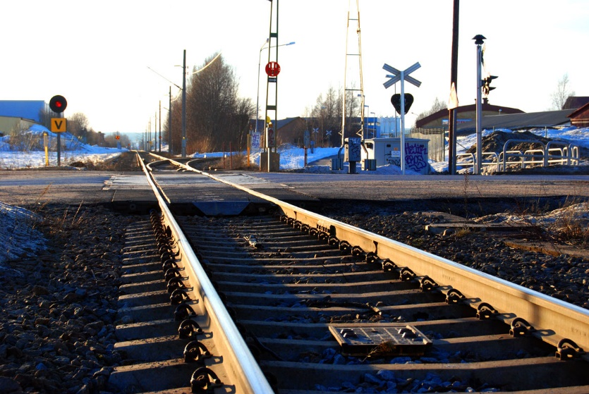
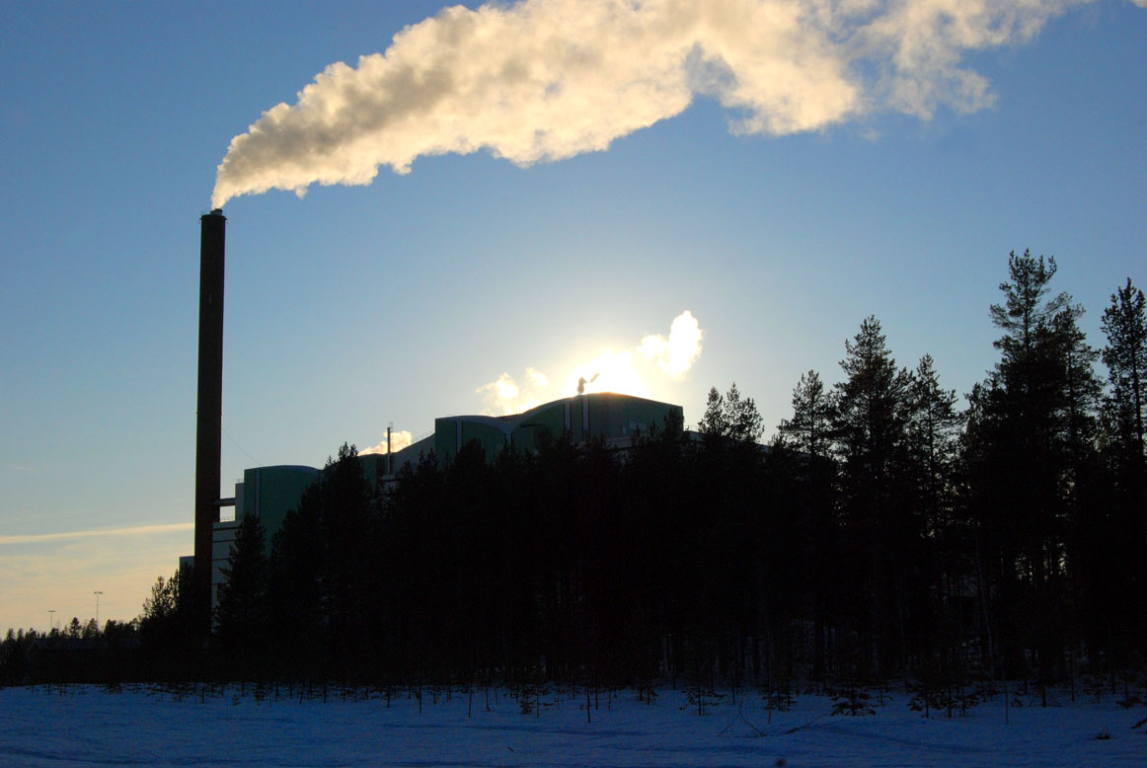
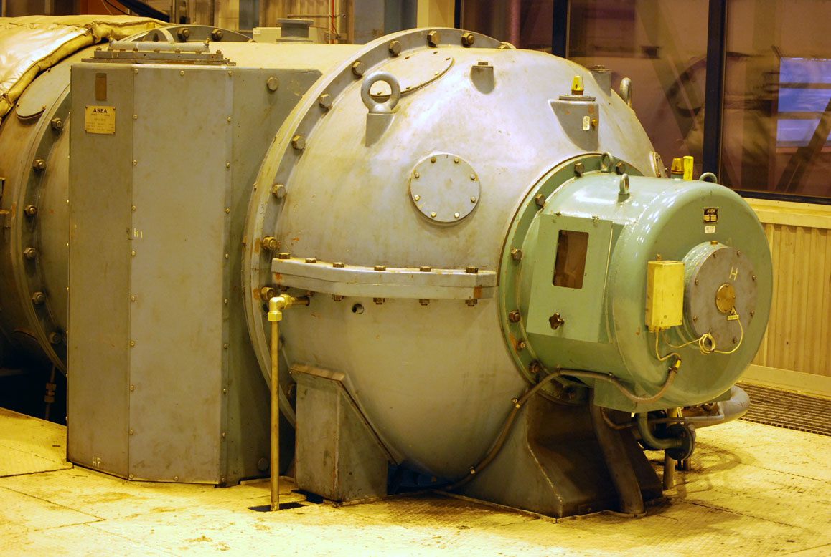
3. Forestry, infrastructure, logistics, energy plants and forest products industries must be simultaneously optimized in order to find the global optimum. However, since the strong interdependencies are often neglected and partial analyses are used, the truly best solution is usually not obtained.

Slide 57
General functions for the optimal dynamic forest feedstock utilization under constraints and risk should be determined with analytical methods.

Slide 58
Stochastic dynamic programming is usually the most relevant and flexible optimization method,
since prices, growth, disturbances etc. can not be perfectly predicted.

Slide 59
Example of optimal adaptive forest feedstock supply with stochastic prices
Lohmander, P., Adaptive Optimization of Forest Management in a Stochastic World, in Weintraub A. et al (Editors), Handbook of Operations Research in Natural Resources, Springer, Springer Science, International Series in Operations Research and Management Science, New York, USA, pp 525-544, 2007

Slide 60
Examples of stochastic dynamic programming in optimal forest feedstock problems:
Lohmander, P., Adaptive Optimization of Forest Management in a Stochastic World, in Weintraub A. et al (Editors), Handbook of Operations Research in Natural Resources, Springer, Springer Science, International Series in Operations Research and Management Science, New York, USA, pp 525-544, 2007
http://www.amazon.ca/gp/reader/0387718141/ref=sib_dp_pt/701-0734992-1741115#reader-link
http://www.Lohmander.com/PL_Handbook2007.pdf
Lohmander, P., Mohammadi, S., Optimal Continuous Cover Forest Management in an Uneven-Aged Forest in the North of Iran, Journal of Applied Sciences 8(11), 2008 http://ansijournals.com/jas/2008/1995-2007.pdf
http://www.Lohmander.com/LoMoOCC.pdf
Lu, F., Lohmander, P., Optimal Decisions for Mixed Forests under Risk, Scientia Silvae Sinicae, Vol. 45, No. 11, Nov. 2009
http://www.Lohmander.com/Lu_Lohmander_2009.pdf
Mohammadi Limaei, S. Lohmander, P. and Obersteiner, M. 2010. Decision making in forest management with consideration of stochastic prices, Iranian Journal of Operations Research, Vol.2, No.1, pp.32-40
http://www.Lohmander.com/LiLoOb2010.pdf

Slide 61
The optimal dynamic forest feedstock supply in Sweden has been calculated within a multi industry dynamic optimization problem.
Optimal total
results in
Sweden for
alternative
stock
level
constraints

Slide 62
Optimal Stock Level
Optimal Harvest Level
Optimal
Bioenergy
Production
Optimal Pulp Production
Lohmander, P., Derivation of the economically optimal joint strategy for development of the bioenergy and forest products industry, CD, MarcusEvans, 2nd Annual European Biomass and Bioenergy Forum,
London, 8th - 9th June 2009 http://www.lohmander.com/London09/London_Lohmander_09.ppt
http://www.lohmander.com/London09.pdf

Slide 63
Lohmander, P., Methodology for optimization of coordinated
forestry, bioenergy and infrastructure investments with focus
on Russian Federation,
Moscow State Forestry University Forest Bulletin,
ISSN 1727-3749, No 84, Issue 1, 2012
EU and Russian Federation with optimal cooperation

Slide 64
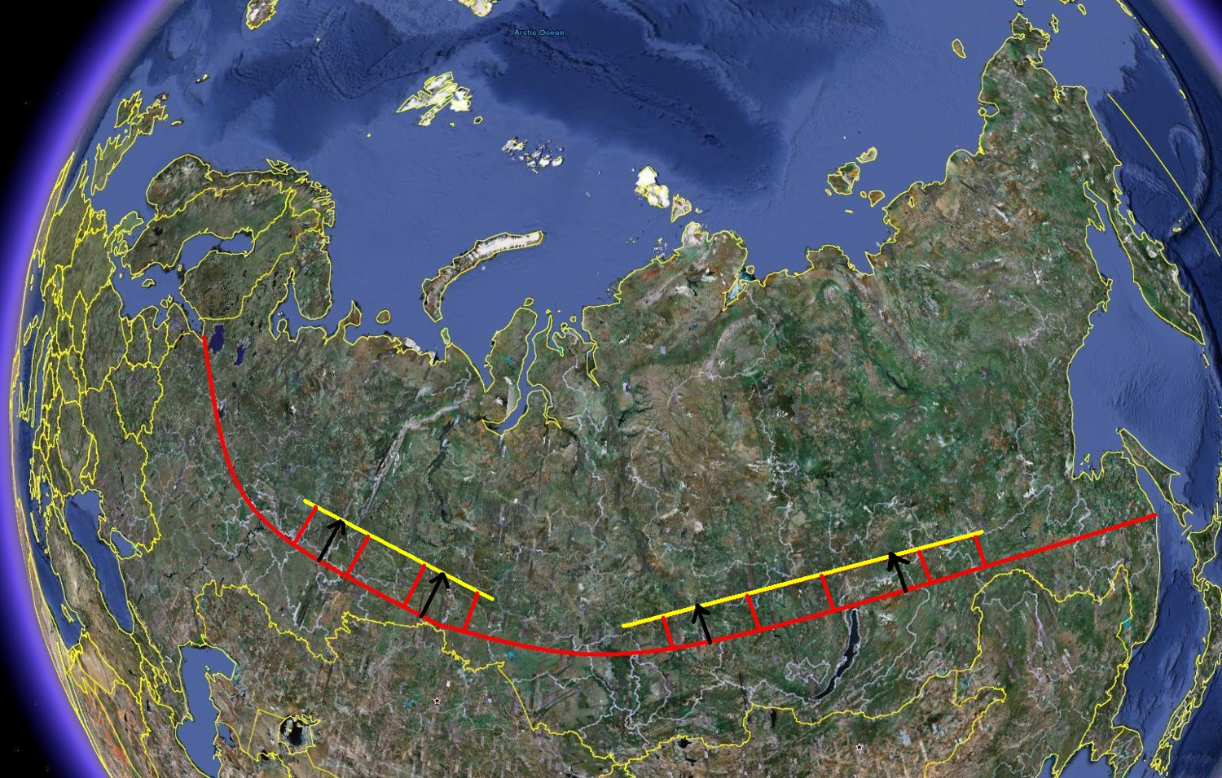

Slide 65
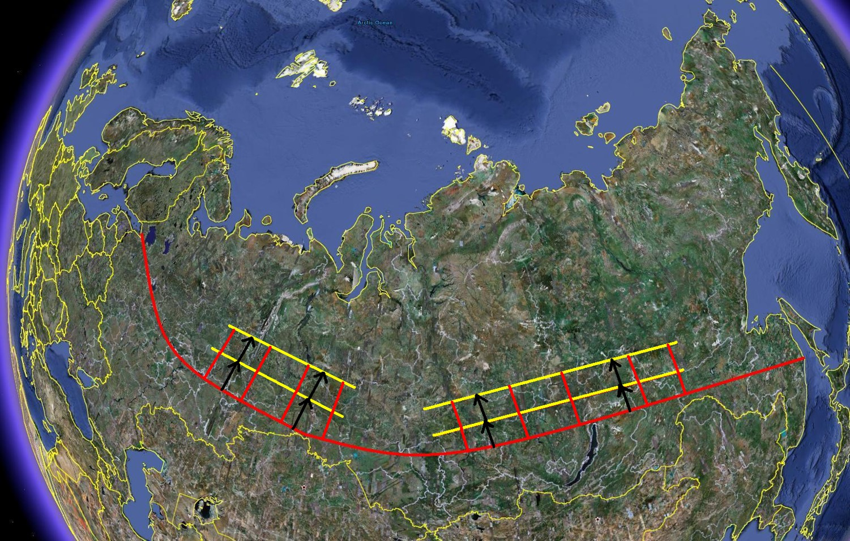

Slide 66
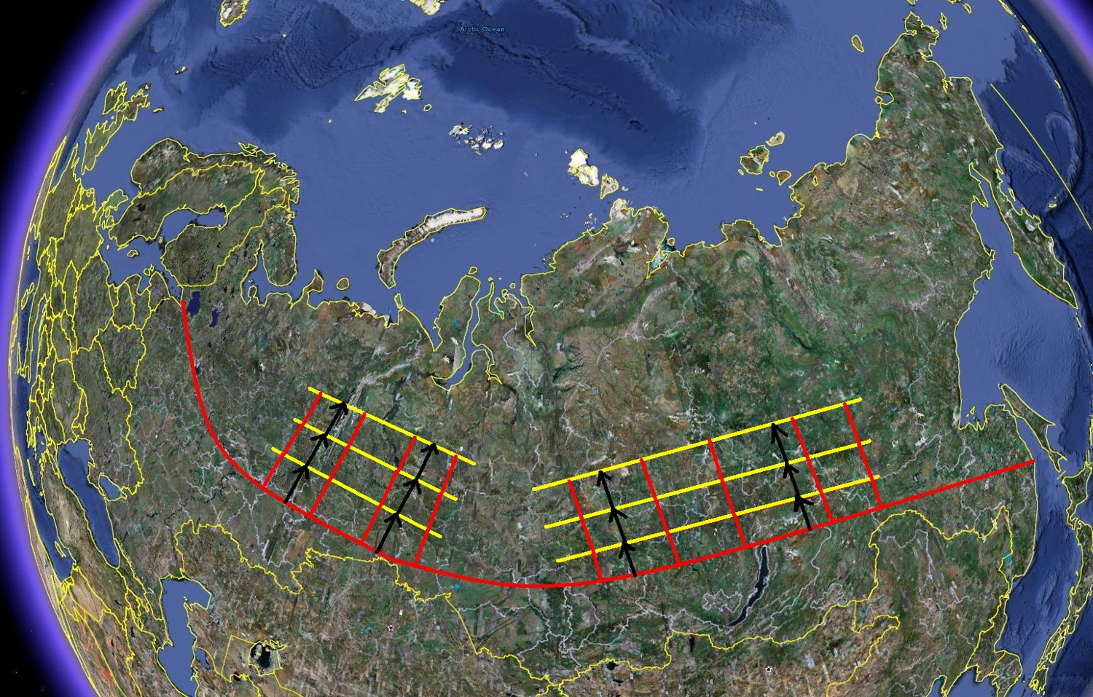

Slide 67
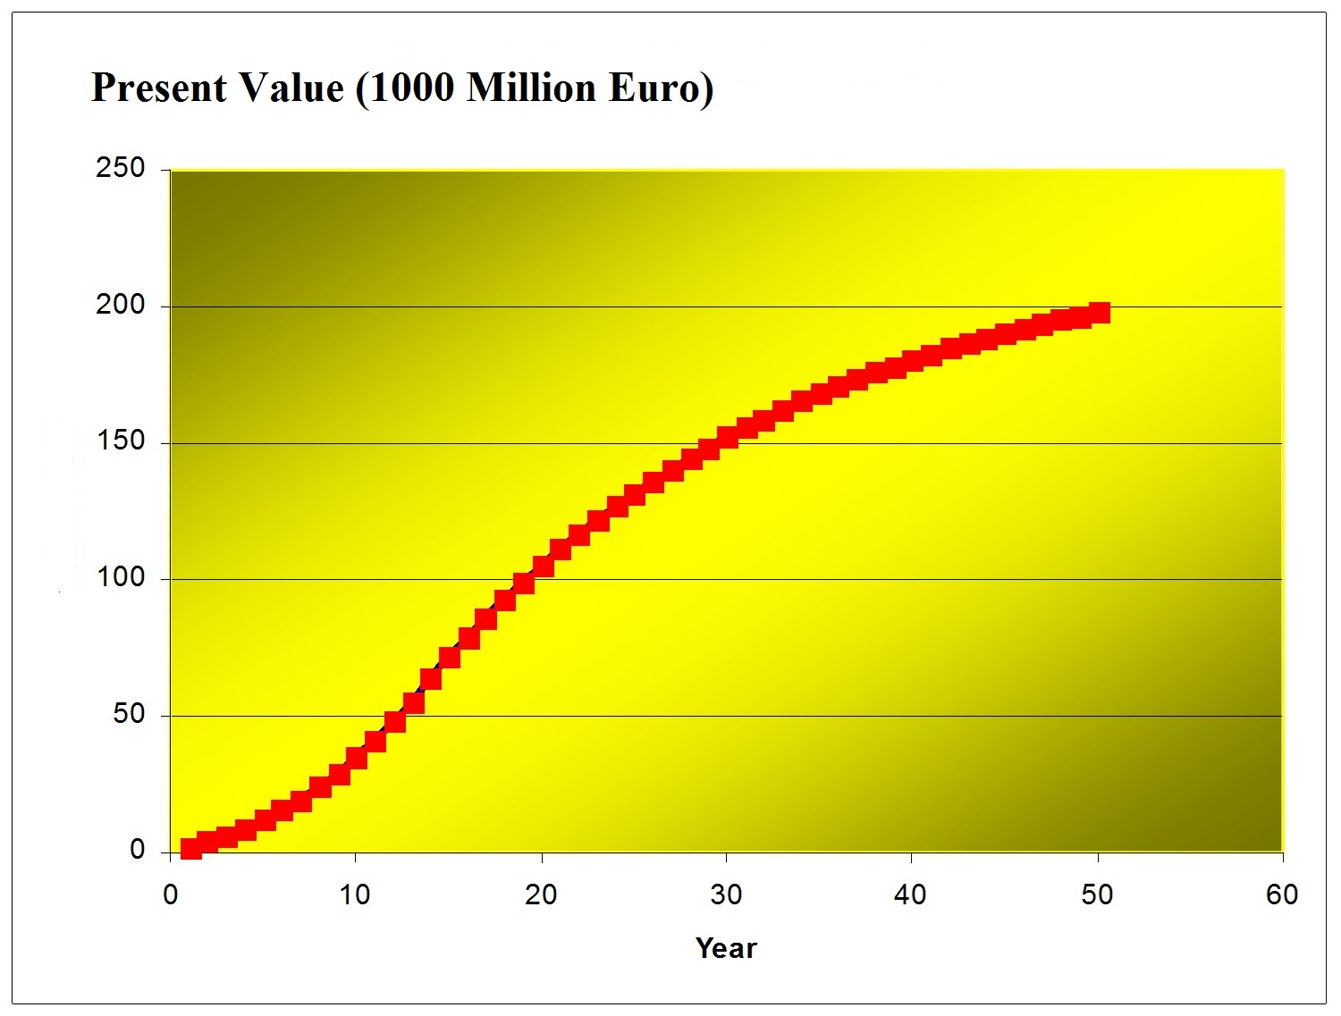
Optimal
cooperation
would be very
profitable
and would
simultaneously
improve the
CO2 situation!

Slide 68
The forest feedstock supply can be optimized!
If you are interested in cooperation,
Please let me know!
Thank you for listening!
Peter Lohmander
Professor Dr
SLU, Sweden, http://www.Lohmander.com
Peter@Lohmander.com

Slide 69
References
http://www.lohmander.com/Information/Ref.htm
Lohmander, P. (Chair) TRACK 1: Global Bioenergy, Economy and Policy, BIT’s 2nd World Congress on Bioenergy,
Xi'an, China, April 25-28, 2012
http://www.Lohmander.com/Schedule_China_2012.pdf
http://www.Lohmander.com/PLWCBE12intro.ppt
Lohmander, P., Economic optimization of sustainable energy systems based on forest resources with consideration of the global warming problem: International perspectives,
BIT’s 2nd World Congress on Bioenergy,
Xi'an, China, April 25-28, 2012
http://www.Lohmander.com/WorldCongress12_PL.pdf
http://www.Lohmander.com/WorldCongress12_PL.doc
http://www.Lohmander.com/PLWCBE12.ppt

Slide 70
Lohmander, P., Lectures at Shandong Agricultural University,
April 29 - May 1, 2012, Jinan, China,
http://www.Lohmander.com/PLJinan12.ppt
Lohmander, P. (Chair) TRACK: Finance, Strategic Planning,
Industrialization and Commercialization, BIT’s 1st World Congress on Bioenergy, Dalian World Expo Center,
Dalian, China, April 25-30, 2011
http://www.bitlifesciences.com/wcbe2011/fullprogram_track5.asp
http://www.lohmander.com/PRChina11/Track_WorldCongress11_PL.pdf
http://www.lohmander.com/ChinaPic11/Track5.ppt
Lohmander, P., Economic forest management with consideration
of the forest and energy industries, BIT’s 1st World Congress on Bioenergy, Dalian World Expo Center, Dalian, China, April 25-30, 2011
http://www.lohmander.com/PRChina11/WorldCongress11_PL.pdf
http://www.lohmander.com/ChinaPic11/LohmanderTalk.ppt

Slide 71
Bioenergy feedstock from forests:
Optimal dynamic supply under constraints and risk
Professor Dr. Peter Lohmander, SLU, Sweden, http://www.Lohmander.com Peter@Lohmander.com
The forests of the world represent a very important and large bioenergy feedstock. Only marginal fractions of the huge potential bioenergy supply from the forests have been used until now.
The optimal sustainable utilization of the forest feedstock over time cannot be determined without explicit consideration of different levels of infrastructure investments, alternative harvesting methods, joint production of several forest products and environmental effects.
The present utilization of forests for energy is much lower than optimal because of several reasons such as:
1. Forest laws and regulations are often historical compromises and are irrational with respect to present and future forest production economics. Since technology and prices change over time, earlier laws and regulations are presently almost never economically rational.
2. Forest laws and regulations are often irrational with respect to environmental effects.
3. Forestry, infrastructure, logistics, energy plants and forest products industries must be simultaneously optimized in order to find the global optimum. However, since the strong interdependencies are often neglected and partial analyses are used, the truly best solution is usually not obtained.
General functions for the optimal dynamic forest feedstock utilization under constraints and risk should be determined with analytical methods. Alternative versions of such problems are solved and the empirical relevance is demonstrated using statistical information in local, regional and global scales.

Slide 72
Bioenergy feedstock from forests:
Optimal dynamic supply under constraints and risk
Professor Dr Peter Lohmander
SLU, Sweden, http://www.Lohmander.com
Peter@Lohmander.com
BIT’s 4th Annual World Congress of Bioenergy
Theme: Roadmap Toward 2020
September 21-23
Qingdao International Convention Center, Qingdao, China

